Slide 1
Not Your Standard Green Patient
Danielle Hirsch, MD, MPH
PGY-4
PEM Fellow

Slide 2
Chief Complaint
Headache
Vomiting
Ear Infection

Slide 3
HPI
Patient complains of headache, decreased sleep, decreased PO, and vomiting. All symptoms began three days ago.
She was seen yesterday by her PCP and diagnosed with an OM and placed on Amoxicillin.
She has been having fevers and c/o left ear pain when her brother was sitting next to her she was bothered by his speaking.
Complains of some left sided ear pain but no neck pain and no change in hearing or sound. No vision complaints.
Headache is left sided going to the top of the head with decreased sleep.
She will vomit everything she eats.
She does state that she hears her heart beating fast.
Mom gave Motrin for a temp of 103F this morning at 8am.
Her brother was recently diagnosed with hand foot and mouth by the PCP so mom called the PCP who suggested she come for further evaluation and a possible x-ray of her head.

Slide 4
ROS
Fever
Ear pain
Nasal congestion
Cough
Headache
Vomiting

Slide 5
Other History
No PMH
No PSH
FHX: Maternal Grandfather has DM2
SHX: lives with her parents and siblings, attends 1st grade
Meds: Amoxicillin, Motrin
NKDA
Vaccines are UTD

Slide 6
Physical Exam
Temp 37.1C, HR 90, BP 104/70, RR 20, SpO2 100% RA
General: Alert, no acute distress.
Skin: Warm, dry, pink, intact.
Head: Normocephalic, atraumatic.
Neck: Supple, no tenderness, no nuchal ridgity.
Eye: Pupils are equal, round and reactive to light, extraocular movements are intact, normal conjunctiva.
Ears, nose, mouth and throat: Left TM with cerumen unable to visualize the TM, tenderness behind the left ear in the mastoid region, Right TM with some redness but no effusion bulging of TM, redness behind both left and right ear, not tender behind right ear. Dry tongue with erythema in the posterior pharynx and tonsil on R>L with uvula stuck to the right tonsil.
Cardiovascular: Regular rate and rhythm, No murmur, Normal peripheral perfusion.
Respiratory: Lungs are clear to auscultation, respirations are non-labored, breath sounds are equal.
Gastrointestinal: Soft, Non distended, No organomegaly, Tenderness: Mild, generalized, Bowel sounds: Hyperactive.
Back: Nontender.
Musculoskeletal: Normal ROM, normal strength.
Neurological: No focal neurological deficit observed, CN II-XII intact.
Lymphatics: shotty lymphadenopathy on right and left anterior cervical region that is non-tender.

Slide 7
PCP
Spoke to PCP who states that he was concerned about viral meningitis given the exposure to her brother, who was diagnosed with Hand/Foot/Mouth, thus sent her in for further management.
Expect was called in but received after patient arrived so discussed with him our concern.

Slide 8
Differential Diagnosis
Mastoiditis
Migraine/Headache/Dehydration
Viral syndrome
Strep Pharyngitis

Slide 9
Labs
WBC 10.1, Hb 12.7, Hct 37.8, Plt 355
Nutrophils 74% (elevated), Lymphocytes 18% (low)
BMP unremarkable
Rapid Strep negative
Draw and hold BCX

Slide 10
Treatment
IVF bolus
Toradol, Compazine
Zofran
Reassessment later revealed that her headache improved but she still had tenderness behind her left ear so sent for CT to evaluate mastoiditis.

Slide 11
CT Mastoids
Right: There is near total opacification of the mastoid air cells, and there is fluid within the middle ear cavity. There is no evidence of coalescence of the mastoid septa. There is no intracranial air. The ossicles appear normally located without erosion. The inner ears structures appear normal. The internal auditory canal is normal. There is some debris in the external auditory canal.
Left : There is near total opacification of the mastoid air cells, and fluid within the middle ear cavity. There is evidence of cortical discontinuity, and there is intracranial air. The ossicles are normally located without obvious erosion. The inner ears structures are normal. The internal auditory canal is normal. The external auditory canal contains a moderate amount of debris.
The wider field-of-view axial reconstructions demonstrate pansinus opacification with fluid levels.
IMPRESSION: Bilateral mastoid and middle ear effusions. On the left there is evidence of cortical breach and there is intracranial air. Recommend consideration of contrast-enhanced CT or magnetic resonance imaging to evaluate for intracranial abscess and sigmoid sinus thrombosis.

Slide 12
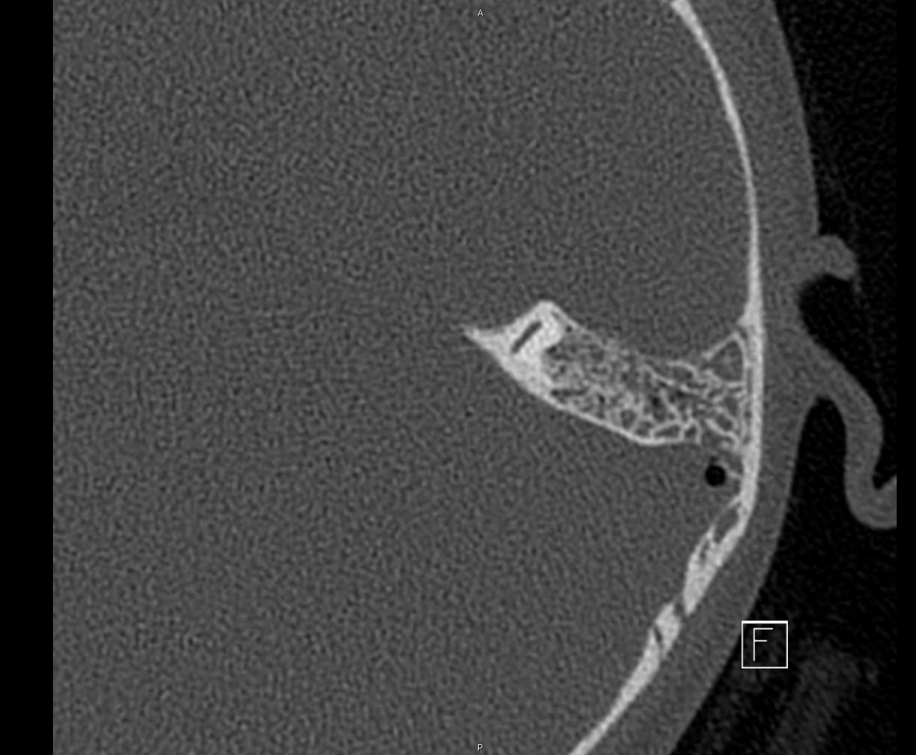

Slide 13
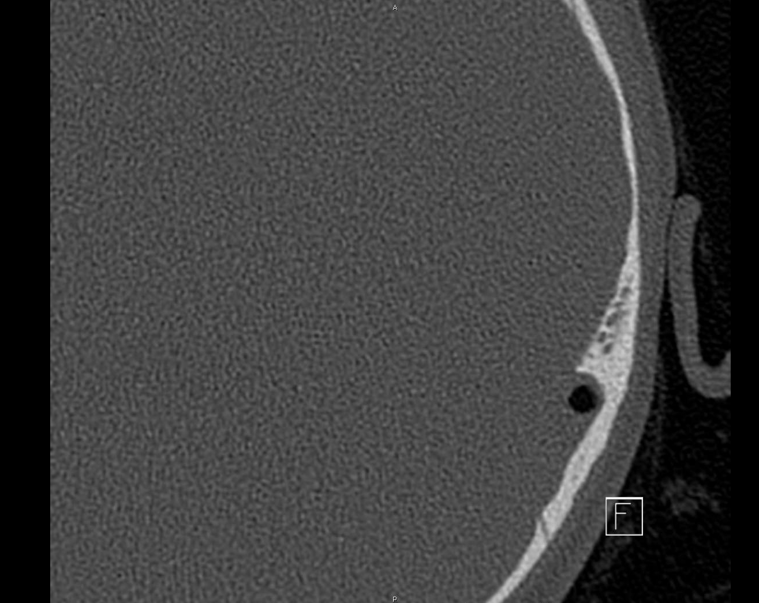

Slide 14
CT Brain with IV contrast
FINDINGS: The opacified mastoids and sinuses are reidentified. The extracranial air is located within an epidural abscess in the left posterior fossa. This abscess measures 3 cm in height and 0.8 cm in depth. The abscess contains fluid and air pockets. Attenuation values are between 25 and 45 Hounsfield units. It elevates the sigmoid sinus. There is enhancement within the displaced sigmoid sinus. There is a filling defect within the enhancing low sigmoid sinus and the proximal jugular vein at the level of the foramen lacerum. Attenuation values are between 80 and 100 Hounsfield units.
The remainder of the venous sinuses enhance normally. There is normal arterial enhancement. There is no pathological parenchymal enhancement. The ventricles are normal in size and location.
IMPRESSION: Left mastoiditis complicated by an epidural abscess, and distal sigmoid sinus/proximal jugular vein thrombus at the level of the foramen lacerum.

Slide 15
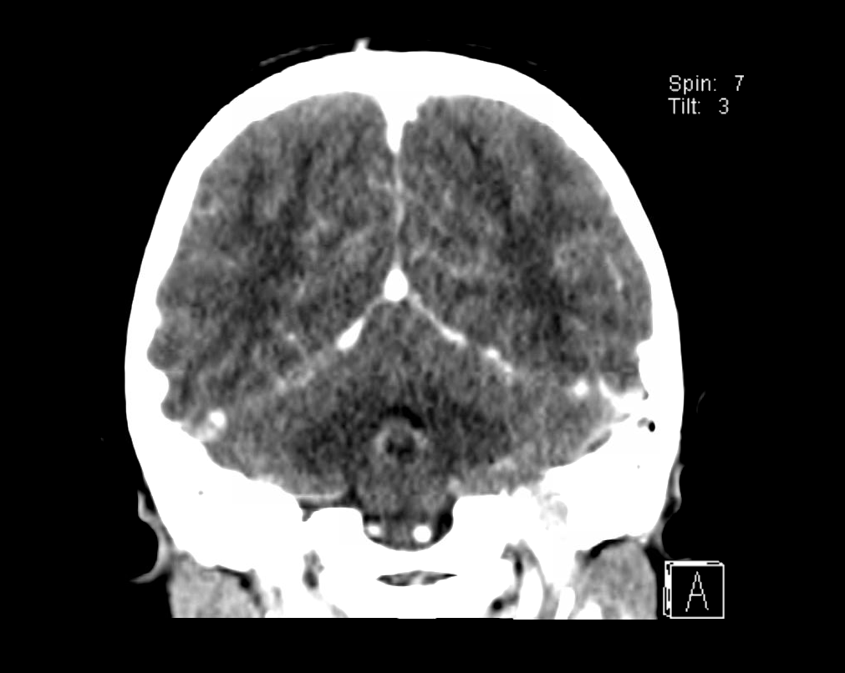

Slide 16
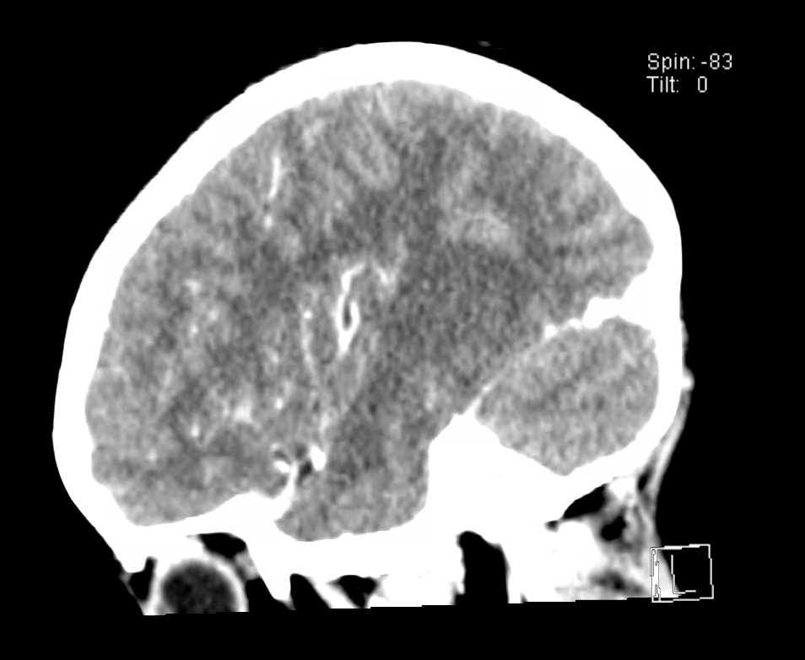

Slide 17
Next Step
Spoke to Neurosurgery and ENT.
Plan to send BCX that was drawn earlier.
ENT and Neurosurgery reviewed images and it was decided that ENT would take to surgery for BTT and drainage of abscess by mastoidectomy.
Antibiotics to start after drainage of abscess.
PT/PTT sent and PT elevated to 15.7

Slide 18
Complications of Otitis Media
Conductive hearing loss
  Purulent exudate filling the middle ear leading to myringosclerosis or typanosclerosis
Spontaneous perforation of the TM
Ossicular necrosis leading to conductive hearing loss
Cholesteatoma
  Healing perforation when skin from the lateral surface of the TM gets trapped in the middle ear
Facial nerve palsy
  Treat with IV then PO antibiotics and perform a wide myringotomy with or without tube placement as soon as possible
Serous labyrinthitis
  Inflammation in the middle ear causing mild to moderate vertigo without sensorineural hearing loss
Suppurative labyrinthitis
  Bacteria in the inner ear causing severe sensorineural healing loss and vertigo associated with nausea and vomiting
  Treat with IV antibiotics early and wide myringotomy with tube placement
Acute coalescent mastoid osteomyelitis
  Suppurative mastoiditis causing destruction of the mastoid air cell
  CT temporal bone to visualize
  Pus can extend through the air cells to the medial portion of the temporal bone causing a sixth cranial nerve paralysis, deep retroorbital pain, and otorrhea (Gradenigo’s syndrome)
  Pus can also break through the mastoid tip and extend into the upper neck (Bezold abscess)
Meningitis

Slide 19
Less Common Complications
Cerebritis
Epidural abscess
Brain abscess
Lateral sinus thrombosis
Otitic hydrocephalus
A child with overt or impending intracranial complications should be stabilized, given IV abx, and CT with IV contrast or MRI

Slide 20
Pathogens of AOM
S. pneumoniae
  Less likely to resolve spontaneously without treatment
H. influenzae
M. catarrhalis

Slide 21
Treatment
First line treatment is Amoxicillin
If allergy (anaphylaxis or hives) treat with Azithromycin, Clarithromycin, or Erythromycin
If symptoms persist for 48-72 hours re-evaluate child and give B-lactam coverage specifically amoxcillin-clavulanate, or cefdinir, cefuroxime, cefpodoxime, or IV/IM ceftraixone
Treat pain with acetaminophen or ibuprofen, topical benzocaine provides brief relief (30-60 minutes) but do not use in patients with TM perforations or ear tubes.

Slide 22
Epidural Abscess
Complication of a temporal bone infection from destruction of bone in coalescent mastoiditis and in chronic otitis media with cholesteatoma.
Options for therapy are antibiotics, antibiotics plus myringotomy, and mastoidectomy.
The mean disease duration of acute mastoiditis has been reported to be 5-14 days.

Slide 23
Sinus Thrombosis
Rare, but potentially life-threatening, condition.
The result of mastoid bone erosion caused by cholesteatoma, granulomatous process or coalescence, forming the perisinual abscess or caused by osteothrombophlebitis in the early phase of infection, in which the bony sinus plate remains intact.
Most common clinical findings are those of raised ICP especially seizures, headaches, vomiting, altered consciousness, and focal neurologic signs.
Treatment includes hydration, systemic antibiotics, and surgical management of the mastoiditis.
  Mastoidectomy and incision of sigmoid sinus with removal of the clot if fevers persist despite medical treatment.
  Anticoagulation with low-molecular-weight heparin followed by warfarin is the preferred therapy for intracranial venous sinus thrombosis.

Slide 24
Patient Outcome
Patient tolerated drainage well, cerumen removed was dried puss, no growth from abscess fluid drained or BCX, placed on Cefepime and Flagyl post-op.
Heme/Onc recommended Heparin initially then switch to Lovenox.
ID recommended switching to IV Ceftriaxone and Clindamycin and home on Cefpodoxime and Clindamycin PO for at least 4 weeks total.
Overall doing well, improving everyday, discharged with home VNA.

Slide 25
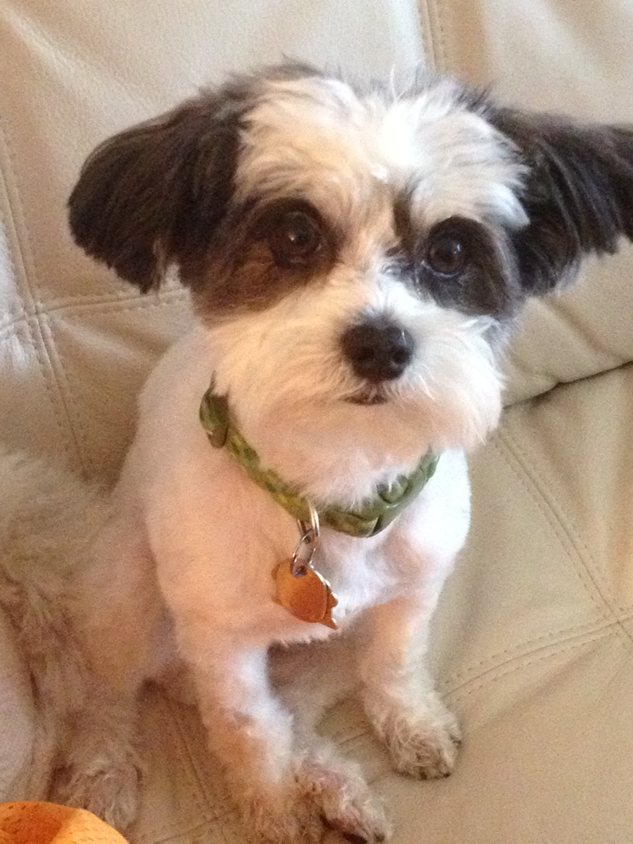
Any Questions?

