Slide 1
Tox Lecture
For Floridians and Boards
Meghan Martin

Slide 2
Case
6yo previously healthy male presents to Cape Canaveral ED crying, with linear welts. Patient saw a “birdie” in the water and tried to pick it up. He felt immediate pain and the welts have been developing over the last hour since the exposure occurred. The hotel provided him with balsamic vinegar, with no improvement.

Slide 3
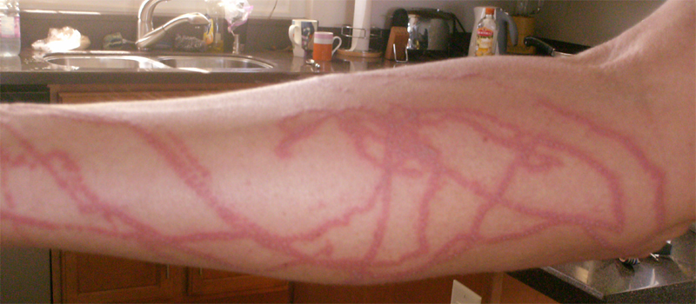

Slide 4
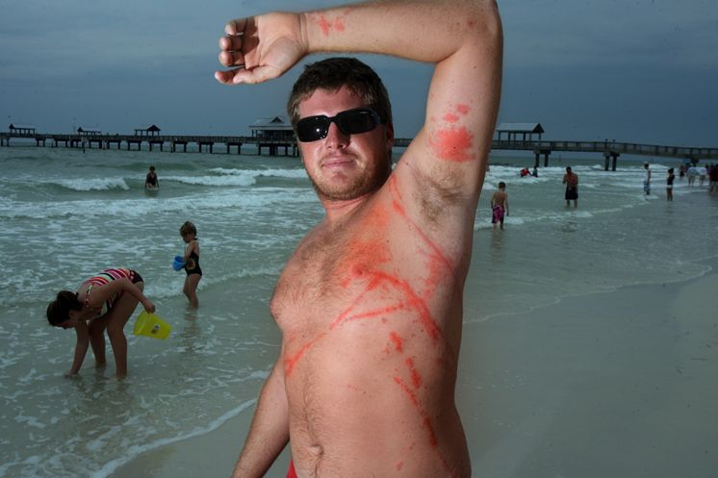
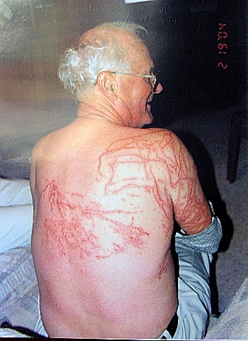

Slide 5
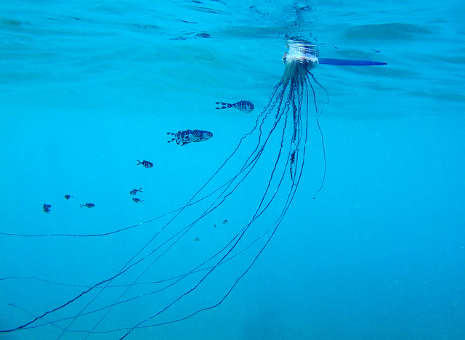
“that birdie wasn’t nice”

Slide 6
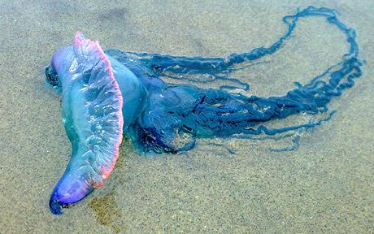

Slide 7

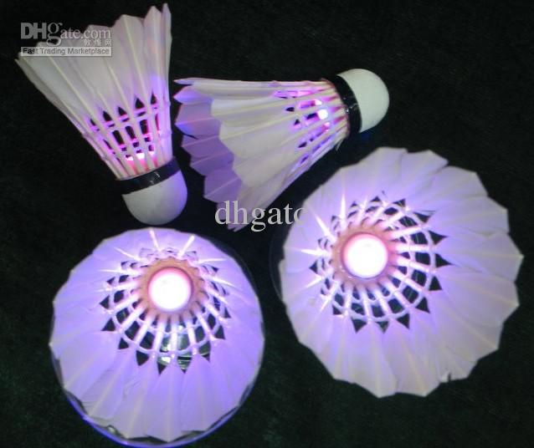

Slide 8
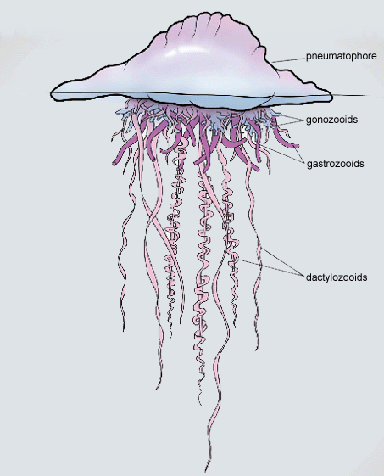
Portuguese Man-o-war
Colony of Hydrozoan
  “float” up to 30 cm
  Tentacles >75ft
  Composed of nematocysts with powerful toxin
Swimmers often stung without seeing the float
Can discharge toxin after death

Slide 9
Toxin
Dermatonecrotic, myotoxic, cardiotoxic, neurotoxic and hemolytic
Systemic reaction
  Headache, fever, myalgias, abdominal ridigity, arthralgias, nausea, vomiting, pallor, respiratory distress, hemolysis, renal failure, coma.
Death can occur if extensive in relation to victim body size

Slide 10
Symptoms
Intense, acute pain for minute to hours
Can be self limited, lasting 2-3 hours
Often followed by a dull ache, may include the joints
Some individuals may experience allergic reactions including anaphylaxis

Slide 11
Treatment
Three principles:
  Relieve pain
  Alleviate effects of venom
  Control shock
Most important: Remove tentacles
  Nematocysts continue to discharge
Wash skin with sea water or saline
  Use gloves!

Slide 12
Treatment
Hot water or hot packs may help
  Inactivates the toxin
Tetanus immunization
No prophylaxis with antibiotics
Analgesics and antihistamines for anaphylaxis

Slide 13
DO NOT
Wash with fresh water
Rub with sand
Use vinegar or ANY chemical
All can cause further envenomation by activating nematocyst to “fire” by changing the pH

Slide 14

Portuguese Man-Of-War tests.
Often mistaken for a jellyfish, the Portuguese Man-of-War is an invertebrate whose tentacles can reach 30 feet. They live in warm ocean waters around the world, and can cause stings even more painful and debilitating than jellyfish.
A series of experiments conducted in May 2009 by the Skidaway Institute of Oceanography proved that spraying Jellyfish Squish on a Portuguese Man-of-War sting paralyzes its nematocysts, preventing them from continuing to fire, and relieving stings within minutes.

Slide 15
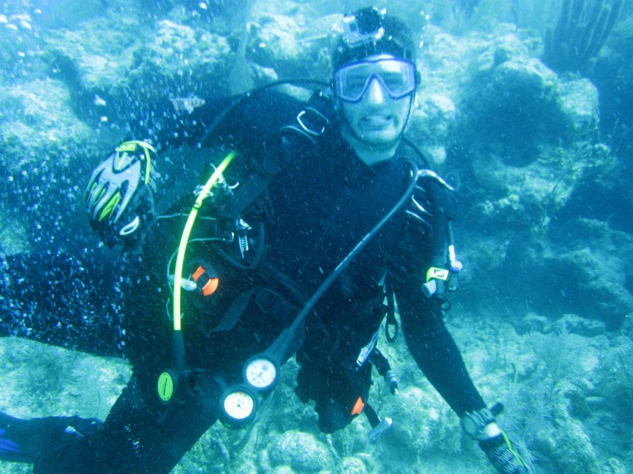

Slide 16
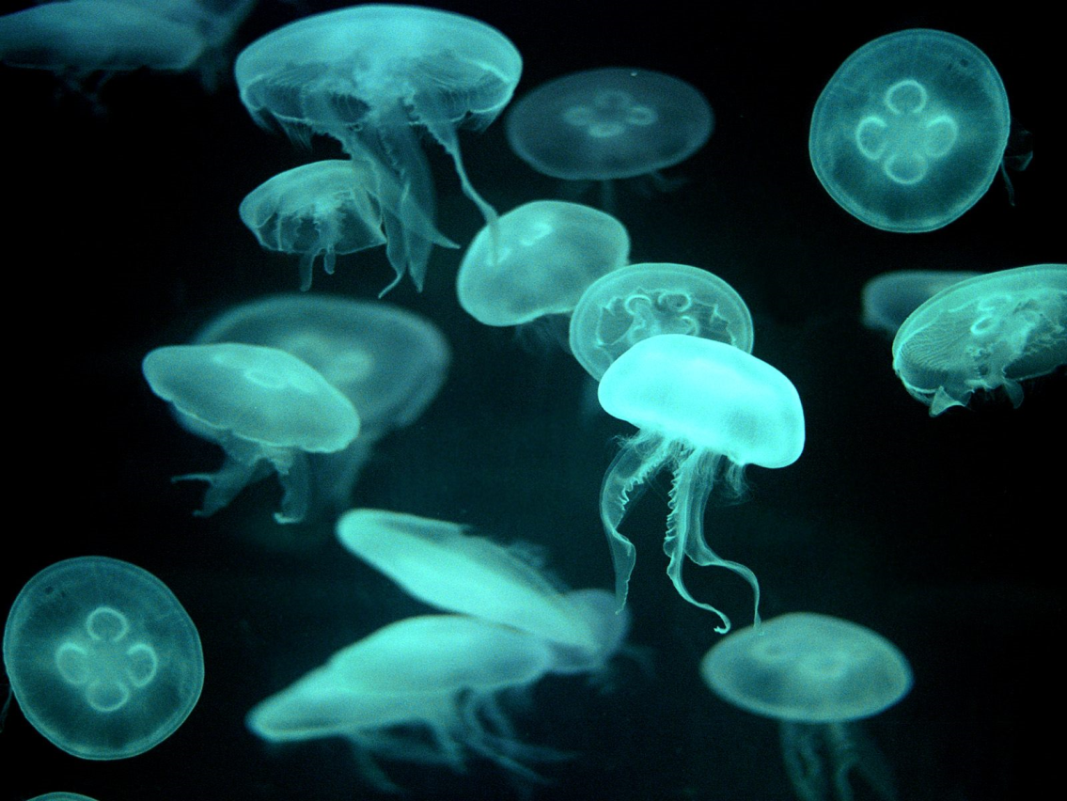
True Jellyfish
Pelagia Noctiluca
Mildly toxic
Major manifestation of local skin irritation

Slide 17
Treatment
Wash with gloved hand, sea water, remove tentacles
Vinegar, baking soda slurry, or meat tenderizer
  30 minutes, 15 for Papain (meat tenderizer)
Local irritation treat with topical corticosteroid cream

Slide 18
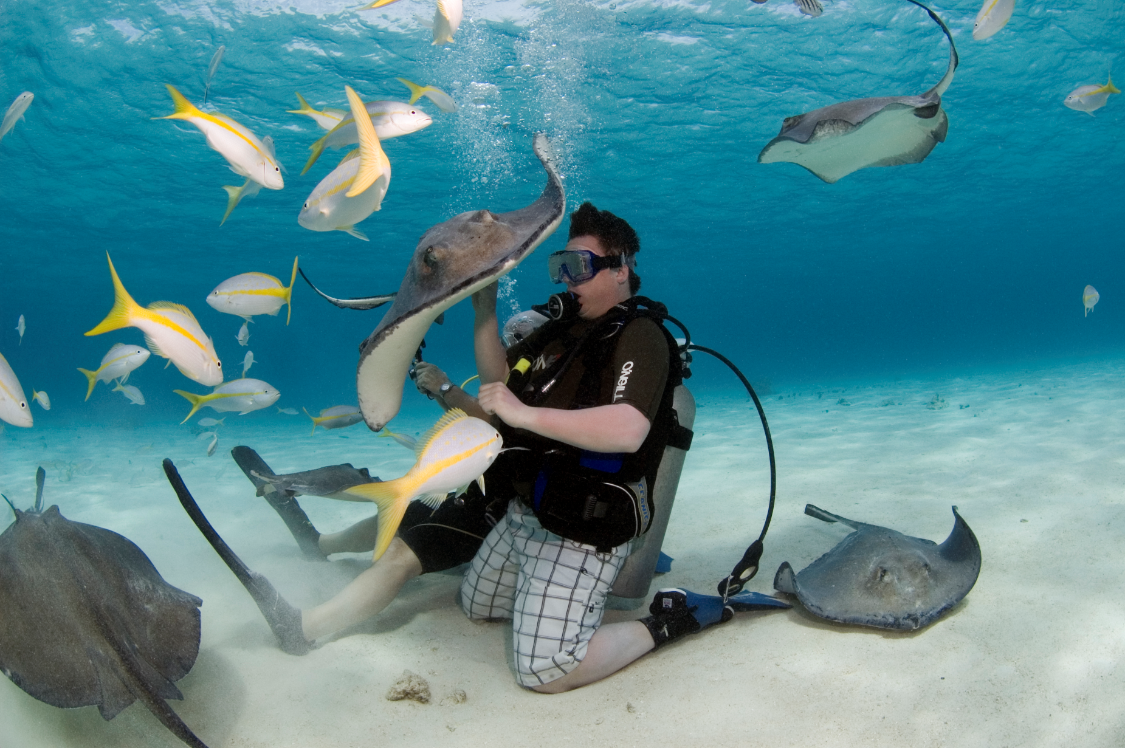
Stingrays!!

Slide 19
Why you should shuffle….
1000 attacks per year in North America
Bottom feeders that bury themselves in the sand
Watch out!
Envenomation usually occur when stepped on
Injuries to lower extremities usually

Slide 20
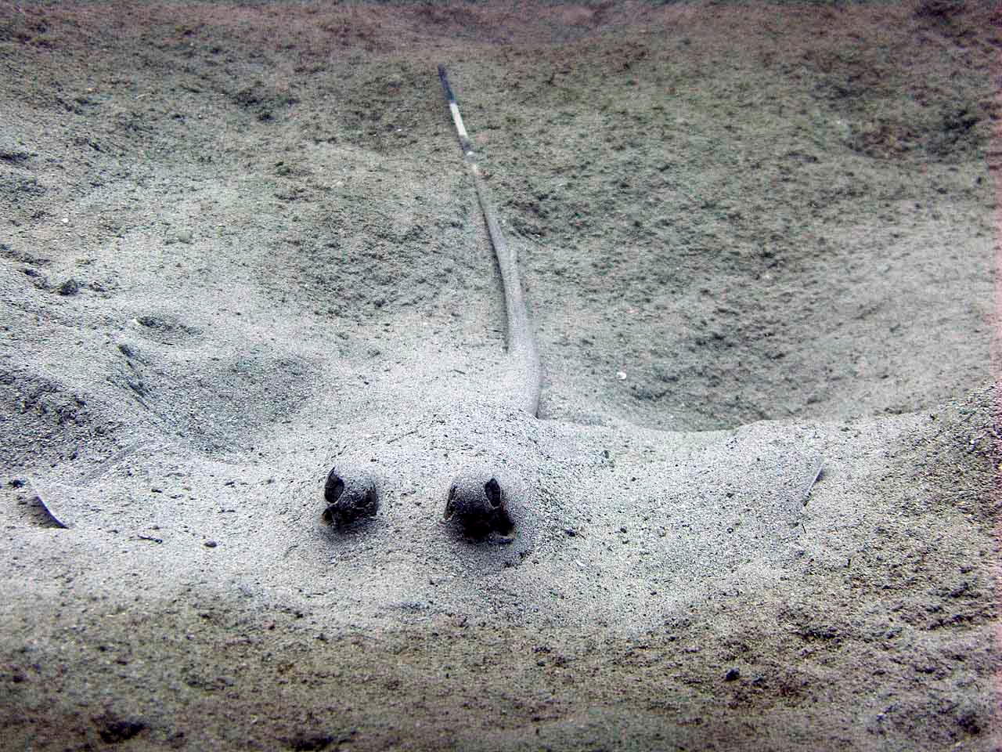

Slide 21
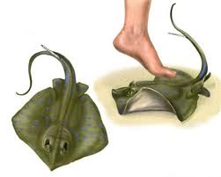
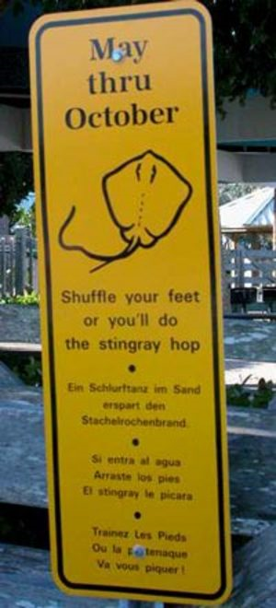

Slide 22
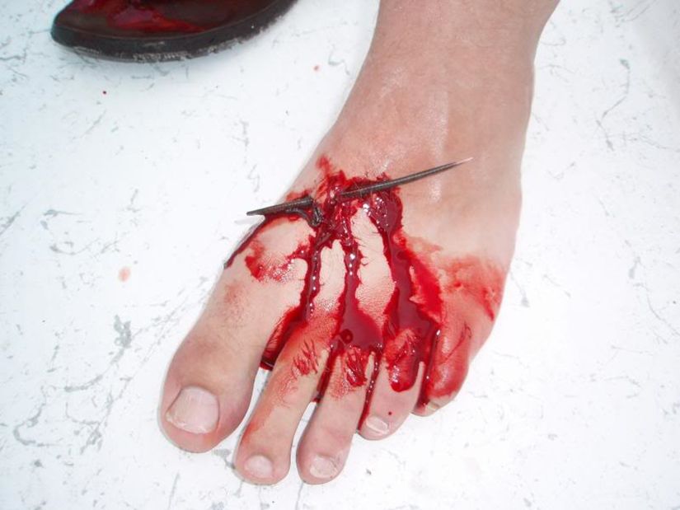
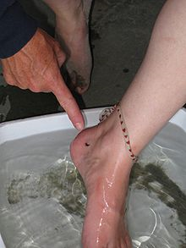
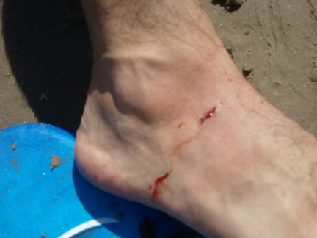

Slide 23
Barbs
Serrated, retropointed, dentin caudal spine
Spine is encased with secretory cells that contain venom
Barb easily penetrates the skin, ruptures the sheath
Toxin is heat labile, contains serotonin, 5-nucleotidase and phosphodiesterase
Depresses medullary centers, interferes with cardiac conduction system, produces severe local pain

Slide 24
Wound
Puncture and laceration wounds
Sting followed by immediate pain, which spreads, from the site of injury
Pain and edema locally
Edges of wound may be discolored from sheath, which spreads within hours
Necrosis without treatment

Slide 25
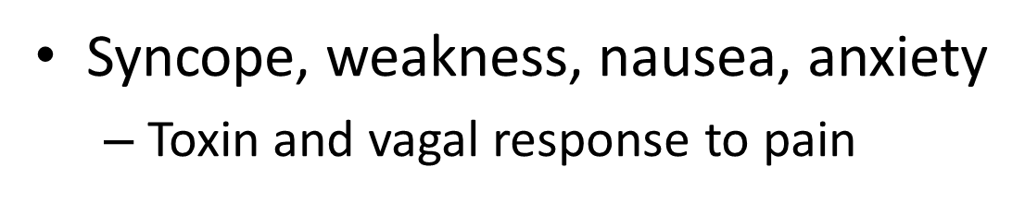
Symptoms
Vomiting, diarrhea, sweating, muscle fasciculation
Paresthesia, hypotension, hypotension, arrhythmias, and death are possible

Slide 26
Treatment Goals
Prevent complications from venom
Alleviate pain
Prevent secondary infection

Slide 27
Treatment
Irrigate with cold salt water immediately
  Removes venom
Immobilize extremity
Control bleeding with pressure
Treat shock with IVF
Remove sheath remnants from wound
Soak in hot water (104-113F) for 30-90 min
Morphine for pain
Tetanus prophy/immunization
No abx prophy

Slide 28


Slide 29


