Slide 1
POCUS: Elbow Fracture Diagnosis
Nathan Williams, MD PGY-4
Pediatric emergency medicine fellow

Slide 2
Introduction
Traumatic elbow injury is a large cause of emergency room visits for children and adolescents
Elbow fractures make up approximately 15% of pediatric fractures
Difficult to diagnose with only physical examination alone
Can POCUS help diagnose fractures accurately and reduce childhood exposure to radiation?
  YES!

Slide 3
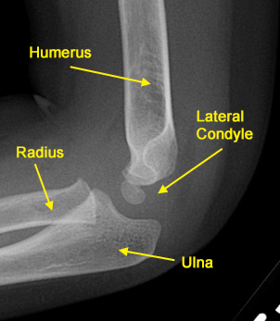
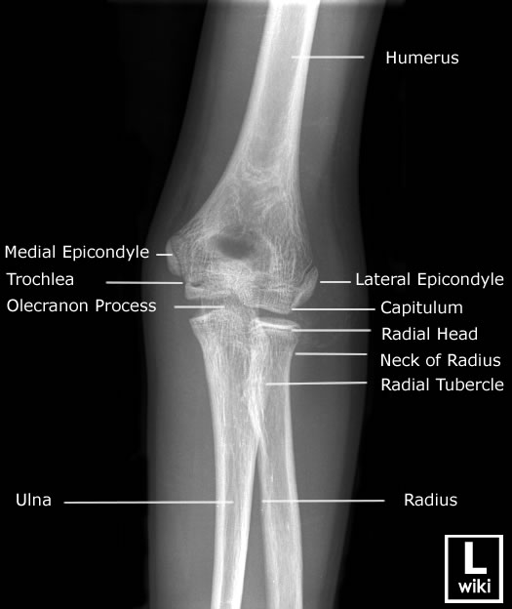
Normal Anatomy-X-ray

Slide 4
Ultrasound Features
Using a Linear probe
Technique: “Patient’s elbow flexed to 90 degrees, the US probe was placed over the posterior aspect of the distal humerus.” Both longitudinal and transverse views.
Helpful to view the normal elbow for comparison
Looking for elevation of posterior fat pad sign
Elbow effusions of 1 to 3 mL could be identified with elbow ultrasonography, while it took 5-10mL to view on x-ray

Slide 5
How studies define fracture
By meta-analysis: “In all studies, presence of elbow fracture was defined as a posterior fat pad sign, cortical disruption, growth plate widening, or hematoma interposed between fracture fragments.”

Slide 6
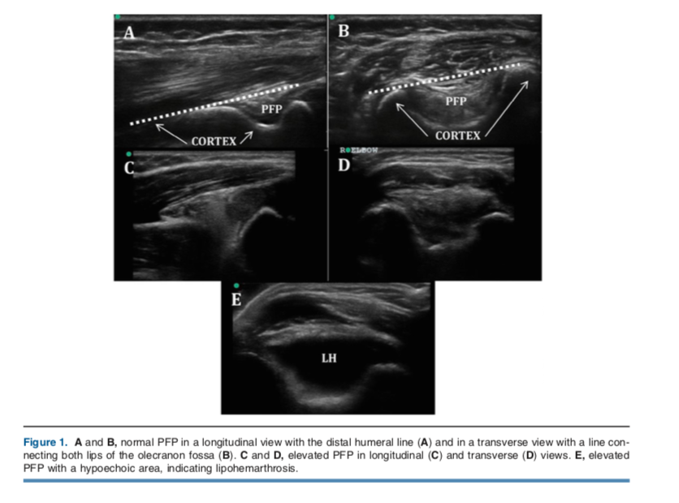
Ultrasound Images

Slide 7
Ultrasound Advantages
On meta-analysis sensitivity 96% and specificity 89%
False negative rate of 3.7%
Less time consuming
Decreased LOS
High negative predictive value
Pediatric Patient size is ideal for this modality

Slide 8
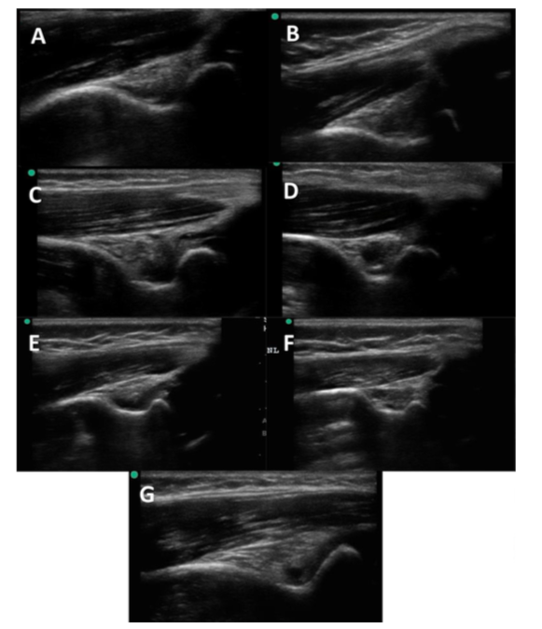
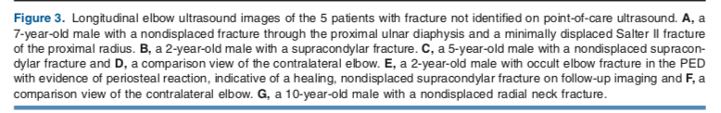
Ultrasound Cases Missed

Slide 9
Disadvantages
May miss fractures
Most accurate to rule out fracture with low index of suspicion for fractures.
Relying on Posterior fat pad is controversial as it may lead to more false positives compared to x-ray.

Slide 10
References
“Diagnostic Performance of Ultrasonography for Detection of Pediatric Elbow Fracture: A Meta-analysis” –Lee, MD et al.
“Reduction of Radiography with Point-of-Care Elbow Ultrasonography for Elbow Trauma in Children” – Tokarski, MD et al.

