Slide 1
Shoulder Dislocation
Mary Emborsky

Slide 2
Shoulder ultrasound for dislocation
Is there a dislocation
Is there a fracture
Look at their normal shoulder first
Use linear probe

Slide 3
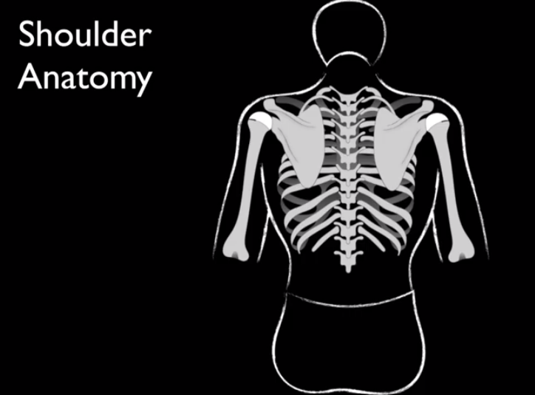
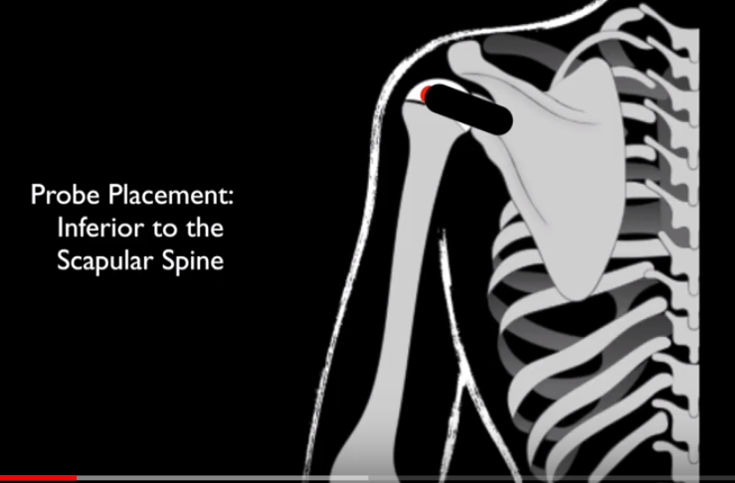
Identify scapular spine
Over glenohumeral joint

Slide 4
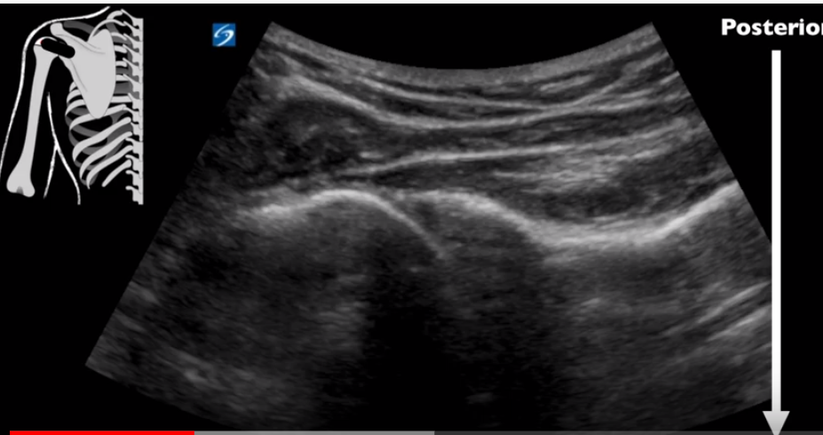
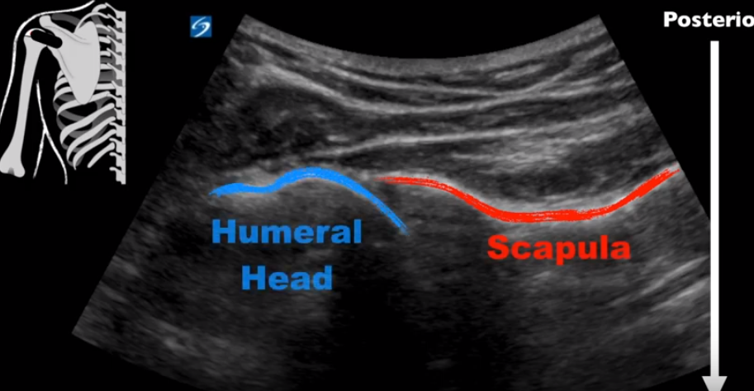
Humerus sits right next to glenoid rim

Slide 5
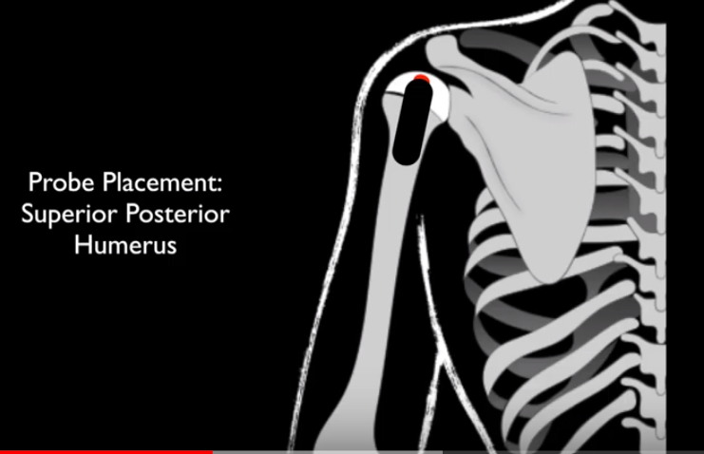
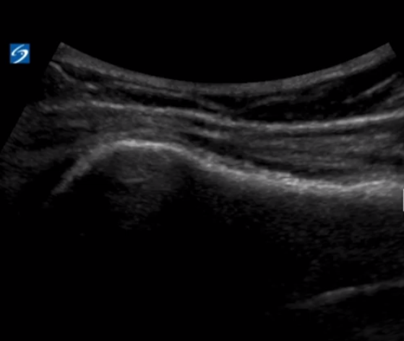
Look for fracture

Slide 6
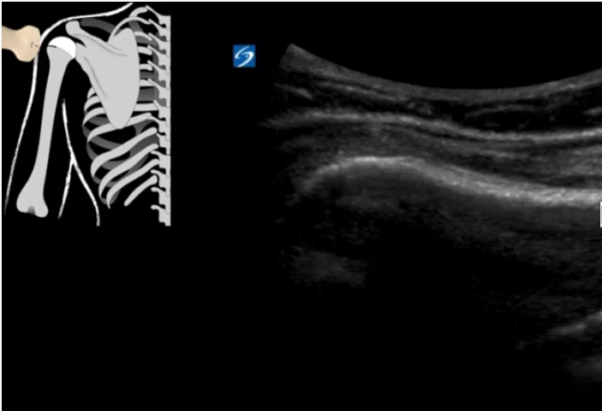
Look further for fracture

Slide 7
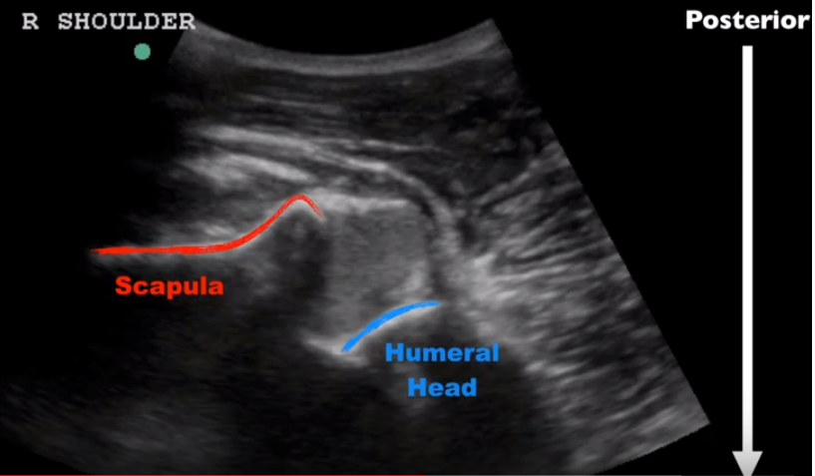
Anterior dislocation (95% are anterior)
hemarthrosis

Slide 8
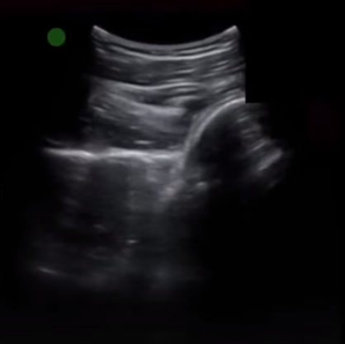
Posterior dislocation

Slide 9
Use the ultrasound so see if you reduced with static and dynamic exams. Have them flex and the elbow and ext rotate gently.

