Slide 1
Pediatric Blunt Abdominal Trauma
January 19, 2021
Jeremy Killion, MD

Slide 2
Disclosures
None

Slide 3
Goals
Detail injuries from blunt abdominal trauma
Review diagnostic modalities in blunt trauma
Review management of blunt trauma

Slide 4
Blunt Trauma(BAT)
10-15% of all pediatric injuries
Falls
Balls
Swings/playground equipment
Toys
Rough Play/sports

Slide 5
Anatomy- Kids are not small Adults
Liver/Spleen/Pancreas lie in the upper abdomen
  Partly protected by the ribs- less effective in children because ribs are very pliable and because the liver and spleen may extend caudally beyond the ribs (esp. in infants/toddlers)
  Children have less overlying fat & weaker abdominal musculature
  Relatively compact torsos with smaller anterior-posterior diameters, which provide a smaller area over which the force of injury can be dissipated
  Children’s intra-abdominal organs are more closely situated & likelihood of multiple organs being injured is higher in pediatric BAT

Slide 6
Liver-
    is relatively large and has less fibrous stroma than adults
    more susceptible to laceration and bleeding after blunt abdominal trauma
Pancreas
  not as vascular as the liver/spleen
  pancreatic trauma rarely causes major blood loss
  pancreatic trauma may cause the release of enzymes resulting in local peritoneal and retroperitoneal inflammation

Slide 7
Abdominal Wall Contusions
Many injuries are only soft tissue
Key on symptoms/stability
Worrisome Clues
  Vomiting
  Distention
  Hematuria
  Seatbelt sign, although lack of a seatbelt sign cannot be used to rule out serious injury

Slide 8
Organ Injury
Spleen
Liver
Pancreas
Kidneys
Bowel

Slide 9
Splenic Injury
Most commonly injured organ
Mechanism
  Ped vs MVC
  Falls, handlebar injuries
Presentation
  Diffuse/Local LUQ pain and tenderness
  Subphrenic blood may result in referred L shoulder pain (Kehr’s sign)
  Left lower rib fx should raise concern

Slide 10
Splenic Injury
Diagnosis
  CT with IV contrast
Management
  Spleen should be persevered; Non-operative is mainstay (90%)
  Removal results in post-splenectomy syndrome
  Presence of hemodynamic instability in a child with an irreparably damaged spleen does remain an absolute indication for splenectomy

Slide 11
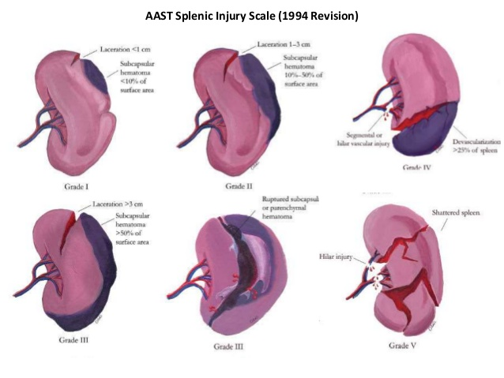
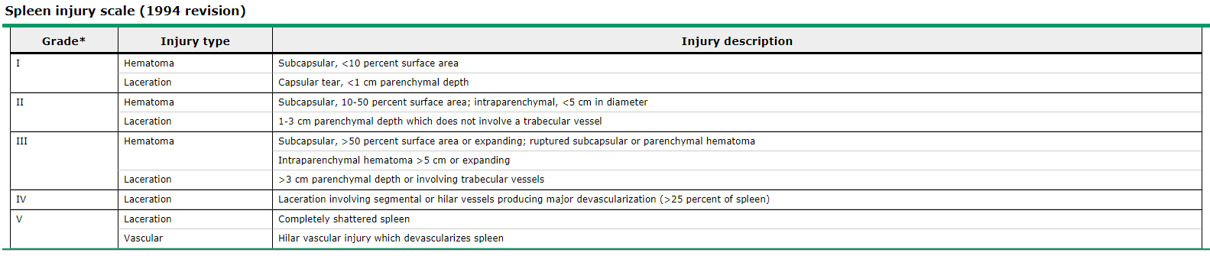
Splenic Grading

Slide 12
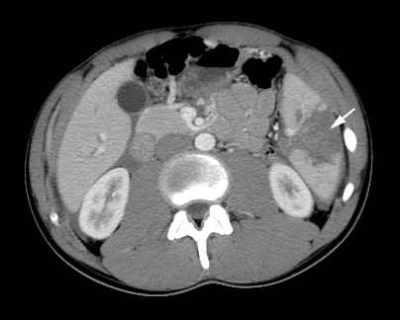
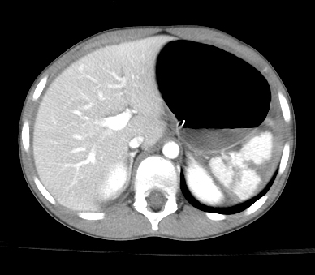
Imaging
3 5

Slide 13
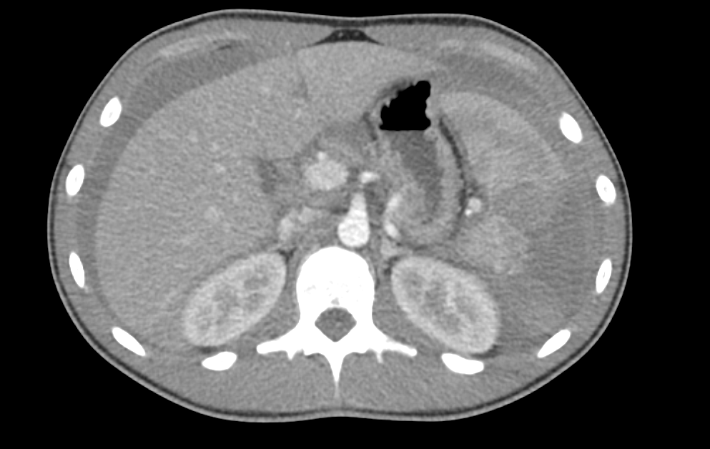
soccer

Slide 14
Liver Injury
2nd most common injured organ
  Most common fatal abdominal injury
Mechanism
  Ped vs MVC
  Falls, handlebar injuries
Presentation
  Diffuse/Local pain and tenderness
  Pain may refer to Rt shoulder

Slide 15
Liver Injury
Laboratory Studies
  Several studies have shown that AST greater than 400 IU/L or ALT greater than 250 IU/L is predictive of liver injury
  Cotton et al used multiple logistic regression analysis in a study of 353 children to show that increased ALT was the only laboratory finding predictive of intra-abdominal injury
    ALT of greater than 131 IU/L and the presence of abdominal trauma were indicative of intra-abdominal injury with 100% sensitivity
    Thus, in cases in which no clear indication exists for imaging following initial assessment, measurement of hepatic enzymes may provide additional information

Slide 16
Liver Injury
Diagnosis
  CT for stable patients
  Laparotomy for unstable patients
Management
  Non-operative is mainstay
  Hemodynamic status guides management-
    stable patients can be managed non-operatively by following serial abdominal exams, serial hematocrits, and if abnormal liver enzymes
    unstable despite fluid resuscitation or requiring blood transfusion, then an exploratory laparotomy may be required

Slide 17
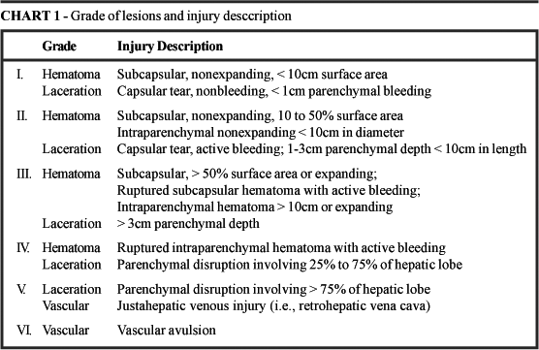
Liver Grading

Slide 18
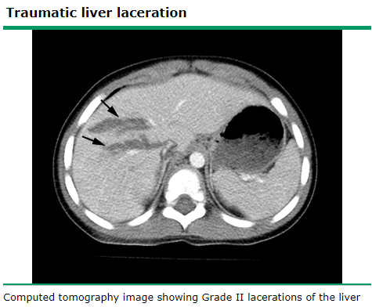

Slide 19
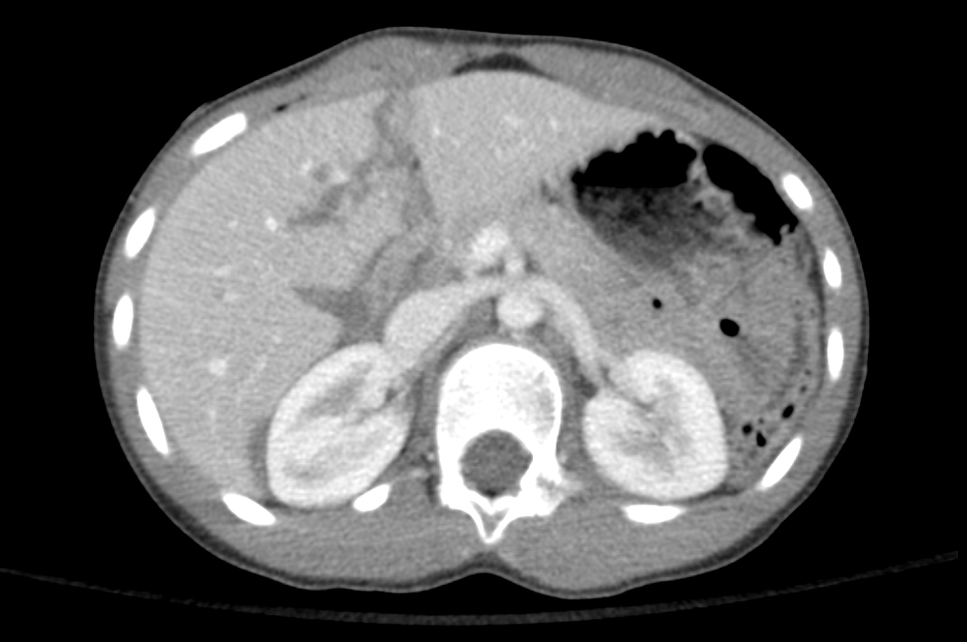
MVC, game of chicken

Slide 20
Pancreatic Injury
Mechanism (3-12% of BAT)- overall rare
  Handlebar injuries
  Compression of pancreas against spine
Presentation
  Delayed diagnosis due to nonspecific symptoms
  Triad
    Epigastric pain, palpable mass, elevated amylase (rare)

Slide 21
Pancreatic Injury
Diagnosis
  Labs: Amylase/Lipase- usually elevated
    Can be normal in 30% of patients with transection
    Value does not correlate with severity
  US/CT
Management
  Non-operative is mainstay
    is the most likely to fail/have complications from non-operative management
  NG decompression and bowel rest
Complications
  Ductal disruption
  Pseudocyst formation

Slide 22
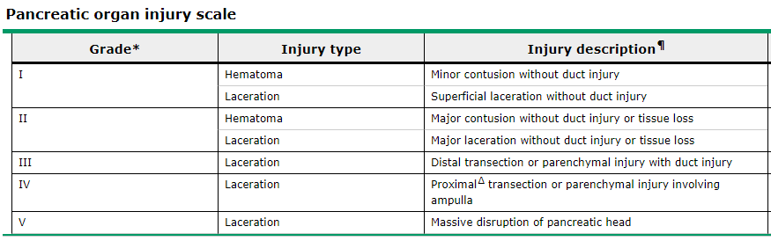
Pancreatic Grading

Slide 23
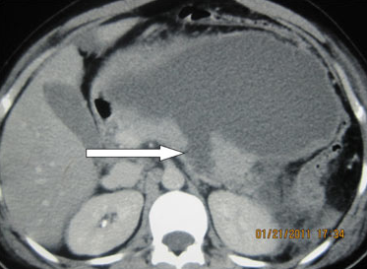
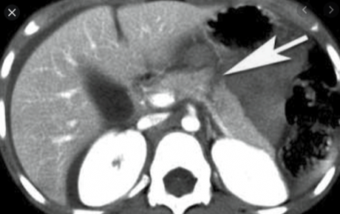
Imaging

Slide 24
Bowel Trauma
not always evident at initial presentation and may have a delayed presentation secondary to perforation
Intestinal injury should be considered with any patient who
  any abdominal tenderness or visible abdominal wall ecchymosis
  seat belt sign should raise a clinician’s suspicion for a bowel injury
  CT findings of extra-luminal air, free intraperitoneal fluid, bowel wall thickening, bowel wall enhancement, bowel dilatation, and fat stranding should raise the clinician’s suspicion of a bowel injury and perforation.

Slide 25
Mechanisms of injury
  compressive force ruptures a transiently distended segment of bowel
  shear injuries occur when the rapid deceleration of the bowel is resisted by a fixed point such as the ligament of Treitz or terminal ileum
  crush injuries are seen when the bowel is compressed against the spine

Slide 26
Duodenal Injuries
Duodenal injury is a specific type of injury to the intestines with unique characteristics, duodenal injury is rare
Diagnosis-
  CT scan with oral contrast can show hematoma or perforation/laceration, can be achieved w/o contrast
Hematoma is managed non-operatively
  Non-operative management of hematoma is bowel rest and TPN
  Resolution of the hematoma normally requires 1-3 weeks of observation
Perforation is managed with an operation

Slide 27
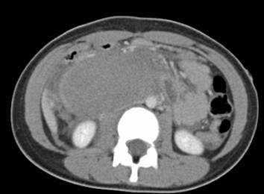

Slide 28
Renal
Mechanism
  MVC, falls, and sports-related trauma (tackles)
History
  gross hematuria or microscopic hematuria with associated hypotension
  flank tenderness, a flank or abdominal mass, and ecchymosis of the flank
Diagnosis
  CT scan with IV contrast
Management
  Hemodynamically stable- bed rest and observation are indicated
  Active bleed on CT scan and the patient is hemodynamically stable angiographic embolization can be used
  Surgical intervention should be undertaken for hemodynamic instability or persistent blood loss requiring ongoing transfusions

Slide 29
Renal Labs
Diagnosis
  Urinalyses are frequently obtained
  both gross and microscopic hematuria have been associated with intra-abdominal injury
  Gross hematuria is defined as being visible to the naked eye
  Microscopic hematuria has been defined differently by different authors- as greater than 5 red blood cells per hpf, more than 20 RBCs/hpf, or more than 50 RBCs/hpf
Morey, et al in a meta-analysis showed 2% (11/548) of patients with UA less then 50 RBC/hpf had significant renal injury
retrospective chart review of 256 children with blunt abdominal trauma (Stalker)
  hematuria has a sensitivity of 33% (35/106) for predicting renal injury
  normal blood pressure and less than 50 RBCs/hpf had a negative predictive value of 100%

Slide 30
Renal
Diagnosis
  CT scan with IV contrast
Management
  Hemodynamically stable- bed rest and observation are indicated
  Active bleed on CT scan and the patient is hemodynamically stable angiographic embolization may be used
  Surgical intervention should be undertaken for hemodynamic instability or persistent blood loss requiring ongoing transfusions
  Standard of care is renal preservation

Slide 31
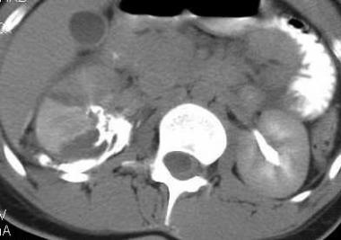
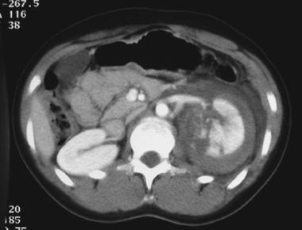
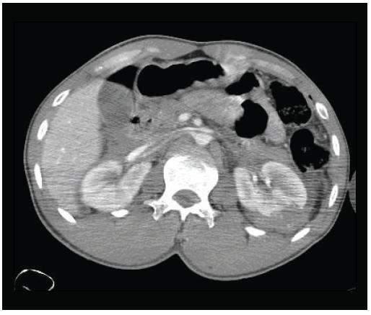

Slide 32
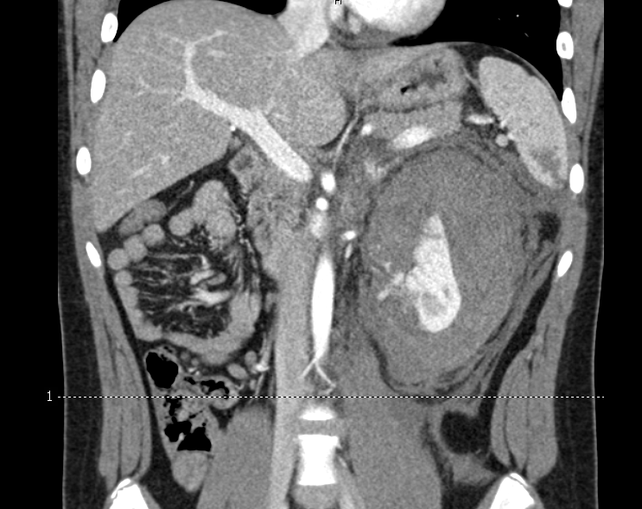
Snowboard, 12 hr, hematuria

Slide 33
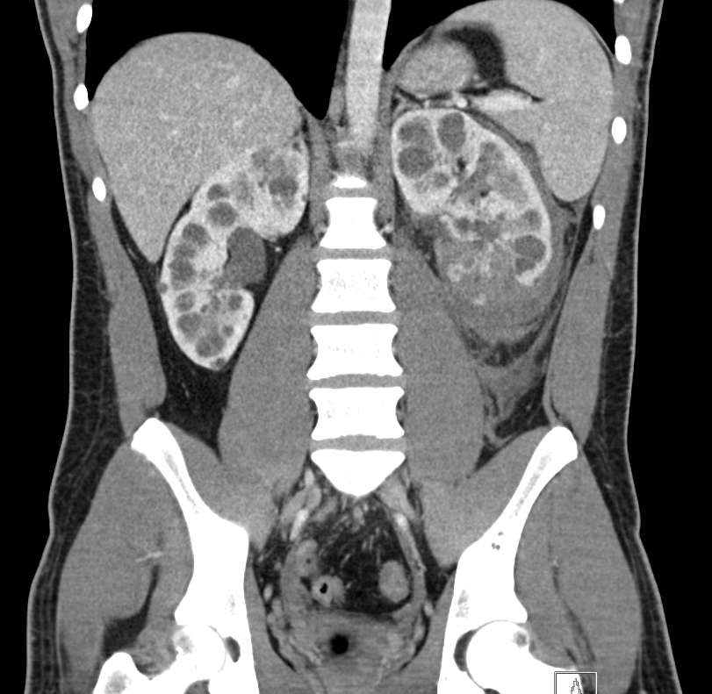
snowboard

Slide 34
Handlebar Injuries
not uncommon in children riding bicycles
After a sudden stop, the child falls over the front of the bicycle and the handlebars hit the abdomen
Trauma can be considered trivial and the symptoms may initially be mild
Delay before injury diagnosis is a mean of 23 hrs
Results in
  Traumatic pancreatitis most common injury 33%
  Renal and splenic trauma 17%
  Duodenal hematoma 13%
  Bowel perforation 10%

Slide 35
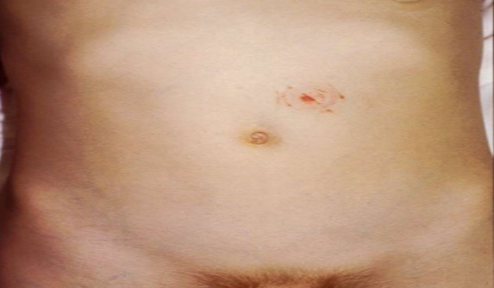
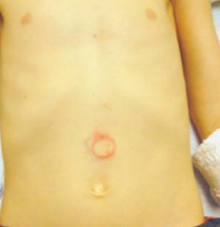

Slide 36
Child Abuse
Abdominal trauma is the 2nd leading cause of abusive trauma mortality
Should be considered when a child presents with abdominal trauma and a discordant story
Risk factors include
  poverty, male gender, young age, previous unexplained or repetitive injuries, an adult male other than the father in the home, and children with physical and developmental delays
liver and the bowel are the most common with injuries to multiple organs are not uncommon
Toddlers aged 2 to 4 years of age are the most likely to suffer abusive injuries

Slide 37
Laboratory Studies
Level 1
  Hgb/Hct/Plt
  UA
  PT/PTT- (Keller, head injury, no benefit for blunt trauma)
  T&S (Keller; 77% trauma send, 3.8% get blood)
Level 2
  Hgb/Hct/Plt (Keller; Hct<30 inc risk of IAI), trend can be important
  UA- data varies, often >5 RBC/hpf

Slide 38
CT Scan Concerns
Concerns about increased risk of cancer from radiation exposure in children have raised questions about possible overuse of CT imaging
Children are more radiosensitive than adults
Frush and colleagues estimated a risk of developing a fatal cancer secondary to radiation to be approximately 1/1000 pediatric CT scan

Slide 39
FAST Exam
The FAST exam has added a method to quickly evaluate a patient with possible abdominal injuries in the trauma bay. While FAST does not replace a CT scan in the evaluation of abdominal trauma, it can aid in the decision to perform a CT scan or go to the operating room.
Positive FAST in a hemodynamically unstable patient
  indication to go to the operating room
Positive FAST in a hemodynamically stable patient
  further evaluation with a CT scan

Slide 40
~50% of IAI has free fluid in pediatrics, Current Ped Reviews 2018
*Negative FAST exam alone does not exclude hemoperitoneum or intra-abdominal injury & repeated assessment is warranted to assess for a change in the patient’s clinical condition.
  GCS 14+, nml exam, negative FAST-> PEC

Slide 41
Bibliography
https://www.ahcmedia.com/articles/63956-blunt-abdominal-trauma-in-pediatrics
Pediatric Emergency Care 11, March 2019
https://www.ahcmedia.com/articles/105772-pediatric-abdominal-trauma
Uptodate.com
Cotton, et al. J Trauma. 2004 May;56(5):1068–75
www.trauma.nl/sites/www.trauma.nl/files/proefschriften/David%20Nellensteijn%20proefschrift.pdf
Wegner, Pediatric Clin N Am. 53, 2006
Jobst, Journal of Pediatric Surgery, Vol 34, 1999
Fox, Academic Emergency Medicine Vol 18, 2011

Slide 42
Quiz Time

