Slide 1
Bronchiolitis
Winter is here
Dec. 18, 2019
P. Mazur, MD

Slide 2
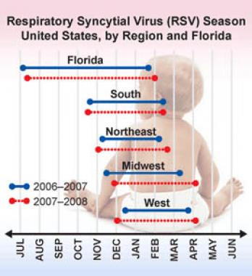

Slide 3
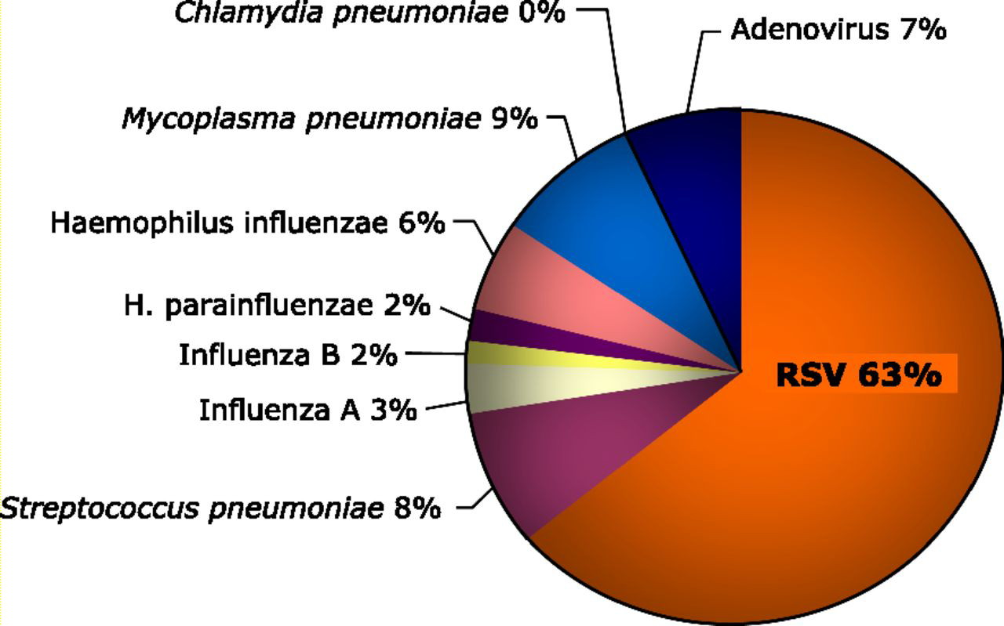

Slide 4
GOAL
Resident will be able to objectively manage bronchiolitis in its varying stages of severity in the ED.
Objectives:
Clinically diagnose bronchiolitis using history and symptoms
Use a Respiratory Score to determine severity of illness and the child’s +/_ response to your management in the ED.
Identify children at higher risk for apnea, respiratory failure
Differentiate RAD from viral bronchiolitis
Know indications for use of Non Invasive Ventilation

Slide 5
RSV infection - Presentation
Most common
URI symptoms
Low grade fever
30% as lower respiratory infection
Less common
Croup
Tracheo bronchitis
APNEA -
Increased RISK
< 2 months of age
<37 weeks gestation

Slide 6
Bronchiolitis
Clinical diagnosis
Seasonal
Age < 2 years
URI symptoms
low grade fever
wheezing
Notes:
RAD diagnosis made confidently after 2 years of age.

Slide 7
Management is Supportive
Nasal suction
Oxygen
Albuterol
Racemic epinephrine
Steroids
IVF
Notes:
Nasal Suction – Oxygen? – Albuterol ? – IV fluid ?

Slide 8
Viral Bronchiolitis vs RAD
Viral bronchiolitis
Reactive Airway disease
Common < 2 years
Airway inflammation
Cellular sloughing
Thick secretions air trapping
Poor penetration of aerosolized medication into airways
Common > 2 years
Bronchoconstriction
Smooth muscle
Alpha/Beta receptors

Slide 9
Respiratory Scoring as a tool for managing bronchiolitis
Refer to handout
Notes:
Focus on RS Calculation table.

Slide 10
Patient 1
7 week old full term infant with URI symptoms X 3 days.
Today respirations are faster and deeper.
This AM not drinking bottle. Decreased wet diapers during night.
RS calculation
T 38, RR 60, P 160, Pox RA 95% RR 1 point
Alert, profuse clear rhinorrhea
MMM, cap refill 2 sec
Chest - intercostal and subcostal retractions rets 2 points
inspiratory and expiratory wheezing wheeze 2 points
5 points total
Notes:
VS wnl, well hydrated, RS 5 points needs intervention, suction dec wheeze to end expiratory only, Now RS 4, Pox 95%. po challenge

Slide 11
Patient 2
18 month male brought ED with 3 days of noisy breathing and increasing cough. Decreased bottling past 2 days. No wet diaper this AM. Tried sibling’s albuterol without improvement.
RS
RR 45, Pulse 190, T 39, Pox 95% RR 3 points
Child irritable, crying
Crusted runny nose, dry patchy facial rash
Oral mucosa tachy, cap refill 3 seconds
Chest - Retractions 3+ intercostal, subcostal, suprasternal 3 points
Wheezing heard as your enter the room. 3 points
9 points
Notes:
Need to get below 5 points, treat fever, nasal suction now not wheezing out loud. RS 7 Ask about child PMH and FH. Trial albuterol. Supra rets diminish, Qualifies for HF

Slide 12
Considering Albuterol
Wheezing in past with viral illness
Use of albuterol/steroids in past for viral illness
Prematurity with residual lung disease
Eczema in child or family
Family history of RAD
Notes:
, Back to patient 2, albuterol no change, try 2 liter NC no change, NIV slides

Slide 13
Noninvasive Ventilation
*High Flow Nasal Cannula
delivers oxygen at >2liter/min
warm/humidified
delivers positive pressure
CPAP / BiPAP
requires ventilator
controlled delivery of O2 and+ pressure
*preferred ED method

Slide 14
Noninvasive Ventilation
High Flow in ED
Positives:
Easy to set up
reduces intubations
improves hypoxia and hypercapnia
can reverse respiratory failure
Negatives:
Unprotected airway (obstruct /aspirate)
Patient unable to tolerate
Facial/nasal trauma
Skilled support staff (assessment/reassesment)

Slide 15
NIV Failure -Predictors
- Initial high FiO2 required
- Initial high PaCO2
-No clinical improvement after 1-2 hours
-Serious underlying disease
(sepsis, Immune Def., oncologic)

Slide 16
Patient #3
4 week old, former 35 week premie. Mother called EMS because child stopped breathing for about 30 seconds, turned blue. Child had cough, runny nose for 3 days. Sibling with same. Oral intake was poor today but continues to make wet diapers.
RS
RR 60, P 190, T 38.2, Pox 93% RR 1 point
Child is alert and fussy
Ant Font flat, MMM, skin mottled, cap refill > 2 seconds
HEENT – clear rhinorrhea, otherwise negative. Rets 3 points
Chest - audible wheezing entering room wheeze 3 point
7 points
Rapid RSV +
CXR ??
Notes:
4 week old premie, fever, resp distress,

Slide 17
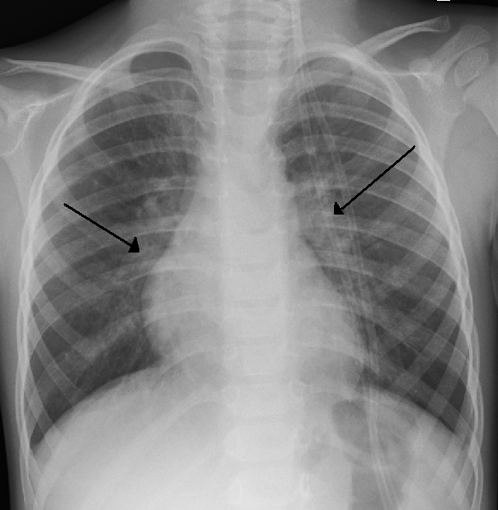

Slide 18
Febrile Infant
4-8 weeks of age – UA micro, Urine culture
?CBC diff Blood culture
?LP
<4 weeks of age -- Full Sepsis W/U

Slide 19
Low risk for bacterial meningitis*
Infants 29-56 days old
Full Term (>37 wks)
No NICU stay
No chronic medical problems
No antibiotics within 72 hours
Well appearing/consolable
No focal infections on physical exam
Blood -
WBC > 5000 and < 15,000
Band to total WBC count <0.2
Urine –
< 10 WBC/hpf
CXR negative
*Fleisher and Ludwig 7th edition, p 586

Slide 20
Testing for RSV
Nasopharyngeal swab
RAPID – RSV antigen - 90% sensitivity
PCR- viral nucleic acids - > 90% sensitive
Utility of RSV testing ?

Slide 21
Are Bronchiolitis and Asthma associated?
Controversial
Viral infection may have a causal role in the development of Asthma. May increase the risk of developing RAD.
Consider:
Age of exposure- by 4 months maternal Ab’s at nadir
Severity of initial exposure
Possible chronic residual airway damage from virus
Genetic predisposition.

Slide 22

Droplet Transmission
Not aerosolized
5 micron droplets on surfaces
Virus remains active for several hours

Slide 23
Viral shedding duration
Patients are symptomatic - average of 15 days
Symptoms can last 21-28 days
Average duration shedding 4-7
Range of duration 1 – 21 days
Shedding varies with
Severity of illness
Age of patient – younger patient longer shedding period
Primary infection vs reinfection

Slide 24
GOAL
Resident will be able to objectively manage bronchiolitis in its varying stages of severity.
Objectives:
Clinically diagnose bronchiolitis using history and symptoms
Identify children at higher risk for apnea, respiratory failure
Differentiate RAD from viral bronchiolitis
Use a Respiratory Score to determine severity of illness and the child’s response to management in the ED
Know indications for use of Non Invasive Ventilation

