Slide 1
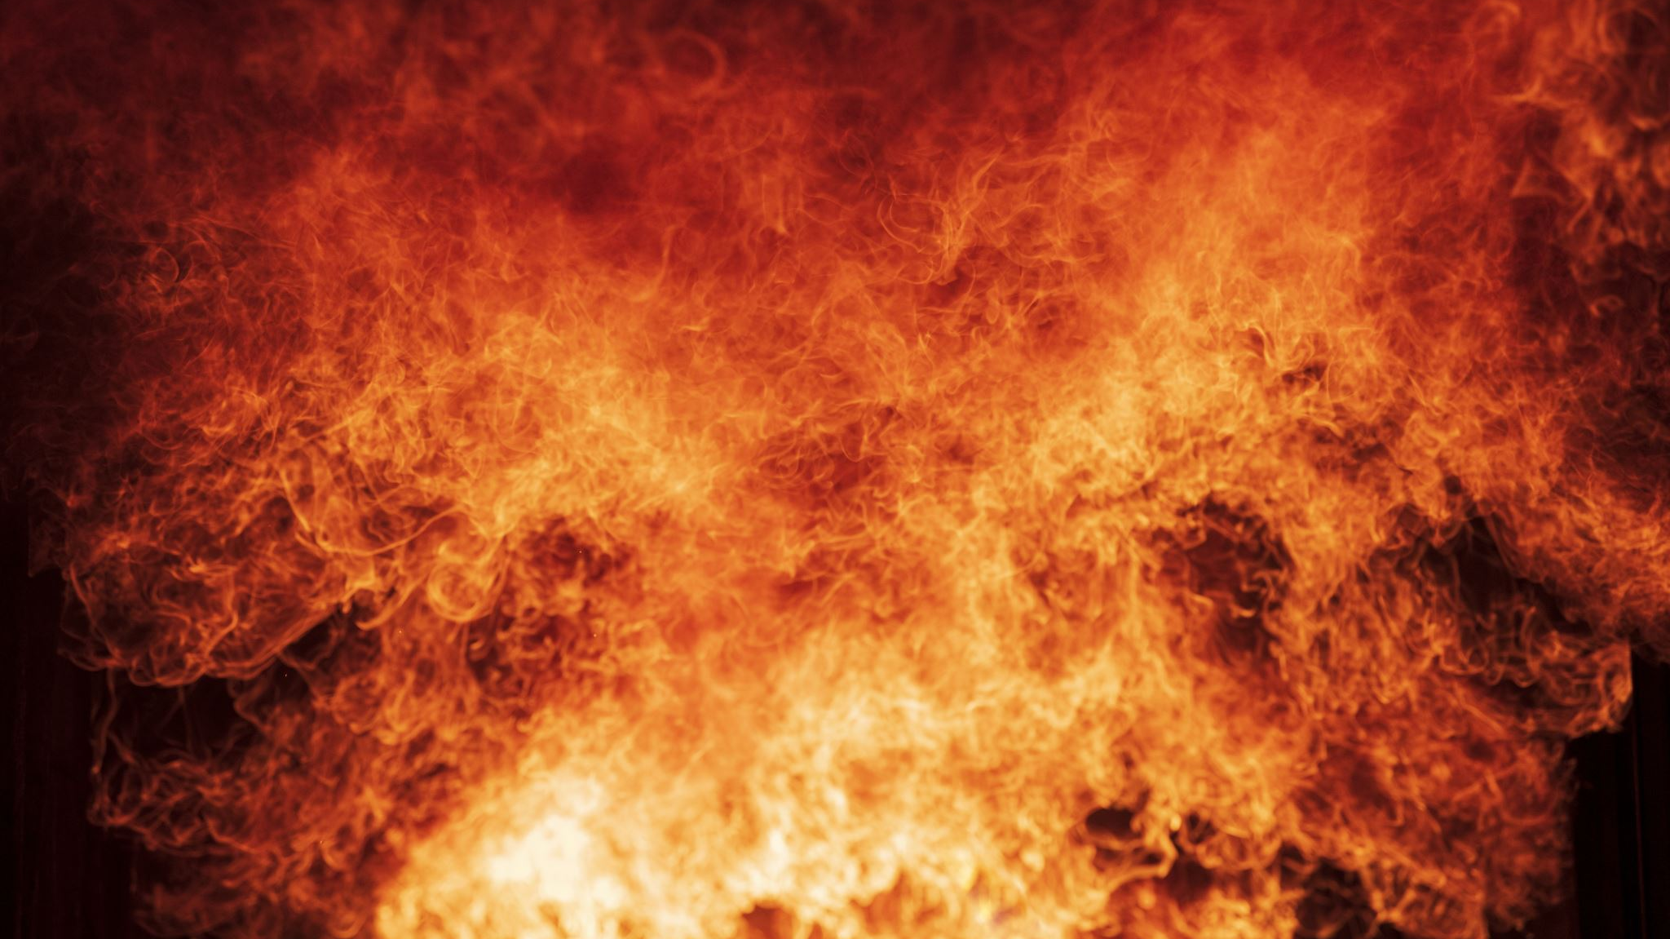
Burnout
And other yearly reminders…

Slide 2
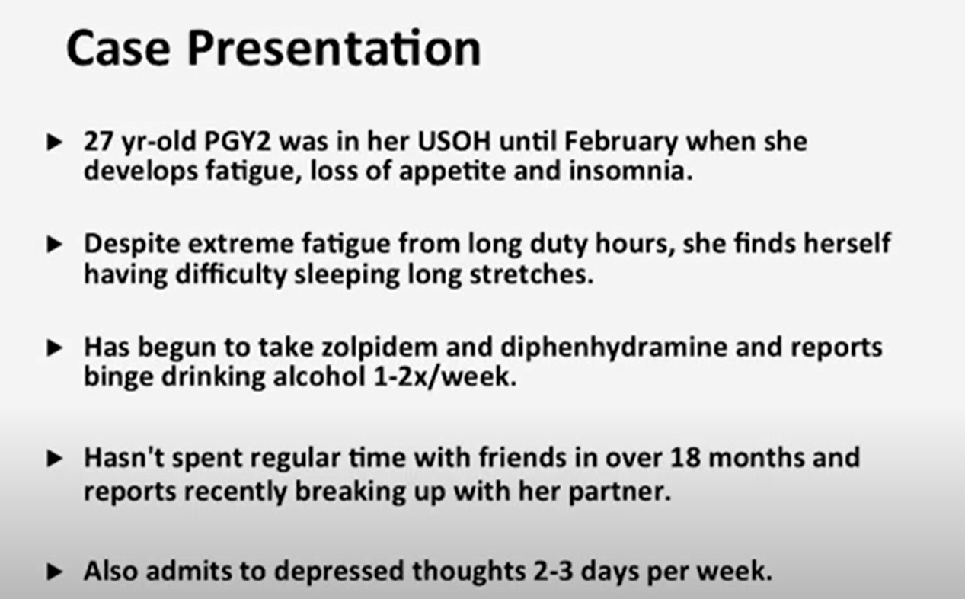

Slide 3
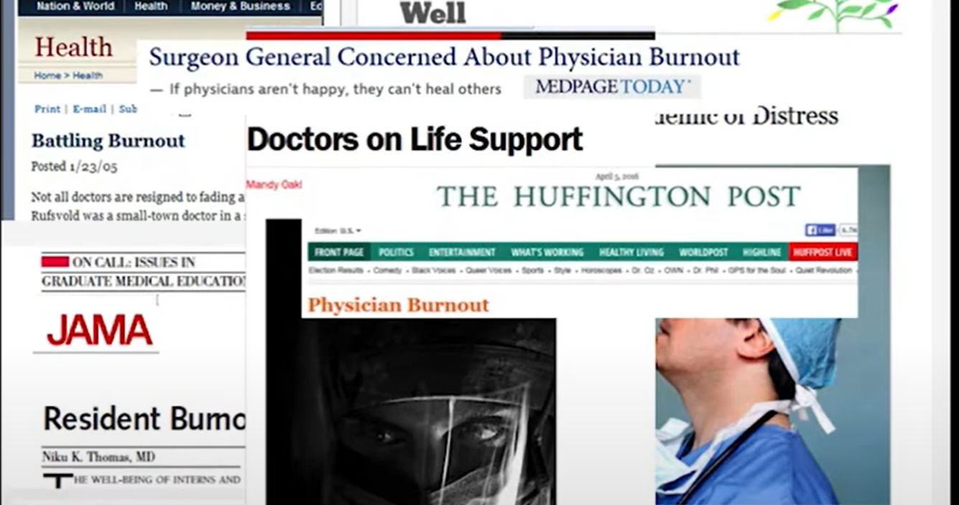

Slide 4
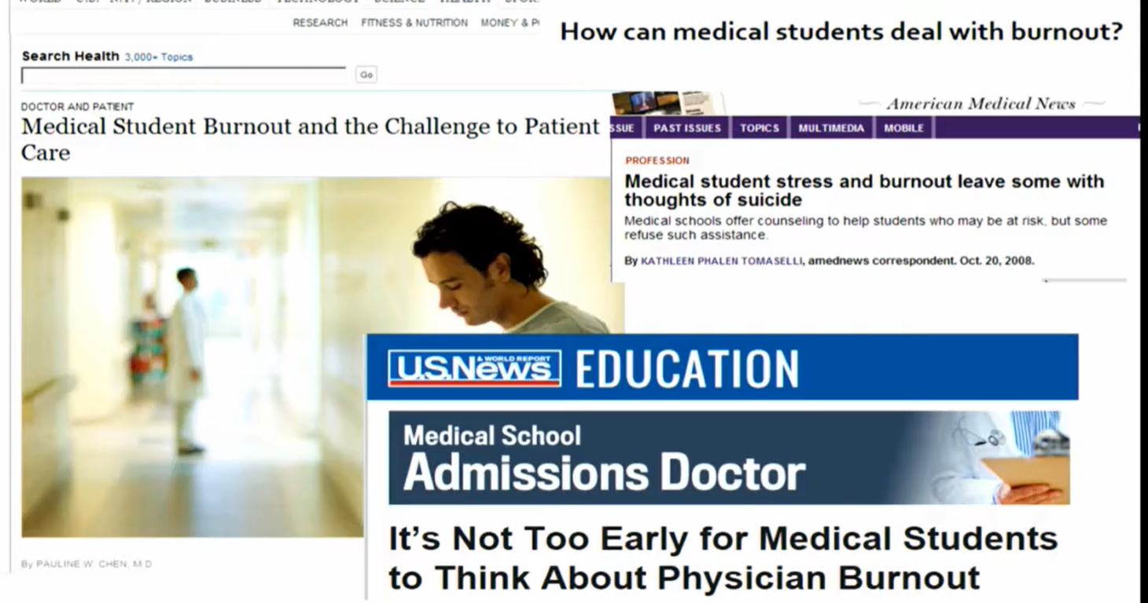

Slide 5
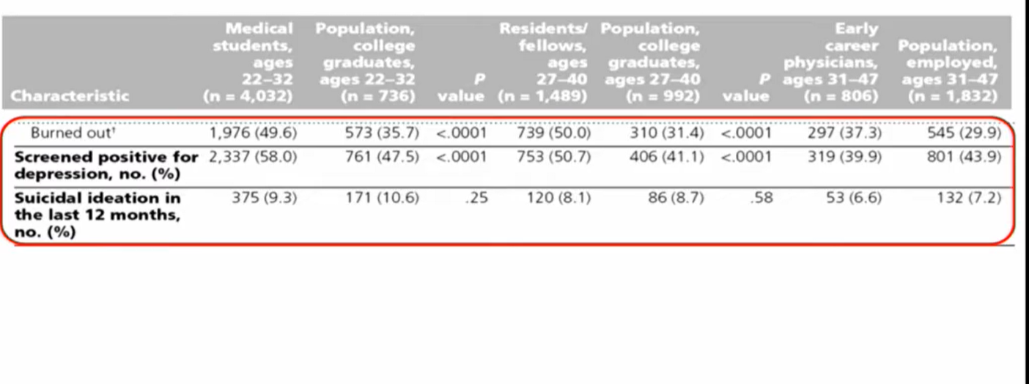

Slide 6
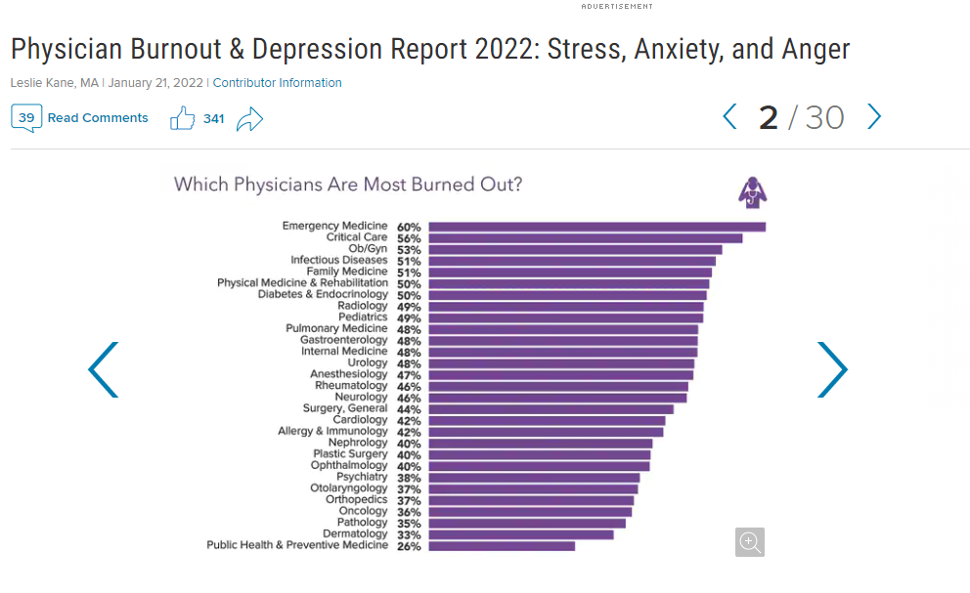

Slide 7
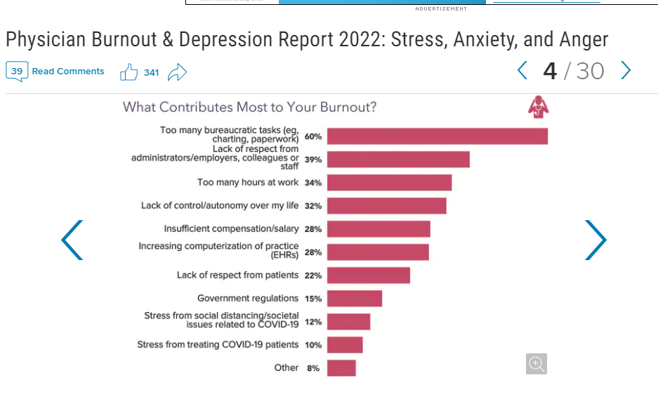

Slide 8
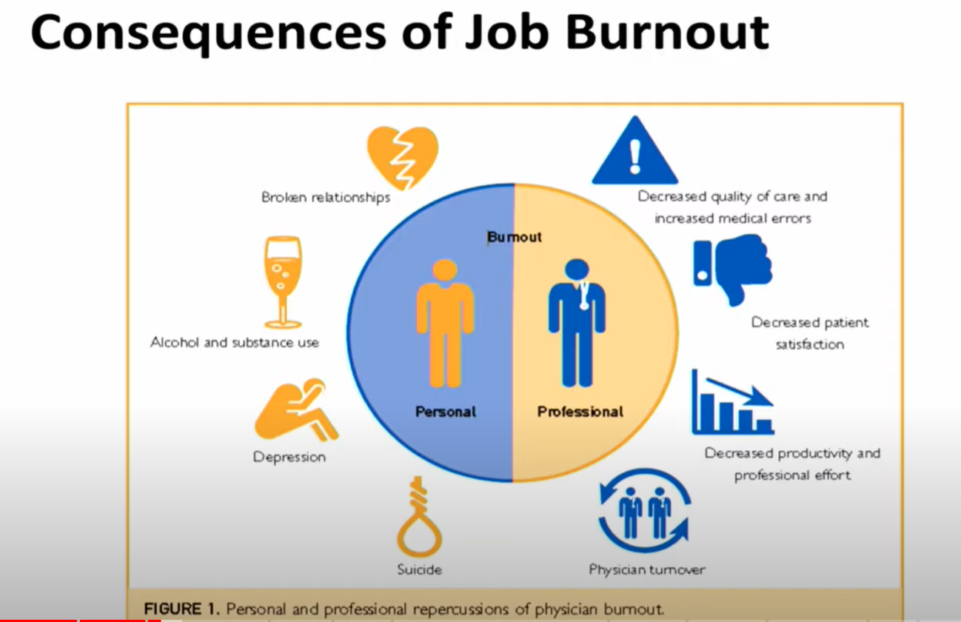

Slide 9
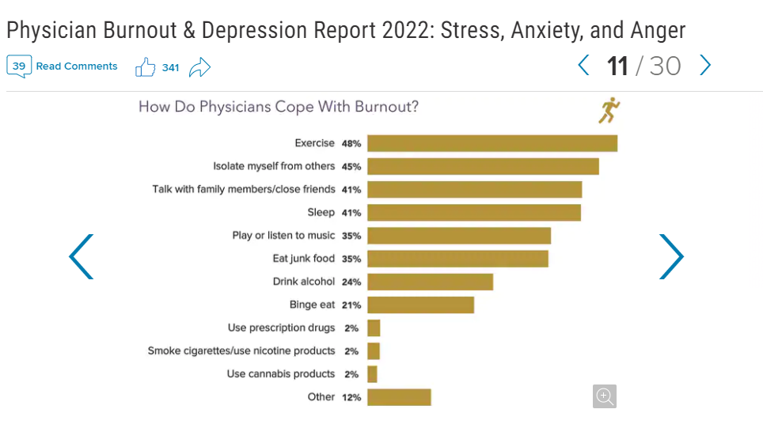

Slide 10

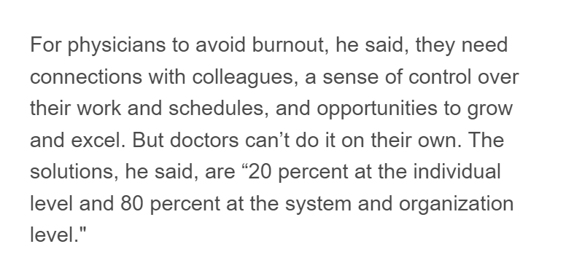

Slide 11
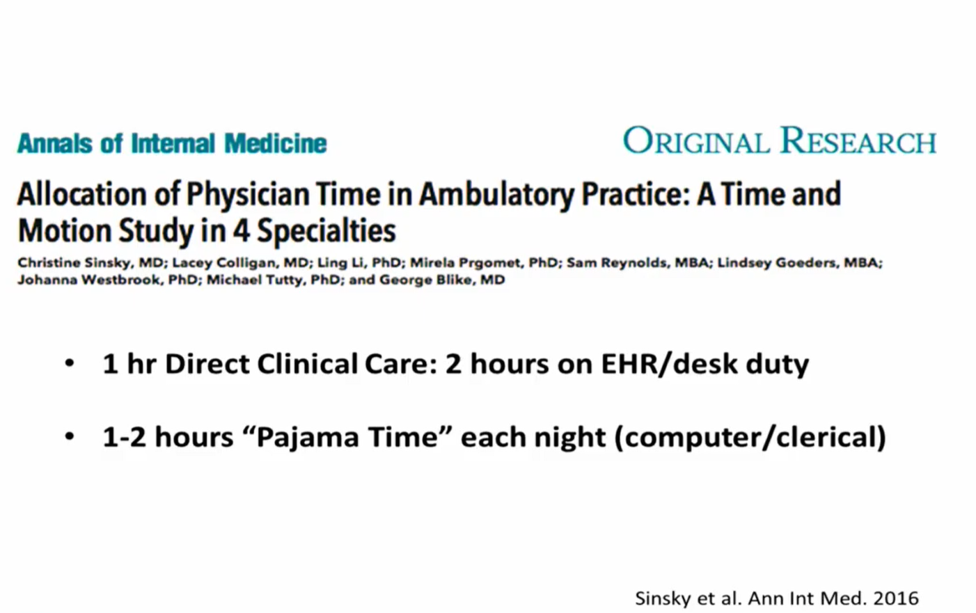
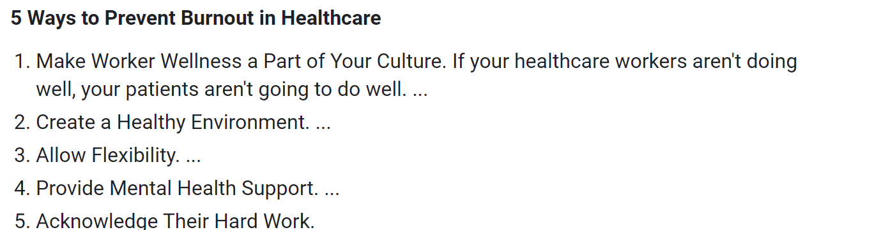

Slide 12
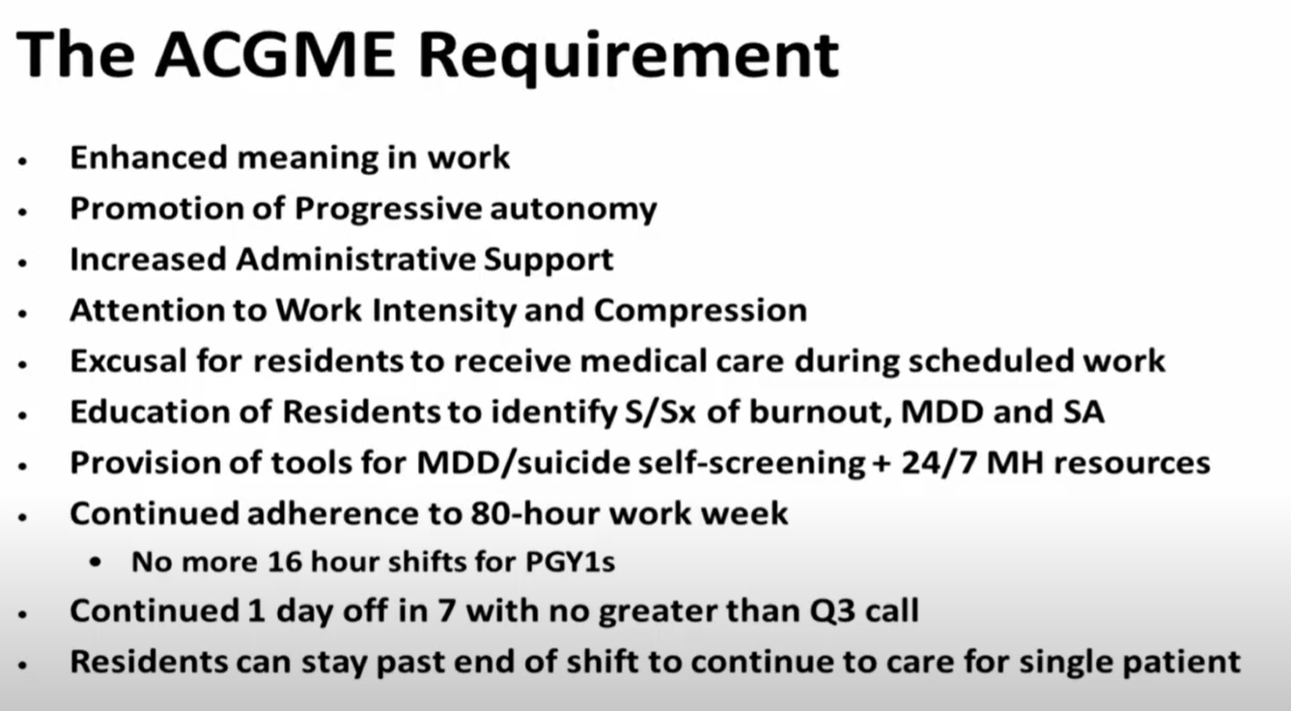

Slide 13

Wonderful support system
Monthly PEC meetings to bring up issues
Work life balance
Organizational and cultural values
Monthly activities
A team ready to support you
Flexible schedules

Slide 14
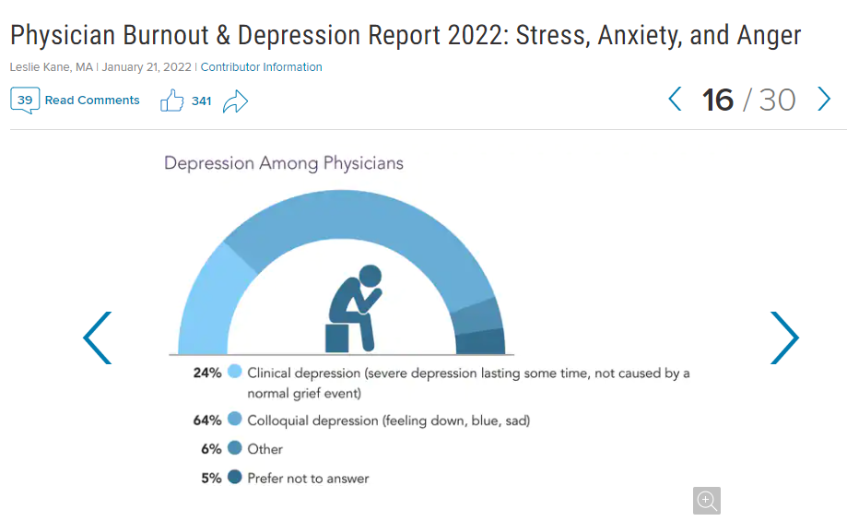
21% of physicians reported depression – of those 24% were clinically depressed

Slide 15
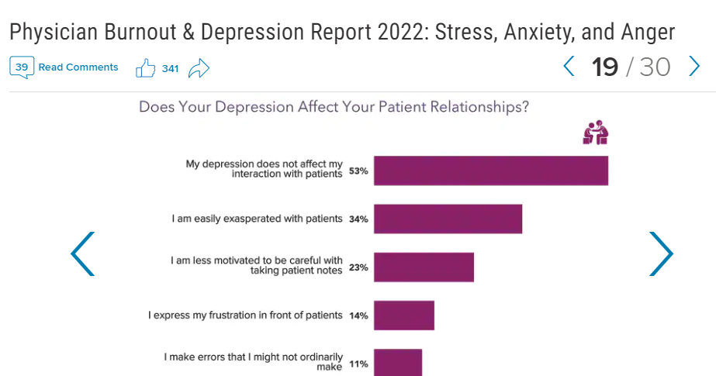

Slide 16
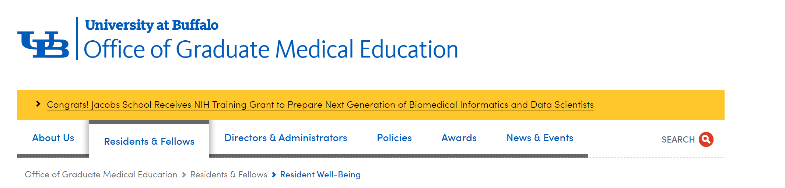
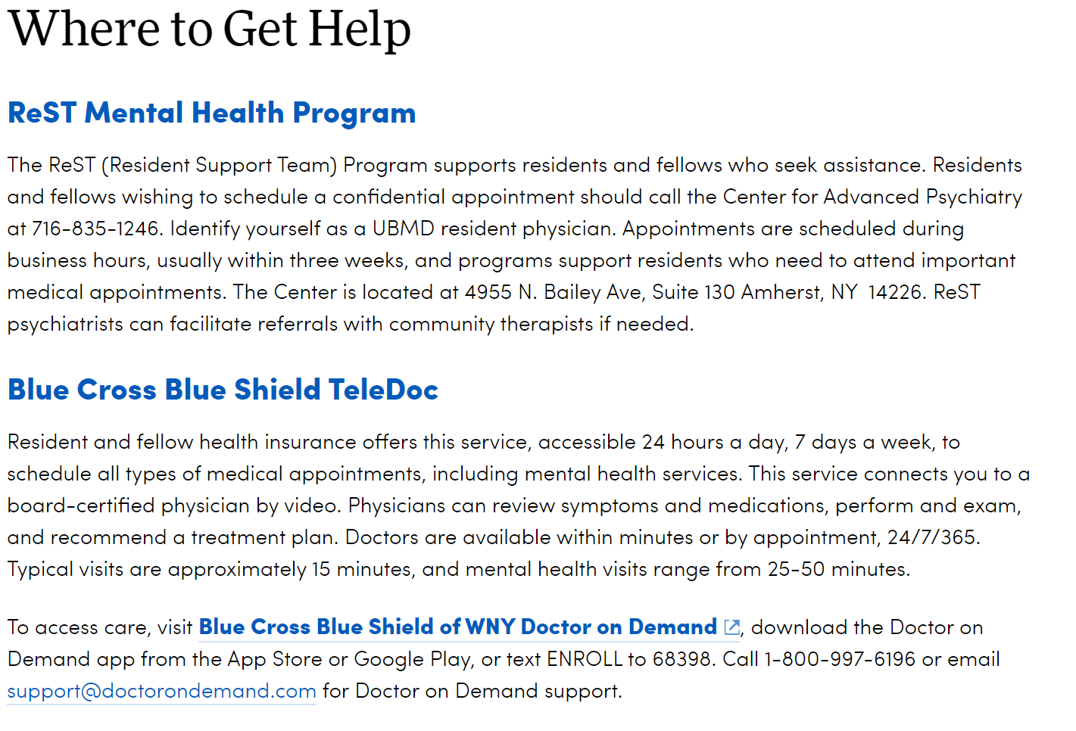
Notes:
Other systems of support

Slide 17
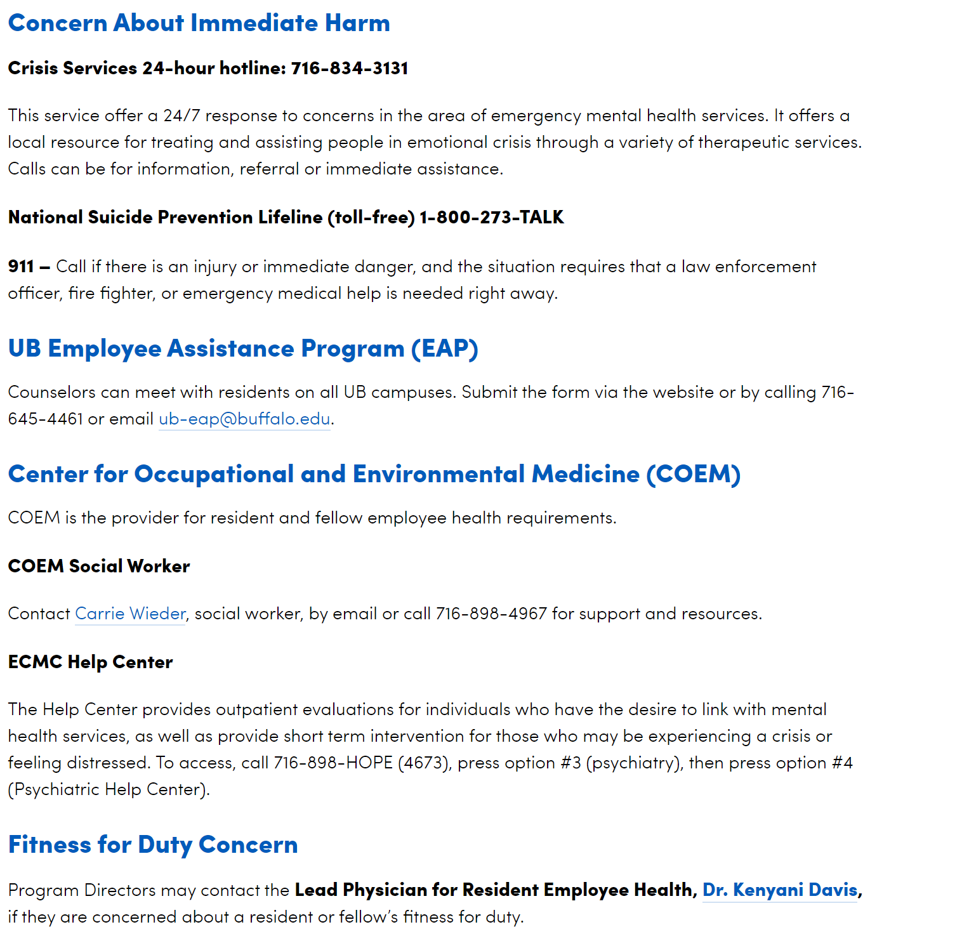

Slide 18
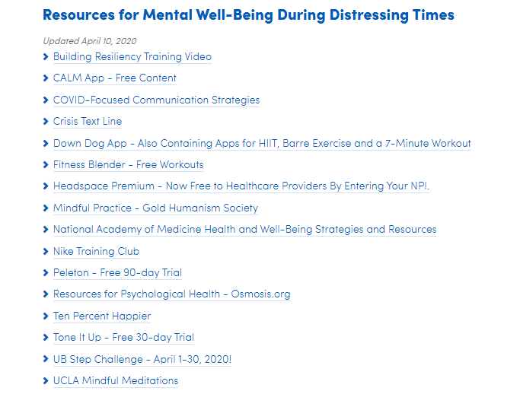
https://medicine.buffalo.edu/offices/gme/residents/resident-well-being.html

Slide 19
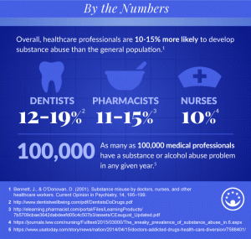
Substance abuse

Slide 20
Substance abuse in residents and fellows
Substance abuse has long been a problem in our society – and the healthcare industry is no stranger to it. Doctors, nurses, and other professionals in the medical field have consistently seen high numbers of drug and alcohol abuse.
  A 2013 study in the Journal of Addiction Medicine stated that 69% of doctors abused prescription medicine as a means of relief from emotional distress or general stress.
  The American Nurses Association reports that 10 percent of nurses may be impaired or in recovery from drug or alcohol addiction.
  A 2012 University of Washington survey of over 25,000 surgeons revealed that roughly 15 percent have problems with alcohol abuse or dependency.

Slide 21
What are some of the warning signs someone dealing with addiction may exhibit in the workplace?
Physical signs such as fatigue, deterioration in personal hygiene and appearance, multiple physical complaints, accidents, eating disorders
Family stability disturbances
Social changes such as withdrawal from outside activities, isolation from peers, inappropriate behavior, undependability and unpredictability, aggressive behavior and argumentativeness.
Professional behavior problems such as unexplained absences, tardiness, decreasing quality or interest in work, inappropriate orders, behavioral changes, altered interaction with other staff and inadequate professional performance
Behavioral signs such as mood changes, depression, slowness, lapses of attention, chronic exhaustion, risk taking behavior, excessive cheerfulness, and flat affect
Drug use indicators such as excessive agitation or edginess, dilated or pinpoint pupils, self-medication with psychotropic drugs, stereotypical behavior, alcohol on breath at work, uncontrolled drinking at social events, blackouts, and binge drinking

Slide 22
What should I do if I suspect a colleague is impaired?
All faculty and residents possess a duty to report to an appropriate supervisor, in confidence, concerns about possible impairment both in themselves and in others. If a resident is observed and/or suspected to be impaired while engaged in the performance of his or her duties, the following actions should occur:
  The resident should report their concern to a supervisor (who will then report to the Program Director), or directly to the Program Director. The individual making the report does not need to have proof of the impairment but must state the facts leading to suspicions.
  The Program Director or their designee will collaborate with the UB GME office to initiate a confidential investigation.

Slide 23
What resources are available?
The following services are available to residents:
  Referral to the UB GME Employee Health Provider
  Brief counseling and crisis intervention
  Follow-up appointments when indicated
  Referral to resources within UB and/or the community
A list of these resources is available on the UB GME Resident Well-Being page

Slide 24
Other stuff

Slide 25
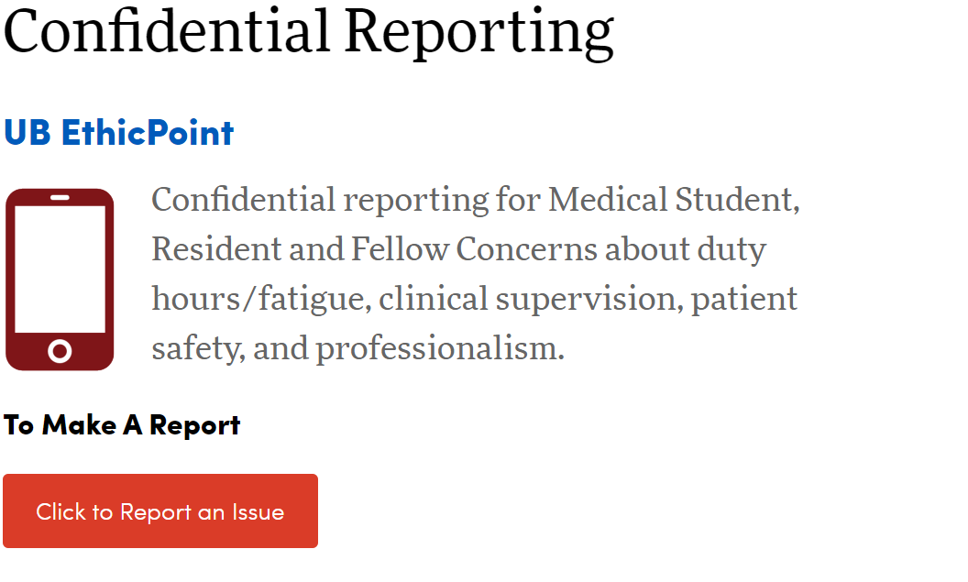
Confidential reporting
https://medicine.buffalo.edu/offices/gme/residents/red-phone.html

Slide 26
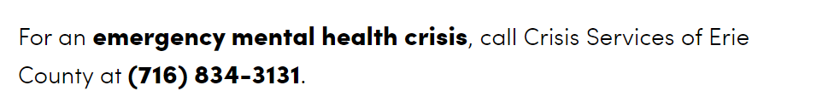
Emergency Mental Health crisis

Slide 27
Discrimination and Harassment
The University at Buffalo (UB) pediatric Emergency Medicine Program is committed to ensuring that no discrimination against or harassment of individuals will occur based on any factor protected by federal or state laws, regulations or executive orders. UB, UMRS and UDRS recognize the adverse effect of discrimination and harassment on medical education and patient care. Therefore, the following policy and procedure has been adopted to ensure a working and learning environment free of discrimination and harassment.

Slide 28
Discrimination
Discrimination is different treatment of an individual or group based upon race, color, national origin, sex, religion, age, disability, gender, pregnancy, gender identity, gender expression, sexual orientation, predisposing genetic characteristics, marital status, familial status, veteran status, military status, or domestic violence victim status (together defined as “protected characteristics”). Sex discrimination includes, but is not limited to sexual harassment, sexual assault, and sexual violence. Policies or practices that adversely impact a protected group may also constitute discrimination, even when applied in a consistent manner.
Discrimination may result from failure to provide accommodations to individuals when required due to the individual's disability, religion, pregnancy status, maternity, breastfeeding, transgender status, or sexual violence victim status.
Discrimination may also result from the failure to consider applicants with criminal convictions for participation in a UB-sponsored training program on an individualized basis, in accordance with GME’s Pre-Employment Background Investigation Policy for Residents and Fellows.

Slide 29
Sexual Harassment
Unwelcome sexual advances, requests for sexual favors, and other verbal or physical conduct of a sexual nature constitute sexual harassment when:
Submission to or enduring such conduct when rejected is made either explicitly or implicitly a term or condition of instruction, employment, or participation in other university activities, or;
Submission to or rejection of such conduct by an individual is used as a basis for evaluation in making academic or personnel decisions affecting an individual, or;
Such conduct has the purpose or effect of unreasonably interfering with an individual's performance or creating an intimidating, hostile, or offensive university environment.

Slide 30
Harassment on the Basis of Other Protected Characteristics
Harassment is a form of discrimination consisting of oral, written, graphic or physical conduct relating to an individual's protected characteristics that has the effect of subjecting the individual to inferior terms, conditions or privileges of employment or interferes with or limits the ability of an individual to participate in or benefit from the university’s programs or activities. Such conduct must amount to more than petty slights or trivial inconveniences, but need not be severe or pervasive. Engaging in speech or expression protected by the First Amendment is not a violation of the university's policies against discrimination and harassment.

Slide 31
Reporting
An individual who believes he or she has been subject to discrimination or harassment (complainant) has the following options:
Consulting with the Program Director of his or her residency, the resident's Department Chair, the Office of Graduate Medical Education (GME) (716-829-2012), or the UB’s Office of Equity, Diversity and Inclusion (EDI) (406 Capen Hall, Buffalo, 14260, 716-645-2266). An individual may consult with these offices without proceeding with a formal report of discrimination, in order to seek advice or an informal resolution to their concerns;
Filing a formal report of discrimination with EDI by calling 716-645-2266, emailing diversity@buffalo.edu, or completing an Information Intake form at https://www.buffalo.edu/equity/reporting-discrimination-and-harassment/information-intake-form.html.
Submitting a report online or by telephone through EthicsPoint. https://medicine.buffalo.edu/offices/gme/residents/red-phone.html EthicsPoint allows individuals to report situations anonymously. EthicsPoint also allows for anonymous communication between the reporting party and the University through the EthicsPoint reporting system. It should be noted that the University will take action to the best of its ability on reports submitted through EthicsPoint; however, due process considerations may limit the University’s ability to act on anonymous complaints.

Slide 32
Reporting Obligations
Residents and fellows who observe or become aware of sexual harassment, sexual violence, and other forms of discrimination or harassment should report this information to the Office of Equity, Diversity and Inclusion, which also serves as the university’s Title IX Office.
Supervisors (including Program Directors, Chairs, faculty, and residents/fellows acting as supervisors as defined in the UB GME Supervision Policy) who observe or become aware of sexual harassment, sexual violence, and other forms of discrimination or harassment must report this information to the Office of Equity, Diversity and Inclusion, which also serves as the university’s Title IX Office.

Slide 33
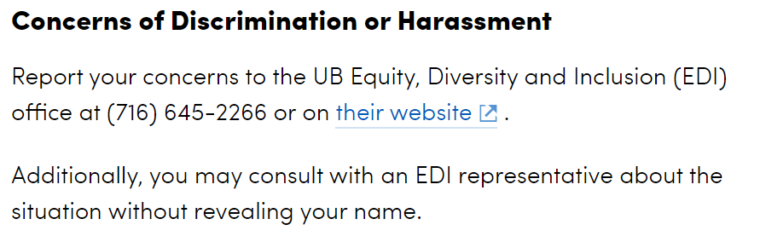
Discrimination or Harassment

Slide 34

Reporting patient safety concerns
STARS report on Kaleidascope

Slide 35
Free access to Journal Articles
https://library.buffalo.edu/

Slide 36
One last thing...
Program mission -
Provide fellows with the tools to ensure they are prepared for and will excel in caring for sick and critically ill children who present to the emergency department

Slide 37
Program Aims
1. Train fellows who are competent to practice independently in multiple practice settings with a solid knowledge base in the specialty and all related subspecialties.
2. Provide trainees with sufficient opportunity to develop necessary skills to conduct and interpret clinical and basic science research.
3. Train residents capable of treating a range of disorders in the specialty and range of patients of various ethnic and socioeconomic backgrounds.
4. Minimize the risk of burnout and promote both resident and faculty wellness.
5. Recruit the best and brightest applicants into our training program.
6. Continue to develop and build on our relationships with other training programs and other departments within our medical school.
7. Continue to integrate resident teaching opportunities into the medical school's clinical activities.
8. Emphasize the importance of lifelong learning, patient safety, and quality improvement.
9. Provide trainees with sufficient opportunity to develop skills preform necessary procedures.
10. Continue to integrate fellow teaching with the pediatric and emergency medicine residents.
11. Provide fellows with a comprehensive education program to aid with board preparation to successfully pass the PEM board examination
12. Provide fellows with a program focused on fostering a diverse and inclusive environment

Slide 38

This is your program....
Please let us know what is working, what needs improvement, & other feedback.
This is your program and you continually have the opportunity to evaluate and improve the it.
Please be an active member to the PEC team.

