Slide 1
Genitourinary Problems and Emergencies
Kunal Chadha, MD
Pediatric Emergency Medicine
February 12, 2020

Slide 2
GU Problems and Emergencies
Urinary tract infections
Urinary retention
Renal Colic and Nephrolithiasis
Female urologic problems
Female genital problems
Penile problems
Testicular problems

Slide 3
Urinary Tract Infections
Fever is the most common presenting symptoms in infants
Previously toilet trained child may present with having “accidents”
Abdominal exam may reveal pain, over distended bladder or stool mass indicating fecal impaction causing stasis of urine
Presence of a flank mass may be sign of UPJ obstruction or hydronephrosis
Uncircumcised males, vaginal foreign bodies and labial adhesions are all risk factors for UTI

Slide 4
Urinary Tract Infections
E. Coli is the most commonly isolated organism responsible for UTI in children (80-90% of total)
Clean catch urine: growth of single organism at 100,000 CFU
Catheter specimen: growth of single organism at 50,000 CFU
Growth of ≥10,000 CFU/mL of a single uropathogen may be considered sufficient to diagnose a UTI in cases where the pretest probability of UTI is high
  Children with a reasonable suspicion who have growth of 10,000-50,000 CFU of a single uropathogen from an initial catheterized specimen should have a repeat urine culture
Organisms such as Lactobacillus, coagulase-negative staphylococci, and Corynebacterium are not considered clinically relevant urine isolates for otherwise healthy, 2-24-month-old children
Children over 2 months of age and otherwise well can be managed as outpatient
Pregnant females should be aggressively treated for asymptomatic bacturia and those with febrile UTI that are unable to tolerate PO need to be admitted and treated with IV antibiotics

Slide 5
Urinary Retention
Causes may include congenital lesions, such as urethral valves, or acquired lesions, such as post traumatic strictures
Children with urethral irritation and dysuria may voluntarily retain urine
  Suggest gentle massage of lower abdomen, soaks in warm tub
Holding urine for up to 12 hours is not uncommon for children

Slide 6
Renal Colic and Nephrolithiasis
Flank pain with or without the presence of hematuria
  IV hydration and pain control with NSAIDs and/or narcotics
Ultrasound is first-line imaging to be obtained
  If the ultrasound is abnormal but does not show a stone specifically, a low-radiation noncontrast CT scan can be obtained
A kidney stone becomes a true emergency when it is associated with a fever, or if there is an obstructing stone in a solitary kidney
  Fever in the setting of an obstructive stone is a medical and surgical emergency, and without timely treatment, a patient can progress to sepsis, with the potential for rapid decompensation
  Aside from these two settings symptomatic control is treatment of choice

Slide 7
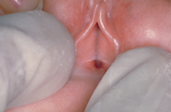
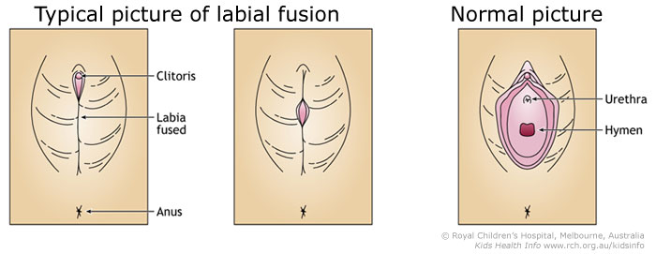
Labial Adhesions
Occurs in approx. 0.6-3% of prepubertal girls
Due to lack of estrogen + irritation due to poor hygiene/diaper rash
Usually an incidental finding by parents or PMD
  May present as vaginal bleeding (most common), dysuria, frequency or refusal to void
Appear as a “median raphe” formed by the two edges of labia minora
Chicken vs Egg association with UTI
Treatment:
  Observation -- reasonable for the asymptomatic child -- typically resolve once the child reaches puberty and the tissues become estrogenized
  Symptomatic – good response to estrogen cream (Premarin or Dienestrol) onto adhesions 1-2x/day for 2-4 weeks
  Recurrence 15-40% so after care is important with good hygiene and petroleum jelly at bedtime to keep the labia from refusing
  NEVER MANUALLY SEPARATE ADHESIONS
Notes:
Potential SE: skin hypopigmentation and breast budding
Theoretical SE: vaginal bleeding or precocious puberty

Slide 8
Urethral Prolapse
Urethral prolapse is a circular protrusion of the distal urethra through the external meatus
  Upon examination, round doughnut-shaped mucosa is observed protruding from the urethral opening
Vaginal bleeding is the most common presenting symptom
Most commonly seen in obese prepubescent girls between ages 2-10, peak 5-8 years old
  Rest occur postmenopausal
  Majority of affected are African American
Predisposing factors include hypoestrogenism and sudden increase in abdominal pressure (e.g., due to constipation, cough, crying, seizure, or heavy lifting)

Slide 9
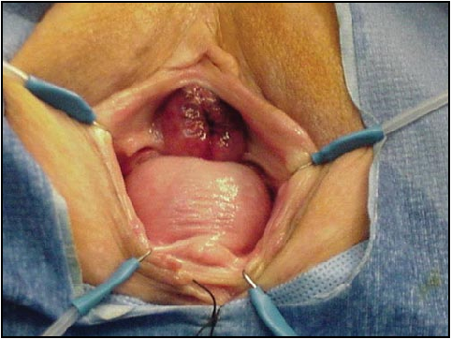
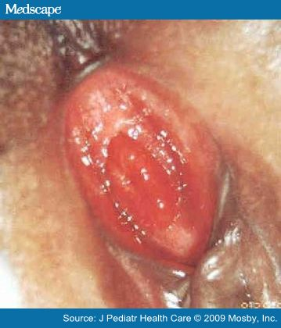
Urethral Prolapse
friable, donut-shaped mass along the introitus that may bleed. The friability and edema is due to impaired venous return, which can lead to venous thrombosis and necrosis in some cases

Slide 10
Urethral Prolapse
Treatment:
  Warm moist compresses or Sitz baths + 2 week course of topical estrogen cream
    If addressed in timely manner, minimal risk for thrombosis or necrosis
  Oral analgesics (with or without topical anesthetics)
  Topical steroids
  Estrogen cream applications
    BID x 2 weeks and may be repeated if there is persistence of symptoms
  Sitz baths
  Stool softeners are helpful for associated constipation
  Recurrence is common; therefore, surgery may be indicated in cases of repeated recurrence or in cases with necrotic appearance of urethra on clinical examination

Slide 11
Lichen Sclerosis
Uncommon, chronic idiopathic skin disorder of vulva
Flat-topped white papules coalesce to form atrophic plaques
Involve vulvar and perianal skin in an hourglass pattern
May be mistaken for abuse
  Commonly may be associated with ecchymosis, fissures and telangiectasias

Slide 12
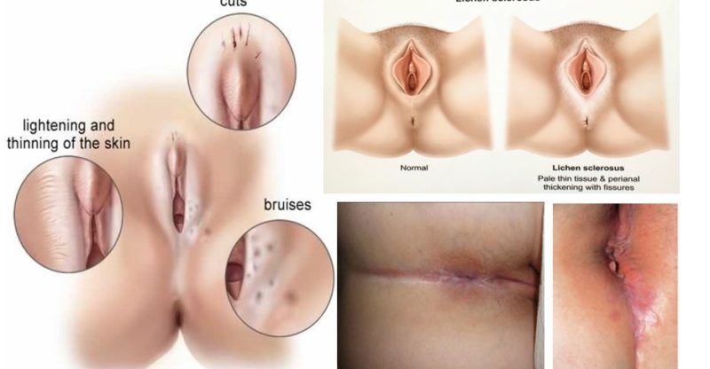
Lichen Sclerosis

Slide 13
Lichen Sclerosis
Treatment:
  Application of clobetasol propionate, 0.05% topically, BID for up to 2 weeks
    Assess at 2 weeks, usually treat 6-12 weeks
  Lubricants (e.g., urea [Nutraplus] cream) are useful to soothe dry tissues
  Hydroxyzine, 25 mg, at bedtime is effective in decreasing nocturnal itching
  Intralesional steroids, etretinate, and surgical management are usually reserved for refractory cases.
Notes:
Topical Glucocorticoid corticosteroid
usually used for soriasis

Slide 14
Congenital Vaginal Obstruction
Consider with acute urinary retention
Most common causes: Imperforate Hymen and Transverse vaginal septum
  In adolescent females – will often present with primary amenorrhea or lower abdominal pain
    Suspect if has normal pubertal development but hasn’t yet had menarche
    As hematocolpos accumulates, can lead to frequency or dysuria
    Bluish hue on inspection of introitus
    consider with urinary retention or recurrent abdominal pain in teenager
  In infants – should see at birth but may not present as issue for weeks to days
    Hydrometrocolpos -- fluid filled vaginal cavity with associated distention of the uterine cavity from mucus secreted due to maternal hormones
    Hydrocolpos – 3 hallmark signs: lower abdominal mass, difficulty with urination, visible bulging at introitus
  Rarely the chronic intrinsic pressure can lead to constipation, hydronephrosis, LE edema, respiratory insufficiency or even IVC obstruction
Notes:
Menarche: average, 2 to 2.5 years after the onset of puberty
Early maturation (defined as menarche ≤11 years)
Late maturation (defined as menarche >14yo)

Slide 15
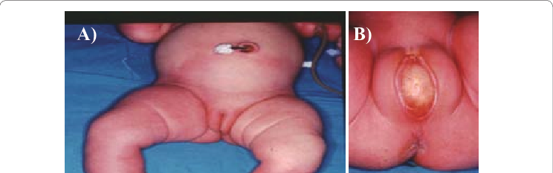
Congenital Vaginal Obstruction
Notes:
Figure 1: Imperforate hymen with hydrocolpos in ten-days-old female newborn
(A) Abdomen is distended due to round mass, a red halo arising from pelvis reaching the level of umbilicus
(B) Genitalia seemed quite normal until the infant cried or the abdominal wall was pressed, when the translucent bulge appeared.

Slide 16
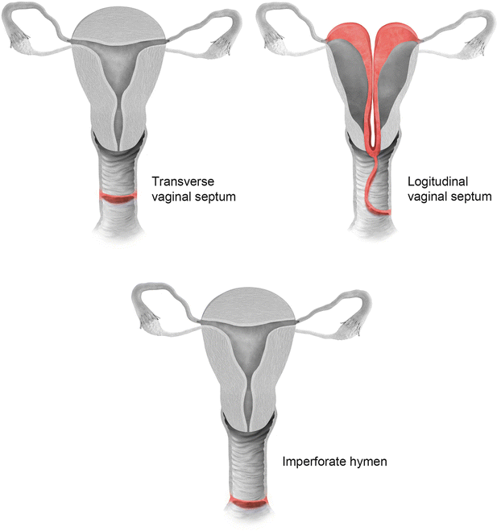
Congenital Vaginal Obstruction
Transverse vaginal septum
  Occurs in 1/30-80,000 women
  MC in upper and middle third of vagina
  Usually presents after puberty with amenorrhea and pelvic pain
  Does not bulge with vasalva
  Typically see normal introitus so harder to diagnose but may be associated with renal malformations
Notes:
Renal malformations --- single kidney or hypoplastic kidneys or duplicated or ectopic collecting systems

Slide 17
Vaginal Rhabdomyosarcoma
Very uncommon, high-grade malignant tumor of the vagina. It typically affects very young girls (mostly <2yo)
A majority of the vaginal rhabdomyosarcomas are of the embryonal variant, which are thought to arise from embryonic connective tissues responsible for skeletal muscle development
Symptoms may include:
  vaginal bleeding
  Frequent urination due to compression/pressure of the tumor
  Urinary retention
  Pain in the pelvic or abdominal region
  Lower back pain

Slide 18
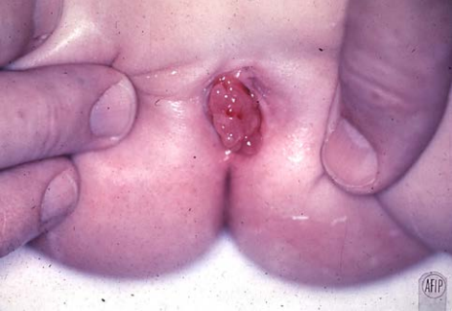
Vaginal Rhabdomyosarcoma
“Grape-like” mass protruding from vagina

Slide 19
Vaginal Rhabdomyosarcoma
Treatment includes both surgical and medical management including chemotherapy and/or radiation therapy
Due to its high metastasizing potential and recurrence rate, regular medical screening at periodic intervals with blood tests, scans, and physical examinations, are mandatory for those who have already been treated for this tumor
With medical advancements and comprehensive treatment practices, the prognosis of Embryonal Vaginal RMS has shown great improvement. The overall cure rates range from between 90-95% (per the WHO) and the 10 year survival rate is around 90%

Slide 20

Penile Problems
Phimosis: tightness of the distal foreskin precludes it being withdrawn to expose the glans
  Does not have to be treated emergently
  Betamethasone cream, 0.05%, applied twice daily for 6 weeks, is the first-line treatment
  Hydrocortisone is an alternative
  Instruct to gently pull the foreskin back as far as it will go, then to apply a small amount directly to the tightened area

Slide 21

Penile Problems
Paraphimosis: results from the foreskin being left in a retracted position This leads to venous congestion and edema of the foreskin, making it difficult to return the foreskin to its normal position
  The application of ice and steady manual compression on the inflamed ring of foreskin usually reduces the edema and permits manual reduction of the paraphimosis
    May need local anesthetic or dorsal penile nerve block to perform manual reduction
  If manual reduction is unsuccessful, an emergency dorsal slit of the foreskin is needed to avoid ischemic injury to the penis

Slide 22
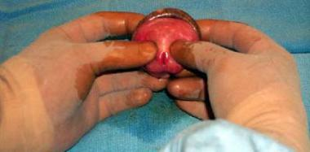
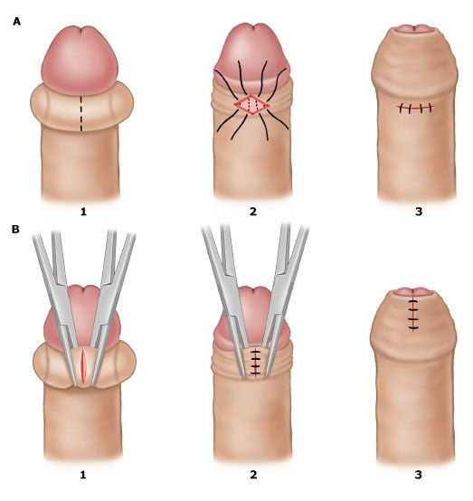
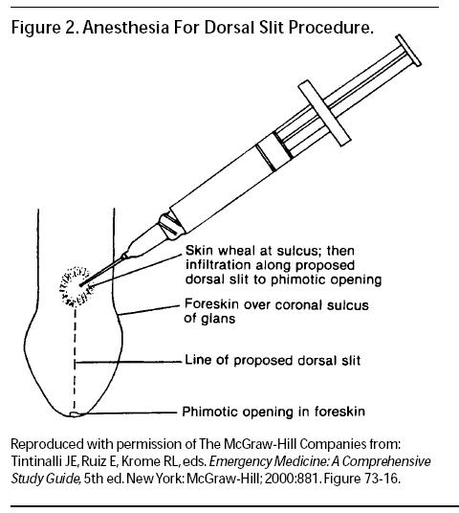
Penile Problems
Notes:
•Dorsal slit: An incision is made along the dorsal skin longitudinally for a length of 1 to 2 cm over the constriction. This will allow edema to flow past the constricting ring and decrease glans edema so that the foreskin can be returned to its normal position. Following reduction, sutures are placed transversely and perpendicular to the longitudinal incision with 4-0 rapidly absorbing suture (eg, 4-0 chromic or similar suture)
A: 1) Incision of constricting band along longitudinal axis of penis, 2) Reduction of paraphimosis and suture placement along transverse axis of penis, 3) Reduced paraphimosis with closed incision.
B: 1) Incision of constricting band of paraphimosis (also appropriate for balanoposthitis with urinary obstruction), 2) Reduction of foreskin followed by suturing of incision, 3) Reduced paraphimosis with closed incision.

Slide 23
Penile problems
Balanitis: inflammation of the glans
Posthitis: inflammation of the foreskin
Balanoposthitis: inflammation of both foreskin and glans
  All can be treated with topical antibiotics/antifungals, oral Keflex or Augmentin and warm soaks

Slide 24
Penile Problems
Priapism: prolonged, painful erection
  Most commonly seen in African American males with sickle cell disease
  Can be caused by trauma or leukemic infiltration
Treatment:
  hydration and irrigation of the corporal bodies with saline in combination with vasoactive substances (phenylephrine), in consultation with Urology

Slide 25
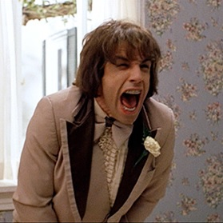
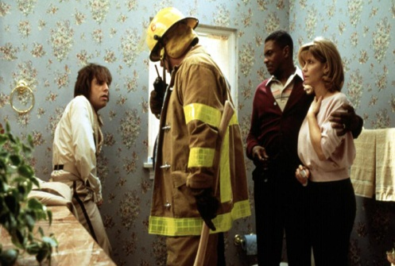
Penile Trauma
Direct Injury
  Most common is from toilet seat falling onto the penis of young boy learning to stand while voiding
  If blood is seen at urethral meatus must consider urethral injury, Urology consultation +/- retrograde urethrogram
Zipper injury
  Entrapment of penile skin or foreskin in teeth of zipper
  Can use a wire cutter to cut the median bar of the zipper, releasing the two sides
Strangulation
  Penis may be encircled by a constricting ring formed by a hair, fiber, or thread

Slide 26
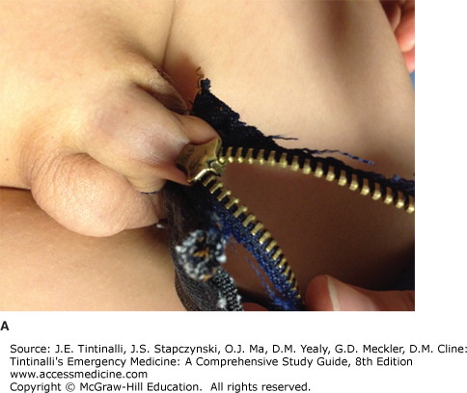
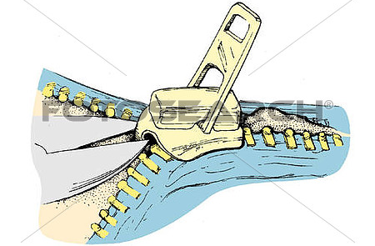
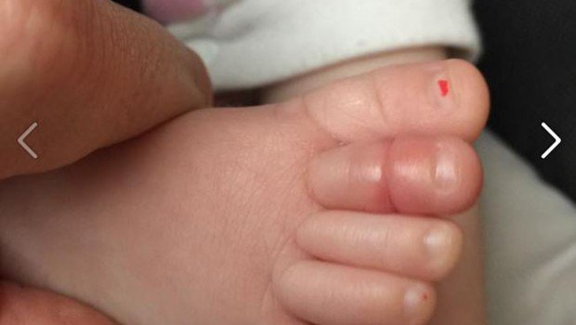
Penile Trauma

Slide 27
Testicular Problems
Testicular Torsion
  Most commonly seen in pubertal males
  acute onset of unilateral testicular pain, swelling, abnormal gait, horizontal lie to testicle, absent cremasteric reflex, nausea, and vomiting
  Any boy with abdominal pain should undergo testicle exam as abdominal pain may be only presenting symptoms
  Duration of symptoms is critical -- salvage rates >6 hours fall dramatically
  If surgeons may find a completely nonviable testis upon evaluation – orchiectomy
  If there appears to be some blood flow to the testis after detorsion and allowing time for blood flow to return, the testis will be fixed into place in the scrotum -- orchiopexy
    The contralateral side will also be fixed in place to prevent future torsion on the other side
  Symptoms beyond 48 hours almost always lead to loss of testicle

Slide 28
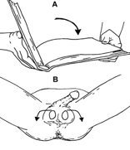
Testicular Torsion
Manual detorsion technique
  the affected testis generally is rotated inward (medially)
    left testis: hold the testicle with the right thumb and forefinger and then rotate clockwise 180 degrees
    right testicle: hold the testicle with the left thumb and forefinger and then rotate in a counterclockwise direction
    Move in direction as if opening a book
Manual detorsion is successful in 30-70% of patients and is evident by the immediate relief experienced by the patient

Slide 29
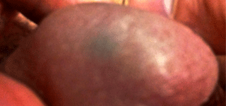
Testicular Problems
Torsion of the testicular appendage
  Appendix testis is a small vestigial structure which is a remnant of Mulleriun duct
    Prepubertal estrogen may enlarge appendix and cause torsion
    Blue dot sign may be seen on examination
  Usually seen in prepubertal males
  More mild pain, insidious in onset
  Treatment usually conservative with NSAIDs and rest

Slide 30
Testicular Problems
Epididymitis: inflammation of the epididymis
  more insidious onset, dysuria, tenderness over the epididymis, and often an abnormal U/A
  Pre-pubertal: supportive treatment unless they have an associated urinary tract infection -- Those who have pyuria, positive urine cultures, or underlying risk factors for urinary tract infection should be treated empirically with antibiotics that cover coliforms and achieve adequate levels in epididymal tissues (trimethoprim-sulfamethoxazole, cephalexin) pending culture results
  Adolescents: treat for Gonorrhea, Chlamydia with Ceftriaxone and Zithromax/doxycycline

Slide 31
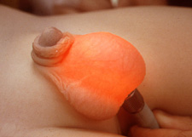
Testicular Problems
Hydrocele: fluid-filled sac surrounding a testicle that causes swelling in the scrotum
  common in newborns and usually disappears without treatment during the first year of life
  generally painless, full of fluid, and require nonurgent management
  may acutely increase in size after straining (heavy crying in an infant), and may fluctuate in size
  Trans illuminates on examination

Slide 32
Testicular Problems
Varicocele: abnormal dilations of the cremasteric and pampiniform venous plexuses surrounding the spermatic cord
  asymptomatic scrotal swelling about the time of puberty
  rare in the prepubertal male
  anatomic defect in the valves of the left spermatic vein that drains directly into the left renal vein
  If the varicocele does not disappear when the child lies down, it suggests an obstruction of the left renal vein, and a renal and bladder ultrasound is appropriate

Slide 33
Testicular Problems
Undescended testicle
  Occurs in 4% of newborn males, decreased to 1.6% by 1 year of age
  Only rarely will spontaneously descend after 6 months of age, therefore needs outpatient urology consultation
  Generally asymptomatic but abdominal testicle may undergo torsion more easily than descended testicle
  Testicular malignancy and infertility increased in male with uncorrected undescended testicle

Slide 34
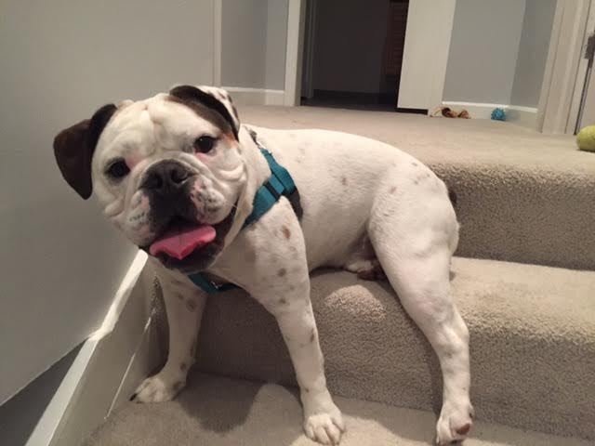
Thank You!

Slide 35


