Slide 1
PEM|COR: Cardiac arrest
Frank P. Carnevale, M.D.
Associate Program Director
Pediatric Emergency Medicine Fellowship
Women & Children’s Hospital of Buffalo
State University of New York at Buffalo
April 30, 2014

Slide 2
PEM|CoR: 2013-2014
09-18-13: Hypovolemic & Distributive Shock
10-30-13: Cardiogenic & Obstructive Shock
11-13-13: Tachycardia
01-29-14: Bradycardia
02-12-14: Fever Work-up
03-19-14: ATLS & RSI Issues
04-30-14: Cardiac Arrest
06-04-14: Neonatal Resuscitation

Slide 3
First: The Secret Behind QE II’s Longevity

Slide 4
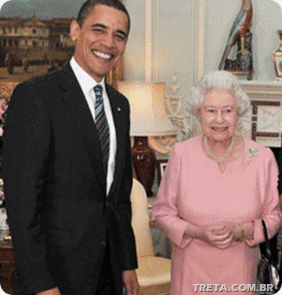

Slide 5
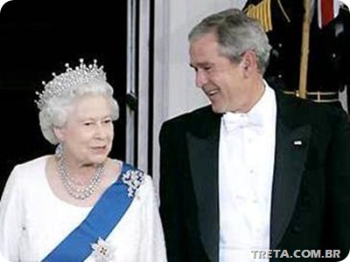

Slide 6
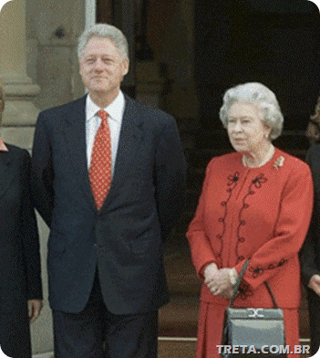

Slide 7
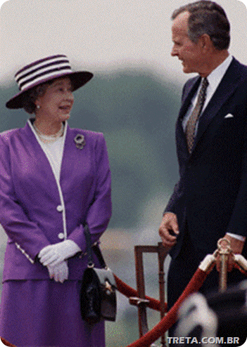

Slide 8
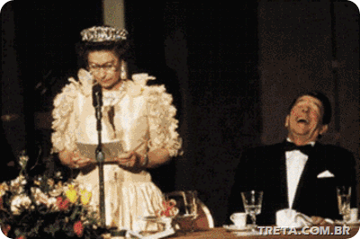

Slide 9
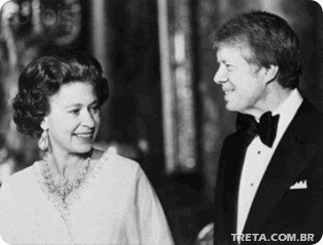

Slide 10
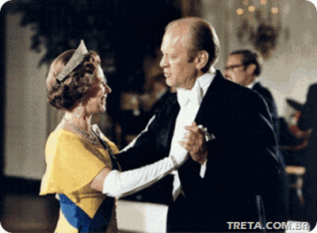

Slide 11
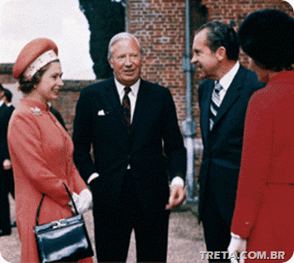

Slide 12


Slide 13
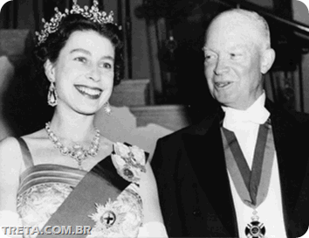

Slide 14
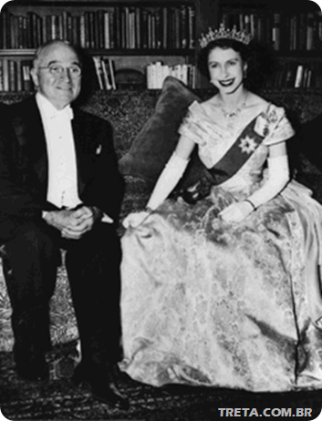

Slide 15
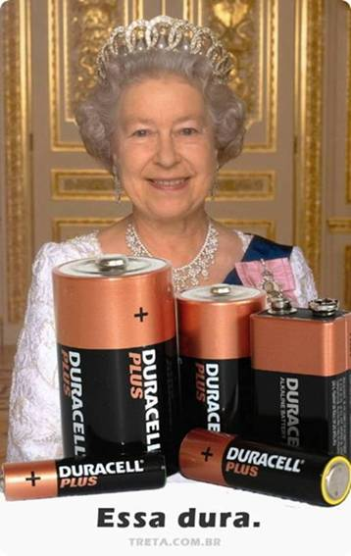

Slide 16
Learning Objectives
Define cardiac arrest and describe pathways to arrest along with survival rates
Review the basics of common arrest rhythms, CPR, and defibrillation
Describe the PALS cardiac arrest algorithm, understanding the importance of family presence and post-arrest management

Slide 17
Learning Objectives
Define cardiac arrest and describe pathways to arrest along with survival rates
Review the basics of common arrest rhythms, CPR, and defibrillation
Describe the PALS cardiac arrest algorithm, understanding the importance of family presence and post-arrest management

Slide 18
Cardiac Arrest Definition
The cessation of blood circulation resulting from absent or ineffective cardiac mechanical activity
Clinically, the child is unresponsive and not breathing or only gasping
There is no palpable pulse

Slide 19
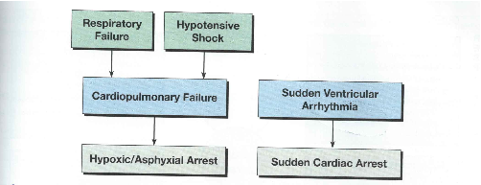

Slide 20
Higher survival rates of arrests in-hospital vs. out of hospital
True
False
15

Slide 21
Higher survival rates when the presenting rhythm is shockable
True
False
15

Slide 22
Lowest survival occurs when there is brady, poor perfusion, and CPR begun before PEA
True
False
15

Slide 23
Survival Rates
Higher if arrest occurs in hospital (~30%) compared with out of hospital (~10%)
Higher (~30%) when the presenting rhythm is shockable compared with non-shockable (~15%)
In hospitalized children, however, when VF/VT develops as a secondary rhythm during resuscitation (~25% of the time), survival is lower (~10%) than in those children who do not develop VF/VT as a secondary rhythm (~25%)
Highest survival rate (64%) occurs when there is bradycardia and poor perfusion and CPR is begun before pulseless arrest develops

Slide 24
Learning Objectives
Define cardiac arrest and describe pathways to arrest along with survival rates
Review the basics of common arrest rhythms, CPR, and defibrillation
Describe the PALS cardiac arrest algorithm, understanding the importance of family presence and post-arrest management

Slide 25
Arrest Rhythms
Aystole
Pulseless electrical activity (PEA)
  Not a specific rhythm, it’s a term describing any organized electrical activity (other than VF, VT, or asystole) on a cardiac monitor that is associated with no palpable pulses
VF
Pulseless VT, including torsades de pointes
Asystole and PEA are the most common initial rhythms in pediatric cardiac arrests

Slide 26
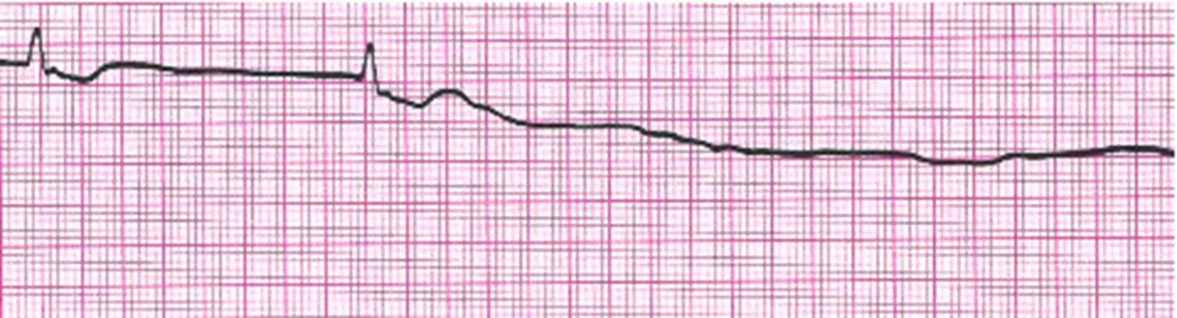
Heart Block
V Tach
Agonal ventricular then asystole
Torsades
20

Slide 27
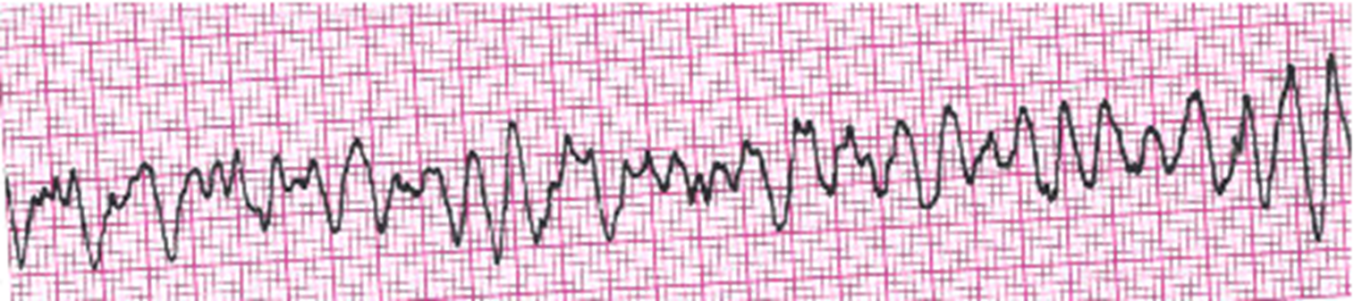
Enter Question Text
V Tach
V Fib
Torsades
SVT
Sinus Tachycardia
20

Slide 28

Enter Question Text
Asystole
Mobitz Type II
Fine V Fib
First degree heart block
20

Slide 30
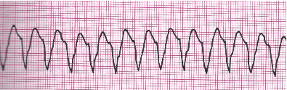
Enter Question Text
SVT
V Fib
Torsades
V Tach
20

Slide 31
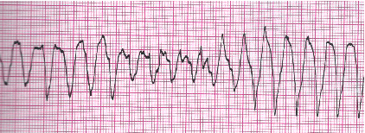
Enter Question Text
V Fib (Fine)
V Fib (Coarse)
Torsades
SVT
20

Slide 32
What is the CPR compression rate per minute for all ages?
At least 70
At least 80
At least 90
At least 100
15

Slide 33
Choose the correct statements of compression:ventilation ratios
Adult 2 rescuer: 30:2
Child 2 rescuer: 15:2
Infant 2 rescuer: 15:2
B & C only
All of the above
20

Slide 34
How many compressions to ventilations when you have an advanced airway in place?
Depends on the physical fitness of your staff
Trick question: there is no ratio for this situation—at least 100 cpm and 10 bpm
15

Slide 35
CPR Key Points
Q: Compression Rate for all ages?
A: at least 100/min
Q: C:V Ratio until advanced airway?
A: 30:2 for all scenarios except 2 rescuer infant and children where it is 15:2
Q: C:V Ratio with advanced airway?
A: at least 100 compressions and 10 breaths / min

Slide 36
Defibrillation Take Home Points
A defibrillation shock “stuns” the heart by depolarizing a critical mass of the myocardium
This allows the heart’s natural pacemaker cells to resume an organized rhythm
Provide compressions until the defibrillator is charged, deliver 1 shock, and immediately resume CPR. Compressions are needed to maintain blood flow to the heart and brain until contractility resumes
There is no evidence that compressions in a child with ROSC is harmful
Monophasic is like DC; Biphasic is like AC
Q: Cut-off for large vs. small paddles?
A: 10 kg or 1 year of age
Pitfall: After any type of shock, the default returns to defibrillation (“unsync”) mode

Slide 37
Learning Objectives
Define cardiac arrest and describe pathways to arrest along with survival rates
Review the basics of common arrest rhythms, CPR, and defibrillation
Describe the PALS cardiac arrest algorithm, understanding the importance of family presence and post-arrest management

Slide 38
Cardiac Arrest Medications
IO is 1st line in the non-accessed arrest patient
Catecholamines:
  Epi: 0.01 mg/kg (0.1 cc/kg bolus) of 1:10,000; repeat every 4 minutes (after every other rhythm check); not suggested after the first shock because it may not be necessary and, if initial VF/VT was related to cardiomyopathy, myocarditis, or drug toxicity, could induce recurrent VF/VT
Antiarrhythmics:
  Amiodarone: use for shock-refractory VF/VT; 5mg/kg bolus (max single dose 300mg); repeat up to 2 more times for total of 15mg/kg
  Lidocaine: if no amiodarone; 1mg/kg
  Mag: for torsades 25-50mg/kg; max 2g

Slide 39
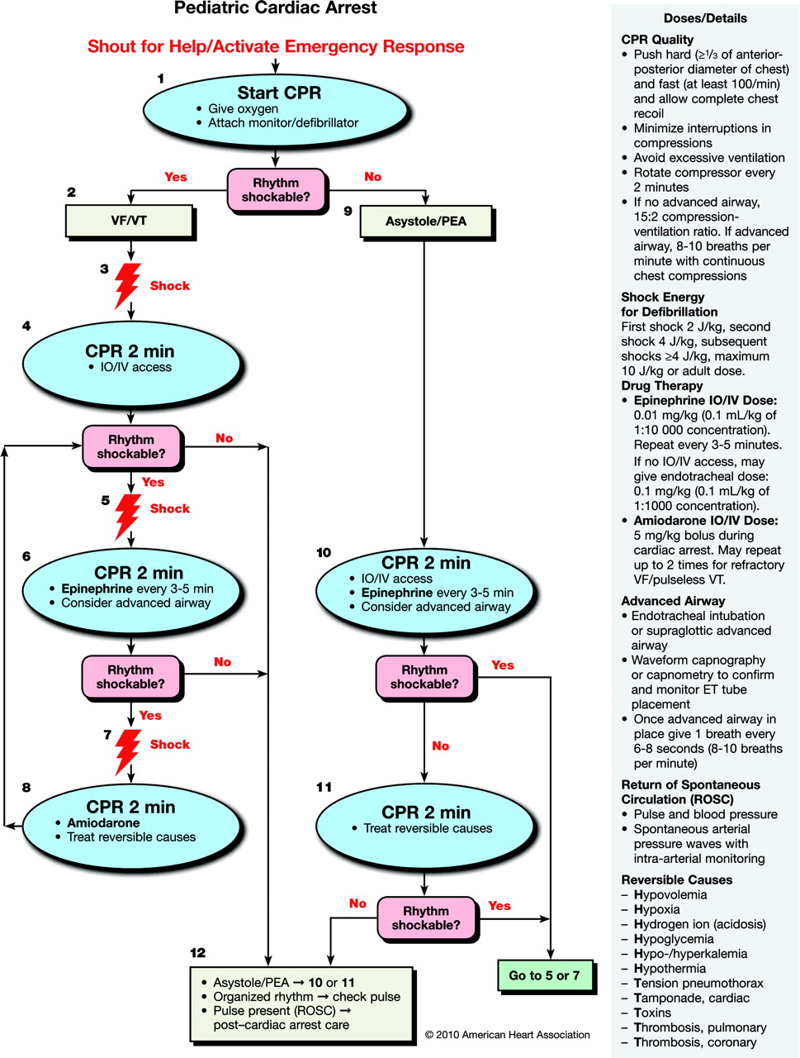

Slide 40
Family Presence
Studies have shown that most family members would like to be present during the attempted resuscitation of a loved one.
Family members may be reluctant to ask
We should consider offering the opportunity whenever possible
Family members may experience less anxiety and depression and more constructive grief behaviors if they are present during resuscitative efforts
Assign a team member to liaison with the family
Be mindful of family members’ presence as we communicate with each other

Slide 41
Post-Arrest Management
Early involvement of transport team
Consider re-sedation/paralysis
Continue to address H’s and T’s
Oxygen: titrate to maintain sats 94%-99%
Hypotensive Shock: Epi 0.3-1 mcg/kg/min
Normotensive Shock: Epi 0.1-0.3 mcg/kg/min
Ventilator settings:
  TV: 6-8 cc/kg
  I-time: 0.5-1 sec
  PIP: 20-30 cm H2O; lowest level allowing expansion
  RR: Infants (45); Children (30); Adolescents (15)
  PEEP: 3-5 cm H2O

Slide 42
Learning Objectives
Define cardiac arrest and describe pathways to arrest along with survival rates
Review the basics of common arrest rhythms, CPR, and defibrillation
Describe the PALS cardiac arrest algorithm, understanding the importance of family presence and post-arrest management

Slide 43
Let’s practice some scenarios with the PEM Fellows
Station #1: Huma
Station #2: Tara
Station #3: Jen
Station #4: Danielle
Station #5: Jeremy (hallway)
Station #6: Meghan (hallway)

