Slide 1
PEM|COR: Cardiogenic & obstructive Shock
Frank P. Carnevale, M.D.
Department of Pediatrics
Division of Pediatric Emergency Medicine
State University of New York at Buffalo
October 30, 2013

Slide 2
PEM|CoR: 2013-2014
09-18-13: Hypovolemic & Distributive Shock
10-30-13: Cardiogenic & Obstructive Shock
11-13-13: Tachycardia
01-29-14: Bradycardia
02-12-14: Fever Work-up
03-19-14: ATLS & RSI Issues
04-30-14: Cardiac Arrest
05-07-14: Neonatal Resuscitation

Slide 3
First, because it’s Halloween…
http://youtu.be/_YQpbzQ6gzs

Slide 4
Learning Objectives
Define shock and describe the 4 basic types of shock
Describe compensated (early) shock
Describe hypotensive (late) shock
Describe how to recognize & treat Cardiogenic Shock
Describe how to recognize & treat Obstructive Shock

Slide 5
Learning Objectives
Define shock and describe the 4 basic types of shock
Describe compensated (early) shock
Describe hypotensive (late) shock
Describe how to recognize & treat Cardiogenic Shock
Describe how to recognize & treat Obstructive Shock

Slide 6
What is the definition of shock?
The reaction of disbelief and horror when I see my shift schedule for the month
The reaction of the children to the news that their parents ate their Halloween candy
Inadequate delivery of oxygen and nutrients to meet tissue metabolic demands
:01

Slide 7
Shock is _____________________ characterized by inadequate peripheral perfusion
Always
Often
Never
:01

Slide 8
You need to be hypotensive in order to be in shock
True
False
:01

Slide 9
What are the 4 types of shock?
Hypovolemic, Anaphylactic, Septic, & Cardiogenic
Hypovolemic, Neurogenic, Cardiogenic, & Obstructive
Hypovolemic, Traumatic, Distributive, & Cardiogenic
Hypovolemic, Distributive, Cardiogenic & Obstructive
Hemorrhagic, Non-hemorrhagic, Septic, & Cardiogenic
:01

Slide 10
What are the forms of Hypovolemic Shock?
Traumatic & Non-traumatic
Infectious & Non-infectious
Hemorrhagic & Non-hemorrhagic
Vomiting & Non-vomiting
Febrile & Non-febrile
:01

Slide 11
What are the forms of Distributive Shock?
Hemorrhagic, Septic & Anaphylactic
Anaphylactic, Septic, & Neurogenic
Neurogenic, Septic, & Traumatic
Cardiogenic, Obstructive, & Septic
Neurogenic, Septic, & Traumatic
:01

Slide 12
The Correct Shock-Cause pairing:
Cardiogenic-Inadequate blood volume
Obstructive-Impaired cardiac contractility
Distributive-Inappropriate distribution of blood
Obstructive-Inadequate volume of blood
:01

Slide 13
Take-Home Points
Shock Definition: Inadequate tissue delivery of oxygen and nutrients to meet tissue metabolic demands
Often (but not always) characterized by inadequate peripheral perfusion
The definition does NOT depend on BP
4 Types of Shock: Hypovolemic, Distributive, Cardiogenic, & Obstructive
Shock can result from 1 or more of the below:
  Inadequate blood volume (Hypovolemic Shock)
  Inappropriate distribution of blood volume & flow (Distributive Shock)
  Impaired cardiac contractility (Cardiogenic Shock)
  Obstructed blood flow (Obstructive Shock)

Slide 14
Key Concept
The earlier you correctly recognize shock, determine the type, and start appropriate therapy, the better the child’s chance for a good outcome

Slide 15
What is the IVFP of choice for resuscitation in pediatrics?
20 cc/kg NS
20 cc/kg D5LR
10 cc/kg D10LR
20 cc/kg ½ NS
10 cc/kg NS
:01

Slide 16
Blood boluses repeatedly administered in hemorrhagic hypovolemic shock?
5cc/kg PRBC
10cc/kg PRBC
15cc/kg PRBC
20cc/kg PRBC
:01

Slide 17
Treatment for non-hemorrhagic hypovolemic shock?
Blood-fluid-fluid
Blood-blood-fluid
Blood x 3
Fluid x 3
:01

Slide 18
Treatment for hemorrhagic hypovolemic shock?
Blood-blood-blood-fluid
Blood-fluid-blood-fluid
Fluid-fluid-fluid-blood
Fluid-blood-blood-fluid
:01

Slide 19
What is the most important drug in treating anaphylaxis?
Saline
Epi
Albuterol
Steroids
Benadryl
:01

Slide 20
What is the hallmark of neurogenic shock
Tachypnea despite hypoxia
Tachycardia despite hypoxia
Tachycardia despite hypotension
Bradycardia despite hypotension
:01

Slide 21
What is now emphasized as the clinical priority in septic shock?
Airway
Breathing
Circulation
Disability
:01

Slide 22
Learning Objectives
Define shock and describe the 4 basic types of shock
Describe compensated (early) shock
Describe hypotensive (late) shock
Describe how to recognize & treat Cardiogenic Shock
Describe how to recognize & treat Obstructive Shock

Slide 23
Compensated Shock
When systolic BP is within the normal range but there are signs of inadequate tissue perfusion
Signs: tachypnea, tachycardia, delayed capillary refill, cool extremities, mottled skin, weak or absent peripheral pulses, vomiting
These signs are due to the body’s attempt to shunt blood away from the non-vital organs (skin & gut) to the vital organs (brain & heart)

Slide 24
Learning Objectives
Define shock and describe the 4 basic types of shock
Describe compensated (early) shock
Describe hypotensive (late) shock
Describe how to recognize & treat Cardiogenic Shock
Describe how to recognize & treat Obstructive Shock

Slide 25
Hypotension is required to be in hypotensive shock
True
False
:01

Slide 26
Hypotensive Shock
When the body can no longer maintain SBP and perfusion; vital organs (heart & brain) are affected causing hypotension and AMS
Cliff bar question: name the SBP cut-off criteria for hypotension in the 4 pediatric age groups
SBP hypotension criteria:
  Neonate (0-1mo): < 60
  Infant (1mo-1yr): < 70
  Child (1yr-10yr): < 70 + [Age(yrs) x 2]
  Adolescent (>10yr): < 90

Slide 27
Some Key Take-Home Points
Due to their robust compensatory mechanisms, children may be critically ill with shock despite an adequate systolic BP and normal mentation
Our expertise in EM: recognize compensated (early) shock and appropriately and rapidly intervene before it progresses to hypotensive (late) shock to cardiopulmonary failure and cardiac arrest

Slide 28
Learning Objectives
Define shock and describe the 4 basic types of shock
Describe compensated (early) shock
Describe hypotensive (late) shock
Describe how to recognize & treat Cardiogenic Shock
Describe how to recognize & treat Obstructive Shock

Slide 29
Cardiogenic Shock
Results from inadequate tissue perfusion secondary to myocardial dysfunction
2 categories of causes…
Arrhythmias
Cardiomyopathies (congenital heart disease, inflammation, sepsis, poisoning, trauma)

Slide 30
Cardiogenic Shock: Recognition
Primary Assessment | Finding
A | Typically patent unless LOC impaired
B | Tachypnea with increased respiratory effort (grunting, nasal flaring, retractions) from pulm. edema
C | Tachycardia, dec. pulses, delay cap ref.
 | Nml BP or hypotensive, Narrow PP
 | Signs of CHF (pulmonary edema, hepatomegaly, JVD)
 | Cyanosis (causes: cyanotic congenital heart disease or pulmonary edema)
 | Changes in LOC
 | Oliguria; cool pale diaphoretic skin
D | Changes in LOC
E | Extremities cooler than trunk

Slide 31
How do you distinguish cardiogenic shock from hypovolemic shock?
Bradypnea
Tachypnea
Work of breathing
Tachycardia
Bradycardia
:01

Slide 32
Cardiogenic Shock:
Management Specifics
Give 10 ml/kg NS slowly over 20 min; assess frequently for pulm edema; may repeat boluses
Administer supplementary O₂ and consider need for noninvasive positive pressure or mechanical ventilation (aka: early intubation)
Early PICU and Pediatric Cardio consultation
Administer pharmacologic support
  Antipyretics, analgesics, and sedatives
  Inodilator (milrinone) or Dobutamine

Slide 33
Learning Objectives
Define shock and describe the 4 basic types of shock
Describe compensated (early) shock
Describe hypotensive (late) shock
Describe how to recognize & treat Cardiogenic Shock
Describe how to recognize & treat Obstructive Shock

Slide 34
Obstructive Shock
Cardiac output is impaired by a physical obstruction of blood flow

Slide 35
Which is NOT a cause of obstructive shock?
Sepsis
PE
Tension pneumothorax
Cardiac tamponade
Ductal-dependant cardiac lesion
:01

Slide 36
Cardiac Tamponade:
Recognition
Primary Assessment | Finding
A | Patent unless LOC impaired
B | Respiratory distress (inc. rate & effort)
C | Tachycardia
 | Poor peripheral perfusion
 | Muffled or diminished heart sounds; If suspected, use ultrasound to see fluid!
 | Narrowed pulse pressure
 | Pulsus paradoxus
 | Distended neck veins
D | Changes in LOC
E | Extremities cooler than trunk

Slide 37
Tension Pneumothorax: Recognition
Primary Assessment | Finding
A | Tracheal deviation toward contralateral side
B | Tachypnea with increased respiratory effort
 | Hyperresonance and hyperexpansion of affected side
 | Diminshed breath sounds on affected side
C | Distended neck veins
 | Pulsus paradoxus
 | Rapid deterioration in perfusion; commonly, rapid evolution from tachy to brady to hypotension and arrest with PEA
D | Changes in LOC
E | Extremities cooler than trunk

Slide 38
Ductal-Dependent Lesions
Two types:
  Cyanotic congenital heart lesions (ductal dependent for pulmonary blood flow); present with cyanosis (that is unresponsive to oxygen) rather than shock—TOF, TAT, TOGV, TAPVR
  Left ventricular outflow obstructive lesions (ductal dependent for systemic blood flow); present with shock—COA, IAA, CAS, HLHS
Present in the first days to weeks of life

Slide 39
LV Outflow Obstructive Lesion: Recognition
Primary Assessment | Finding
A | Patent unless LOC impaired
B | Respiratory failure; signs of pulmonary edema
C | Rapid progressive deterioration in systemic perfusion
 | CHF (cardiomegaly, hepatomegaly)
 | Higher preductal vs. postdutctal BP & sats (COA, IAA)
 | Absence of femoral pulses (COA, IAA)
 | Metabolic acidosis (elevated lactate)
D | Rapid deterioration in LOC
E | Cool skin

Slide 40
Pulmonary Embolism
Rare in pediatrics
Children at increased risk: central lines, sickle cell disease, malignancy, connective tissue disorders, pregnancy, and coagulation disorders

Slide 41
Pulmonary Embolism: Recognition
Primary Assessment | Finding
A | Patent unless LOC impaired
B | Respiratory distress with increased rate/effort
C | Tachycardia
 | Cyanosis
 | Hypotension
 | Systemic venous congestion/right heart failure
 | Chest pain
D | Changes in LOC
E | Extremities may be cooler than trunk

Slide 42
Obstructive Shock:
Specific Management
Cardiac Tamponade:
  Consultation of PICU, Peds Cardio, Peds Surgery
  Emergency Pericardiocentesis if impending or actual pulseless arrest
Tension Pneumothorax:
  Immediate needle decompression followed by thoracostomy for chest tube placement ASAP
  Board Exam Pitfall: Do not wait for CXR!
Ductal-Dependent Lesions:
  Intubate first (PGE₁ causes apnea) and give prostaglandin E₁ to restore ductal patency
  Inotropic agent to improve contractility
Pulmonary Embolism:
  CTA of chest
  Consider fibrinolytics (rtPA), anticoagulants (heparin, etc.)

Slide 43
What is the correct problem-initial management pair?
Cardaic tamponade-pericardiocentesis
Tension Pneumothorax-tube thoracostomy
Ductal dependant lesion-inodilator
:01

Slide 44
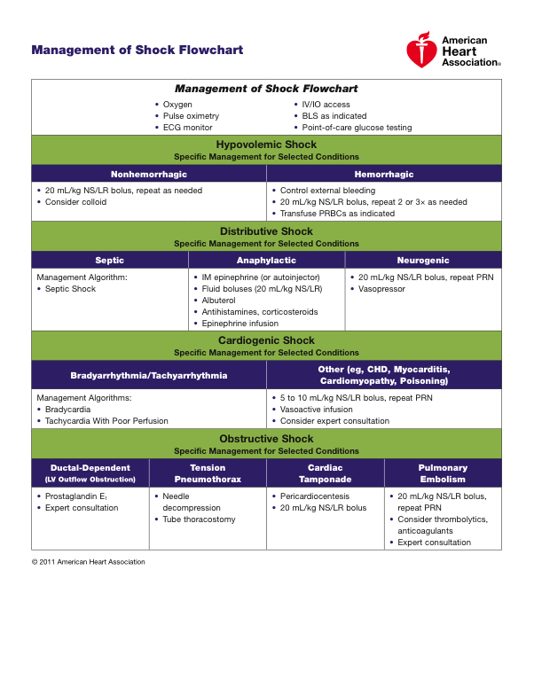

Slide 46
Learning Objectives
Define shock and describe the 4 basic types of shock
Describe compensated (early) shock
Describe hypotensive (late) shock
Describe how to recognize & treat Cardiogenic Shock
Describe how to recognize & treat Obstructive Shock

Slide 47
Let’s practice some scenarios with the PEM Fellows
Station #1: Huma
Station #2: Jeremy
Station #3: Danielle
Station #4: Meghan
Station #5: Tara
Station #6: Jen

