Slide 1
PEM|CoR
Pediatric Emergency Medicine Core Review
An educational program for EM residents & PEM Fellows consisting of core didactic lecture topics and practice scenarios
Yearly repeating cycle
Occurs most months on a Wednesday at BGH auditorium from 9:30A-11:30A
9:30A-10:30A: didactic presentation
10:30A-11:30A: PEM Fellows will lead the practice scenarios

Slide 2
PEM|CoR: 2013-2014
09-18-13: Hypovolemic & Distributive Shock
10-30-13: Cardiogenic & Obstructive Shock
11-13-13: Tachycardia
01-29-14: Bradycardia
02-12-14: Fever Work-up
03-19-14: Pediatric ATLS & RSI Issues
04-30-14: Cardiac Arrest
05-07-14: Neonatal Resuscitation

Slide 3
PEM|COR: Hypovolemic & Distributive Shock
Frank P. Carnevale, M.D.
Department of Pediatrics
Division of Pediatric Emergency Medicine
State University of New York at Buffalo
September 18, 2013

Slide 4
Learning Objectives
Define shock and describe the 4 basic types of shock
Describe compensated (early) shock
Describe hypotensive (late) shock
Describe how to recognize & treat Hypovolemic Shock
Describe how to recognize & treat Distributive Shock

Slide 5
First, it’s all about priorities…
http://youtu.be/YHYn0u_H0BM

Slide 6
Learning Objectives
Define shock and describe the 4 basic types of shock
Describe compensated (early) shock
Describe hypotensive (late) shock
Describe how to recognize & treat Hypovolemic Shock
Describe how to recognize & treat Distributive Shock

Slide 7
Definition of Shock
Inadequate tissue delivery of oxygen and nutrients to meet tissue metabolic demands
Often (but not always) characterized by inadequate peripheral perfusion
The definition does NOT depend on BP
Cliff Bar Question: name the 4 main types of shock
Shock can result from 1 or more of the below:
  Inadequate blood volume (Hypovolemic Shock)
  Inappropriate distribution of blood volume & flow (Distributive Shock)
  Impaired cardiac contractility (Cardiogenic Shock)
  Obstructed blood flow (Obstructive Shock)

Slide 8
Key Concept
The earlier you correctly recognize shock, determine the type, and start appropriate therapy, the better the child’s chance for a good outcome

Slide 9
Learning Objectives
Define shock and describe the 4 basic types of shock
Describe compensated (early) shock
Describe hypotensive (late) shock
Describe how to recognize & treat Hypovolemic Shock
Describe how to recognize & treat Distributive Shock

Slide 10
Compensated Shock
When systolic BP is within the normal range but there are signs of inadequate tissue perfusion
These early signs are due to the body’s compensatory mechanisms and are clues to the presence of shock:
Hypothermic, tachycardia, weak pulses, narrow pulse pressure, tachypnea, delayed capillary refill, cool, pale, mottled extremities, oliguria, vomiting

Slide 11
Learning Objectives
Define shock and describe the 4 basic types of shock
Describe compensated (early) shock
Describe hypotensive (late) shock
Describe how to recognize & treat Hypovolemic Shock
Describe how to recognize & treat Distributive Shock

Slide 12
Hypotensive Shock
When the body can no longer maintain SBP and perfusion
Cliff Bar Question: name the SBP cutoffs for hypotension in a neonate, infant, child, and adolescent (adult).
SBP Hypotension criteria:
  Neonate (0-1mo): < 60
  Infant (1mo-1yr): < 70
  Child (1yr-10yr): < 70 + [Age(yrs) x 2]
  Adolescent (>10yr): < 90

Slide 13
Late Signs of Shock
Hypotension is a late finding in most types of shock and signals impending cardiac arrest
Deterioration in level of consciousness as brain perfusion declines
Note: this is an accelerating process—it may take hours for compensated shock to progress to hypotensive shock but only minutes for hypotensive shock to progress to cardiopulmonary failure and cardiac arrest

Slide 14
Some Key Take-Home Points
Due to their robust compensatory mechanisms, children may be critically ill with shock despite an adequate systolic BP and normal mentation
What we need to do: recognize compensated (early) shock and appropriately and rapidly intervene before it progresses to hypotensive (late) shock to cardiopulmonary failure and cardiac arrest

Slide 15
Learning Objectives
Define shock and describe the 4 basic types of shock
Describe compensated (early) shock
Describe hypotensive (late) shock
Describe how to recognize & treat Hypovolemic Shock
Describe how to recognize & treat Distributive Shock

Slide 16
Hypovolemic Shock
Most common cause of shock in children
Two Forms: Nonhemorrhagic & Hemorrhagic
Dec. preload leads to reduced SV and dec. CO
Intravascular volume loss can be from:
  Diarrhea and/or Vomiting
  Hemorrhage (internal and external)
  Inadequate fluid intake
  Osmotic diuresis (i.e. DKA)
  Third-space losses (fluid leak into tissues)
  Large burns

Slide 17
Recognize Hypovolemic Shock
History of volume loss with…
Increasing tachycardia
Diminishing or absent peripheral pulses
Weakening central pulses
Narrowing pulse pressure
Colder extremities with prolonged cap. refill
Decreasing level of consciousness
Hypotension
Note: this may require a calm yet authoritative redeployment of resources

Slide 18
Treatment of Hypovolemic Shock
Oxygen, Pulse oximetry, ECG monitor, IV/IO access, BLS as indicated, POC glucose
NS 20cc/kg bolus over 5-10min, repeat prn
Pitfall: delaying or slow administration of IVF
Pitfall: if compensated shock is due to DKA, give NS 20cc/kg over one hour

Slide 19
Treatment of Hypovolemic Shock: Summary
Non-hemorrhagic:
  Fluids (IVFP of 20 cc/kg NS)
  Fluids
  Fluids
Hemorrhagic:
  Stop the Bleeding
  Fluids
  Fluids
  Fluids
  Blood (10 cc/kg PRBC’s; repeat if needed)

Slide 20
Learning Objectives
Define shock and describe the 4 basic types of shock
Describe compensated (early) shock
Describe hypotensive (late) shock
Describe how to recognize & treat Hypovolemic Shock
Describe how to recognize & treat Distributive Shock

Slide 21
Forms of Distributive Shock
Cliff Bar Question: Name the 3 forms of Distributive Shock
Septic Shock (most common form)
Anaphylactic Shock
Neurogenic Shock

Slide 22
Septic Shock
Pathophysiology: Toxins 1) reduce SVR resulting in maldistribution of blood flow (warm shock) and a relative hypovolemia; 2) inc. capillary permeability causing loss of plasma from vascular space; 3) dec. myocardial contractility; then SVR increases from normal compensatory mechanisms (cold shock)
May have history of infection, WBC high or low, temperature high or low

Slide 23
Findings Consistent with Septic Shock
Primary Assessment | Finding
A | Typically patent unless LOC impaired
B | Tachypnea without increased effort
C | Tachycardia
 | Nml BP or hypotensive
 | Oliguria
 | Changes in LOC
cold shock | Delayed capillary refill
 | Cool, pale, mottled, diaphoretic skin
 | Narrowed PP
warm shock | Bounding pulses, brisk cap refill
 | Widened PP, warm flushed skin
D | Changes in LOC
E | Cool/warm extrem.; petech. purpura

Slide 24
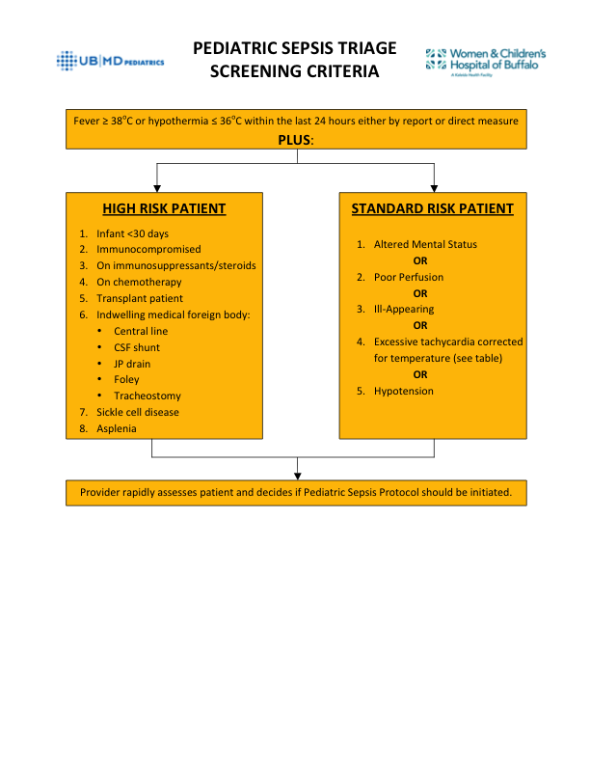

Slide 25
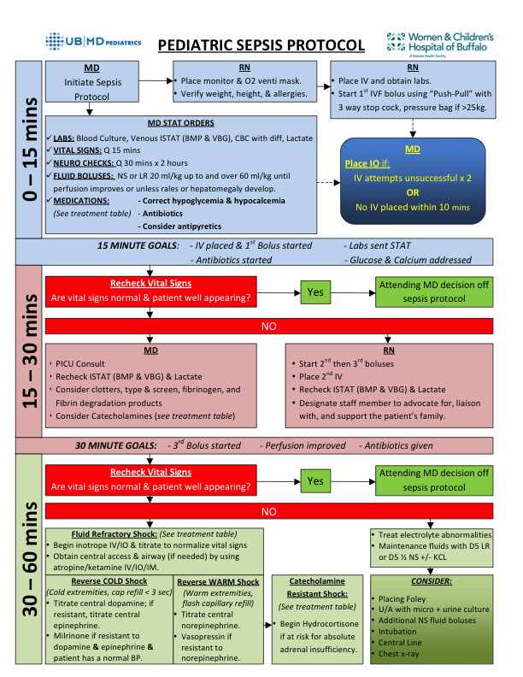

Slide 26
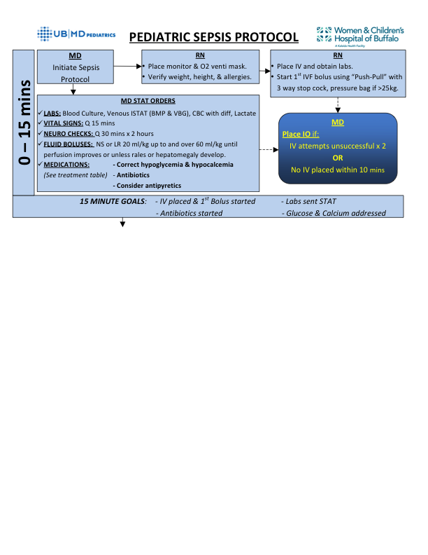

Slide 27
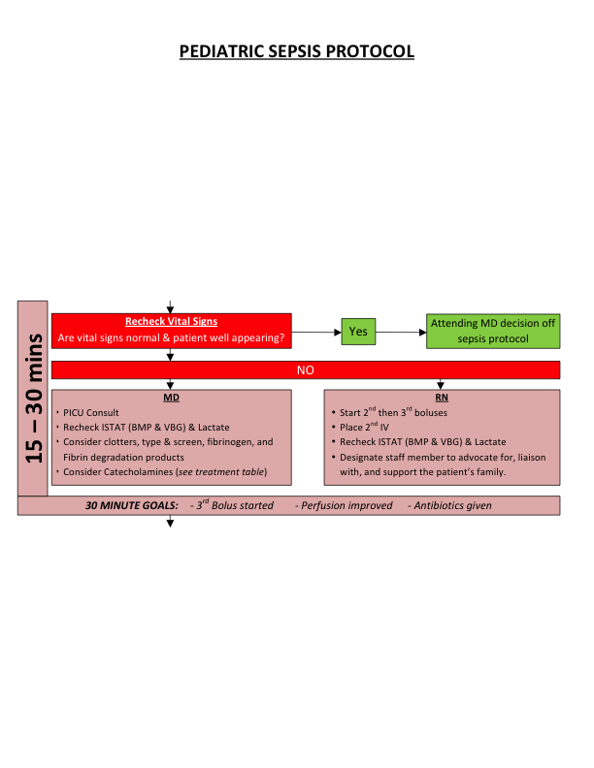

Slide 28
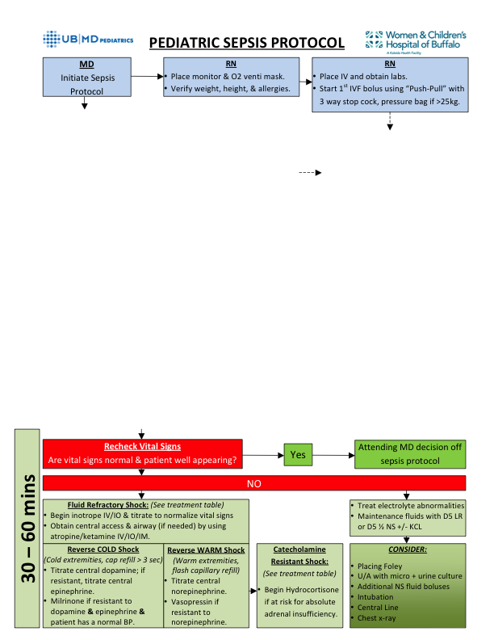

Slide 29
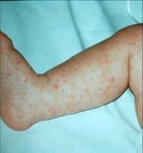

Slide 30
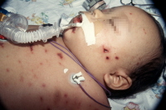

Slide 31
Anaphylactic Shock
Acute multisystem allergic response caused by a severe reaction to an antigen
Characterized by anxiety/agitation, vasodilation, increased capillary permeability, angioedema, pulmonary constriction, wheezing/stridor, urticaria, nausea/vomiting, and circulatory collapse

Slide 32


Slide 33
Initial Management of Anaphylactic Shock
A,B,C’s
Note: angioedema may quickly result in complete upper airway obstruction, so anticipate the need for early advanced airway
Most important drug: Epi (1:1000) 0.01mg/kg IM to maximum dose of 0.5mg/dose
That is the life-saving drug—don’t delay!
A 2nd dose or an epi drip may be needed after 10 minutes if hypotensive or severe symptoms

Slide 34
After your ABC’s and Epi, what do you think about next?
All the rest is gravy…
Albuterol, racemic epi neb
Antihistamines
  H1 blocker (diphenhydramine)
  H2 blocker (ranitidine or famotidine)
Steroids—IV Solumedrol
If you only needed one epi IM dose, observe for 2 hours, and if asymptomatic, may discharge patient—admit everyone else.

Slide 35
Neurogenic Shock
Results from a cervical or upper thoracic (above T6) injury that disrupts the sympathetic nervous system innervation of blood vessels and the heart
Causes uncontrolled vasodilation and prevents the development of tachycardia as a compensatory mechanism
Primary Signs: hypotension with a wide PP along with a normal HR or bradycardia
Other signs: increased RR with diaphragmatic breathing and motor/sensory deficits

Slide 36
Management of Neurogenic Shock
ABC’s with attention to C-Spine precautions
Position the child flat or head-down to improve venous return
Administer a trial of IV NS and assess response
For fluid-refractory hypotension, use vasopressors (phenylephrine or NE)
Provide supplementary warming or cooling as needed as these patients are more sensitive to temperature variations.

Slide 37
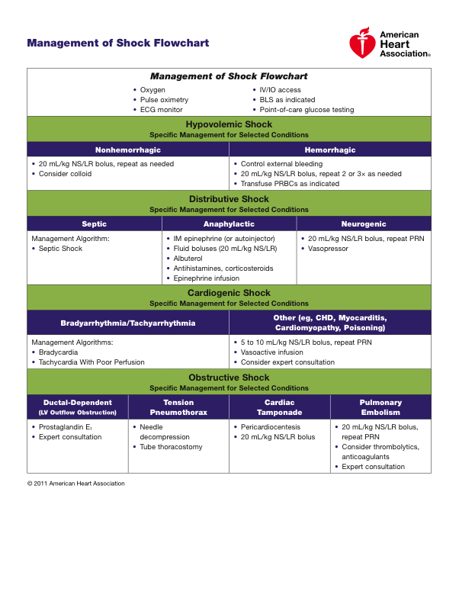

Slide 38
Let’s practice some scenarios with the PEM Fellows
Station #1: Danielle
Station #2: Meghan
Station #3: Jeremy
Station #4: Huma
Station #5: Jen
Station #6: Tara

