Slide 1

American Academy of Sleep Medicine
The following product has been
developed by the
American Academy of Sleep Medicine
Copyright © 2003 American Academy of Sleep Medicine
One Westbrook Corporate Center, Ste. 920, Westchester, IL 60154
Telephone: (708) 492-0930 Fax: (708) 492-0943
Visit Us at www.aasmnet.org
© American Academy of Sleep Medicine

Slide 2
American Academy of Sleep Medicine
Learning Objectives
1. List factors that put you at risk for sleepiness and
fatigue.
2. Describe the impact of sleep loss on residents’
personal and professional lives.
3. Recognize signs of sleepiness and fatigue in
yourself and others.
4. Challenge common misconceptions among
physicians about sleep and sleep loss.
5. Adapt alertness management tools and strategies
for yourself and your program.
© American Academy of Sleep Medicine

Slide 3

American Academy of Sleep Medicine
The Scope of the Problem
“… I always had a prior theory that when you look up all the old sixties research how do you brainwash someone? You sleep deprive them. That’s number, two, and three. Sleep deprive them. You feed them bad food and you repeat things over and over again. It’s like that kind of covers residency.”
© American Academy of Sleep Medicine

Slide 4
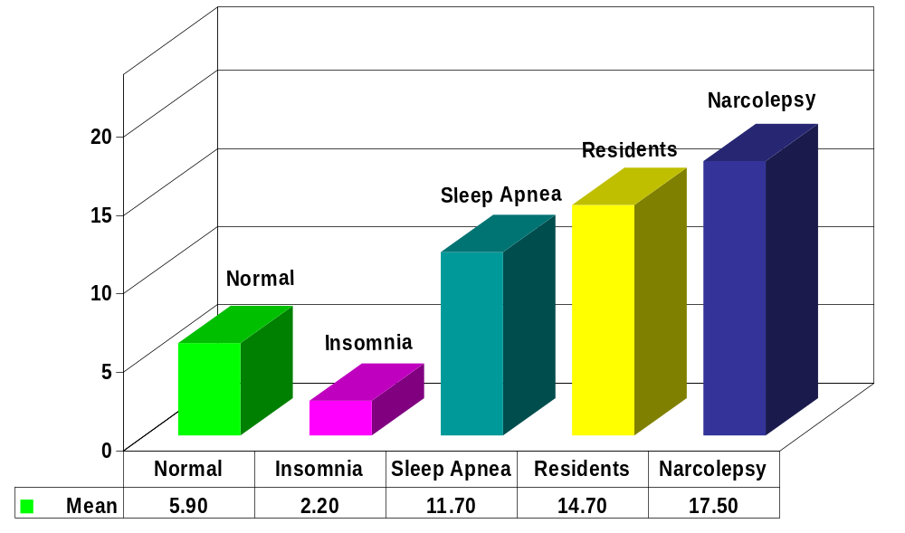
American Academy of Sleep Medicine
Epworth Sleepiness Scale
Sleepiness in residents is equivalent to that found in patients
with serious sleep disorders. Mustafa and Strohl, unpublished data. Papp, 2002
© American Academy of Sleep Medicine

Slide 5
American Academy of Sleep Medicine
Why So?
Physicians know relatively little about sleep
needs and sleep physiology.
There is no “drug test” for sleepiness.
Most programs do not recognize and address
the problem of resident sleepiness.
The culture of medicine says:
  “Sleep is “optional” (and you’re a wimp if
  you need it)”
  “Less sleep = more dedicated doc”
© American Academy of Sleep Medicine

Slide 6

American Academy of Sleep Medicine
What causes sleepiness?
© American Academy of Sleep Medicine

Slide 7

American Academy of Sleep Medicine
Myth: “It’s the really boring noon conferences that put me to sleep.”
Fact: Environmental factors (passive learning situation, room temperature, low light level, etc) may unmask but DO NOT CAUSE SLEEPINESS.
© American Academy of Sleep Medicine

Slide 8
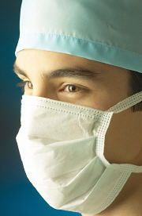
American Academy of Sleep Medicine
Conceptual Framework
(in Residency)
Insufficient Sleep
(on call sleep loss/inadequate recovery sleep)
Fragmented Sleep
(pager, phone calls)
EXCESSIVE DAYTIME SLEEPINESS
Circadian Rhythm Disruption
(night float, rotating shifts)
Primary
Sleep Disorders
(sleep apnea, etc)
© American Academy of Sleep Medicine

Slide 9
American Academy of Sleep Medicine
Sleep Needed vs Sleep Obtained
Myth: “I’m one of those people who only need 5 hours of sleep, so none of this applies to me.”
Fact: Individuals may vary somewhat in their tolerance to the effects of sleep loss, but are not able to accurately judge this themselves.
Fact: Human beings need 8 hours of sleep to perform at an optimal level.
Fact: Getting less than 8 hours of sleep starts to create a “sleep debt” which must be paid off.
© American Academy of Sleep Medicine

Slide 10

American Academy of Sleep Medicine
The Circadian Clock Impacts You
It is easier to stay up
later than to try to fall
asleep earlier.
It is easier to adapt to
shifts in forward
(clockwise) direction
(day evening night).
Night owls may find it
easier to adapt to night
shifts.
© American Academy of Sleep Medicine

Slide 11
American Academy of Sleep Medicine
Consequences of Chronic Sleep Deprivation
Sleep is a vital and necessary function, and sleep needs
(like hunger and thirst) must be met.
© American Academy of Sleep Medicine

Slide 12
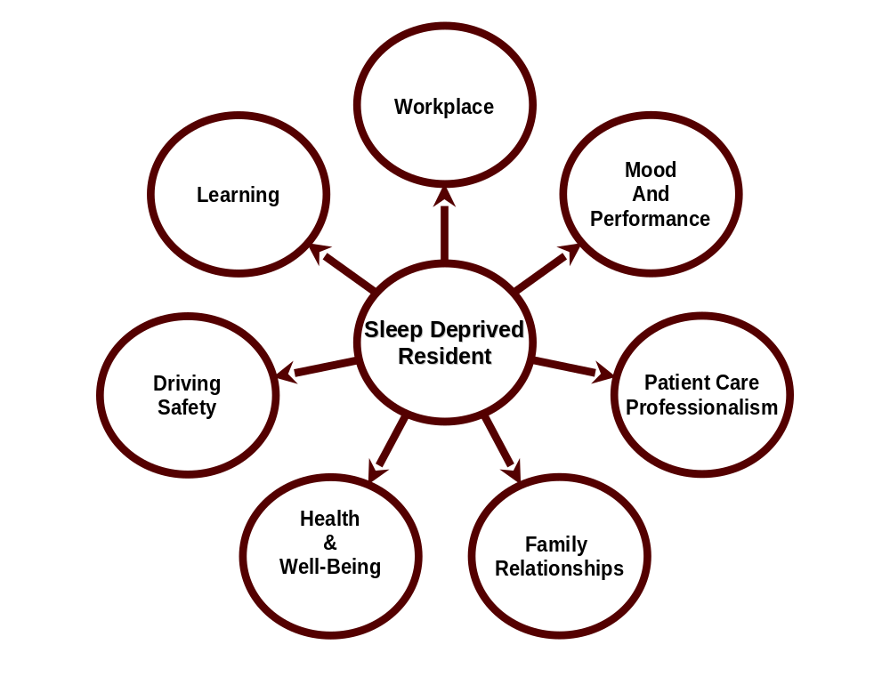
American Academy of Sleep Medicine
© American Academy of Sleep Medicine

Slide 13

American Academy of Sleep Medicine
Surgery: 20% more errors and 14% more time required to perform simulated laparoscopy post-call (two studies) Taffinder et al, 1998; Grantcharov et al, 2001
Internal Medicine: efficiency and accuracy of ECG interpretation impaired in sleep-deprived interns Lingenfelser et al, 1994
Pediatrics: time required to place an intra-arterial line increased significantly in sleep-deprived Storer et al, 1989
© American Academy of Sleep Medicine

Slide 14
American Academy of Sleep Medicine
Across Tasks
Emergency Medicine: significant reductions in comprehensiveness of history & physical exam documentation in second-year residents Bertram 1988
Family Medicine: scores achieved on the ABFM practice in-training exam negatively correlated with pre-test sleep amounts Jacques et al 1990
© American Academy of Sleep Medicine

Slide 15
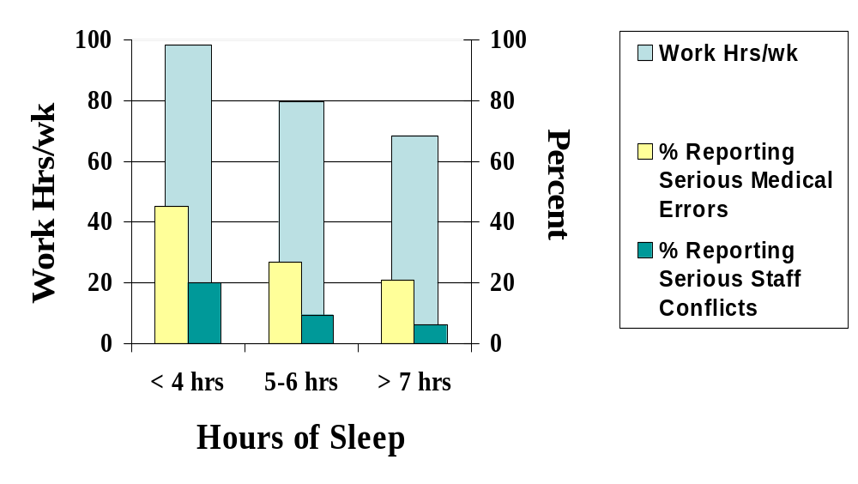
American Academy of Sleep Medicine
Work Hours, Medical Errors, and Workplace Conflicts by Average Daily Hours of Sleep*
*Baldwin and Daugherty,
1998-9 Survey of 3604 PGY1,2 Residents
© American Academy of Sleep Medicine

Slide 16
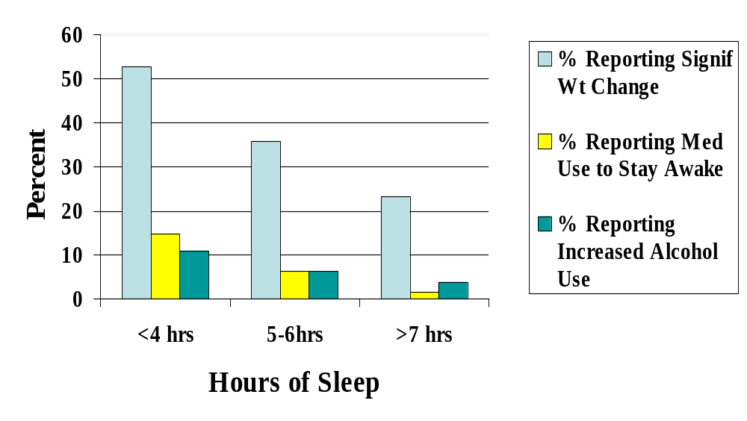
American Academy of Sleep Medicine
Adverse Health Consequences by Average Daily Hours of Sleep*
*Baldwin and Daugherty,
1998-9 Survey of 3604 PGY1,2 Residents
© American Academy of Sleep Medicine

Slide 17
American Academy of Sleep Medicine
Sleep Loss and Fatigue:
Safety Issues
58% of emergency medicine residents reported near-crashes driving.
  -- 80% post night-shift
  -- Increased with number of night shifts/month
  Steele et al 1999
50% greater risk of blood-borne pathogen exposure incidents (needlestick, laceration, etc) in residents between 10pm and 6am. Parks 2000
© American Academy of Sleep Medicine

Slide 18
American Academy of Sleep Medicine
Impact on Medical Education
Residents working longer hours report decreased satisfaction with learning environment and decreased motivation to learn. Baldwin et al 1997
Study of surgical residents showed less operative participation associated with more frequent call. Sawyer et al 1999
© American Academy of Sleep Medicine

Slide 19
American Academy of Sleep Medicine
Recognizing Sleepiness in
Yourself and Others
© American Academy of Sleep Medicine

Slide 20

American Academy of Sleep Medicine
Myth: “If I can just get through the
night (on call), I’m fine in the morning.”
Fact: A decline in performance starts after about 15-16 hours of continued wakefulness.
Fact: The period of lowest alertness after being up all night is between 6am and 11am (eg, morning rounds).
© American Academy of Sleep Medicine

Slide 21
American Academy of Sleep Medicine
Estimating Sleepiness
Myth:“I can tell how tired I am and I know when
I’m not functioning up to par.”
Fact: Studies show that sleepy people underestimate their level of sleepiness and overestimate their alertness.
Fact: The sleepier you are, the less accurate
your perception of degree of impairment.
Fact: You can fall asleep briefly (“microsleeps”)
without knowing it!
© American Academy of Sleep Medicine

Slide 22
American Academy of Sleep Medicine
Anesthesia Resident Study
Residents did not perceive themselves to be asleep almost half of the time they had actually fallen asleep.
Residents were wrong 76% of the time when they reported having stayed awake.
Howard et al 2002
© American Academy of Sleep Medicine

Slide 23
American Academy of Sleep Medicine
Recognize The Warning Signs of
Sleepiness
Falling asleep in conferences or on rounds
Feeling restless and irritable with staff, colleagues, family, and friends
Having to check your work repeatedly
Having difficulty focusing on the care of your patients
Feeling like you really just don’t care
© American Academy of Sleep Medicine

Slide 24
American Academy of Sleep Medicine
If you don’t recognize that you’re sleepy,
you’re not likely
to do anything about it.
© American Academy of Sleep Medicine

Slide 25
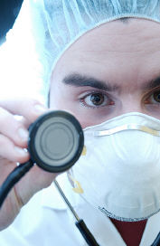
American Academy of Sleep Medicine
Alertness Management Strategies
© American Academy of Sleep Medicine

Slide 26
American Academy of Sleep Medicine
Napping
Pros: Naps temporarily improve alertness.
Types: preventative (pre-call)
  operational (on the job)
Length:
  short naps: no longer than 30
  minutes to avoid the grogginess
  (“sleep inertia”) that occurs when
  you’re awakened from deep sleep
  long naps: 2 hours (range 30 to 180
  minutes)
© American Academy of Sleep Medicine

Slide 27
American Academy of Sleep Medicine
Napping
Timing:
  -- if possible, take advantage of circadian
  “windows of opportunity” (2-5 am and 2-5 pm);
  -- but if not, nap whenever you can!
Cons: sleep inertia; allow adequate recovery
time (15-30 minutes)
Bottom line: Naps take the edge off but do
not replace adequate sleep.
© American Academy of Sleep Medicine

Slide 28
American Academy of Sleep Medicine
Healthy Sleep Habits
Get adequate (7 to 9 hours) sleep before anticipated sleep loss.
Avoid starting out with a sleep deficit!
© American Academy of Sleep Medicine

Slide 29
American Academy of Sleep Medicine
Recovery from Sleep Loss
Myth: “All I need is my usual 5 to 6 hours the
night after call and I’m fine.”
Fact: Recovery from on-call sleep loss
generally takes 2 nights of extended
sleep to restore baseline alertness.
Fact: Recovery sleep generally has a higher
percentage of deep sleep, which is
needed to counteract the effects of sleep
loss.
© American Academy of Sleep Medicine

Slide 30
American Academy of Sleep Medicine
Healthy Sleep Habits
Go to bed and get up at about the same time
every day.
Develop a pre-sleep routine.
Use relaxation to help you fall asleep.
Protect your sleep time; enlist your family and
friends!
© American Academy of Sleep Medicine

Slide 31
American Academy of Sleep Medicine
Healthy Sleep Habits
Sleeping environment:
  Cooler temperature
  Dark (eye shades, room darkening shades)
  Quiet (unplug phone, turn off pager, use ear plugs, white noise machine)
Avoid going to bed hungry, but no heavy meals within 3 hours of sleep.
Get regular exercise but avoid heavy exercise within 3 hours of sleep.
© American Academy of Sleep Medicine

Slide 32
American Academy of Sleep Medicine
Recognize Signs of DWD *
Trouble focusing on the road
Difficulty keeping your eyes open
Nodding
Yawning repeatedly
Drifting from your lane, missing signs or exits
Not remembering driving the last few miles
Closing your eyes at stoplights
* Driving While Drowsy
© American Academy of Sleep Medicine

Slide 33
American Academy of Sleep Medicine
Drive Smart; Drive Safe
AVOID driving if drowsy.
If you are really sleepy, get a ride home, take a taxi, or use public transportation.
Take a 20 minute nap and/or drink a cup of coffee before going home post-call.
Stop driving if you notice the warning signs of sleepiness.
Pull off the road at a safe place, take a short nap.
© American Academy of Sleep Medicine

Slide 34
American Academy of Sleep Medicine
Drowsy Driving:
What Does Not Work
Turning up the radio
Opening the car window
Chewing gum
Blowing cold air (water) on your face
Slapping (pinching) yourself hard
Promising yourself a reward for staying awake
© American Academy of Sleep Medicine

Slide 35
American Academy of Sleep Medicine
It takes only a 4 second
lapse in attention to have a
drowsy driving crash.
© American Academy of Sleep Medicine

Slide 36
American Academy of Sleep Medicine
Caffeine
Strategic consumption is key
Effects within 15 – 30 minutes; half-life 3 to 7 hours
Use for temporary relief of sleepiness
Cons:
  disrupts subsequent sleep (more arousals)
  tolerance may develop
  diuretic effects
© American Academy of Sleep Medicine

Slide 37
American Academy of Sleep Medicine
How To Survive Night Float
Protect your sleep.
Nap before work.
Consider “splitting” sleep into two 4 hour periods.
Have as much exposure to bright light as possible when you need to be alert.
Avoid light exposure in the morning after night shift (be cool and wear dark glasses driving home from work).
© American Academy of Sleep Medicine

Slide 38
American Academy of Sleep Medicine
Alertness Strategies
There is no “magic bullet.”
Know your own vulnerability to sleep loss.
Learn what works for you from a range of strategies.
There needs to be a shared responsibility for fatigue management and a “culture of support” in the training program.
© American Academy of Sleep Medicine

Slide 39
American Academy of Sleep Medicine
In Summary…
Fatigue is an impairment like alcohol or drugs.
Drowsiness, sleepiness, and fatigue cannot be eliminated in residency, but can be managed.
Recognition of sleepiness and fatigue and use of alertness management strategies are simple ways to help combat sleepiness in residency.
When sleepiness interferes with your performance or health, talk to your supervisors and program director.
© American Academy of Sleep Medicine

Slide 40

American Academy of Sleep Medicine
For More Information Contact:
Your local Sleep Education Advocate
or visit
www.aasmnet.org/MEDSleepprogram.htm
© American Academy of Sleep Medicine

